Slide 1
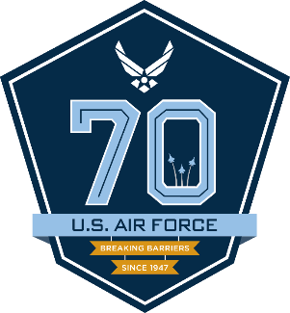
Air Force Life Cycle Management Center
I n t e g r i t y - S e r v i c e - E x c e l l e n c e
Sustainment Technologies
“Big Rocks”
Mark Smallwood, PE, CIH
AFLCMC/EZP
1

Slide 2

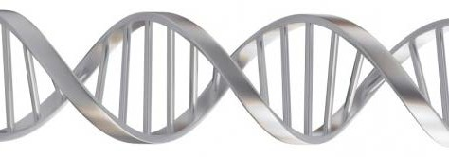


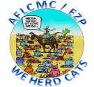
AFLCMC/EZP DNA –
It’s Who We Are!
Vision: Affordable Warfighter Readiness…Innovative Product Support Engineering Capabilities
Mission: Ensure AF Enterprise Focus by Applying Airworthiness Approach that Promotes Cost-Effective Technology and Sustainment Solutions
Coordinated Requests
Customer Focused
Responsive
We Raise the bar!
B r e a k i n g B a r r i e r s … S i n c e 1 9 4 7
2

Slide 3
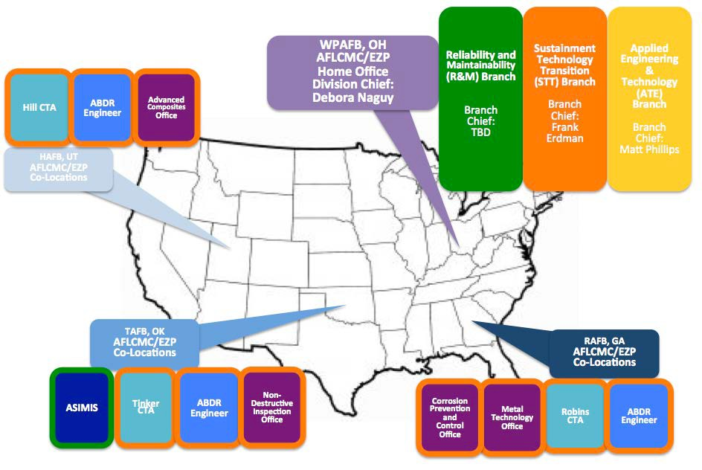
AFLCMC/EZP Nationwide Team
Frank Erdman
Mark Smallwood
Jerry Gibson
B r e a k i n g B a r r i e r s … S i n c e 1 9 4 7
4

Slide 4







AFLCMC/EZP Organization
Technical Disciplines
Reliability & Maintainability (R&M) & Sustainment Branch
Reliability Analysis, Planning, Tracking, & Reporting
Reliability Centered Maintenance (RCM)
Condition Based Maintenance Plus (CBM+)
Engineering Technical Assistance Reports (ETARs)
Critical Safety Items (CSIs)
Aircraft Structural Integrity Management Information System (ASIMIS)
Product Support Engineering Division
Debbie Naguy Division Chief
Matt Phillips Tech Director
Reliability Maintainability & Sustainment
Sustainment Technology Transition Branch
Airworthiness New Materials and Substitution Lead
Weapon System Sustainment Technology Enterprise Program (WS-STEP)
Laser De-Paint Initiative
Chromium Risk Mitigation Initiative
Cadmium Risk Mitigation Initiative
AF Additive Manufacturing Implementation Plan
Sustaining Engineering Requirements Support
AF Corrosion Technical Working Group
Aircraft Battle Damage Repair Engineering (ABDRE)
Center Test Authorities (CTAs)
Corrosion Prevention & Control Office
Non-Destructive Inspection Office
Advanced Composites Office
Metals Technology Office
Frank Erdman Branch Chief
John Hedke Technical Expert
Sustainment Technology Transition
Mark Smallwood Branch Chief
Mike Froning Technical Expert
Applied Engineering & Technology
Jerry Gibson Branch Chief
Applied Engineering & Technology Branch
Materials Handling Engineering
Packaging Technology & Engineering
4

Slide 5

Tomorrow’s Lifecycle Overview…
…Bend the Cost Curve thru Enterprise Mindset!
$$$$
$$
Acquisition
Maintenance & Sustainment
$$$$
Demilitarization
$
Requirements Development
5

Slide 6




The Innovation Journey
Focus on Transformational Technology Areas to Support and Enhance Technology Readiness + Enable Cost Effective Engineering
Key in on Greatest Opportunities
Stand up and Establish Long-Term Commitment to Enterprise “Big Rocks” Initiatives
  Additive Manufacturing
  Corrosion Prevention & Control
  Condition Based Maintenance (CBM+)
  Robotics Applications
Apply Crawl…Walk…Run Approach
6

Slide 7
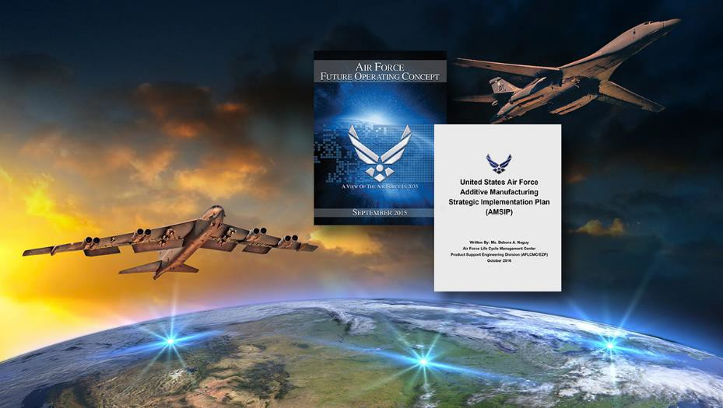
Additive Manufacturing (AM)
Laying the Foundation of AM
► Standardized processes & tools
► Standardized equipment & machines
► Skilled technicians & engineers
► Cyber secure, centralized technical data
► Enterprise Network
Additive Manufacturing Strategic Implementation Plan… Leveraging AFFOC
7

Slide 8

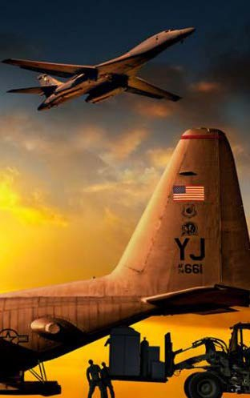
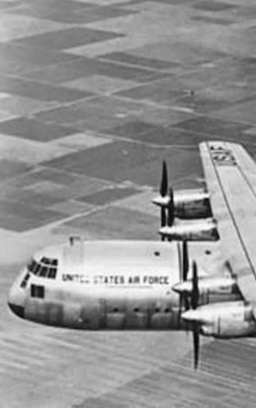




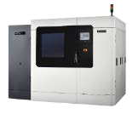
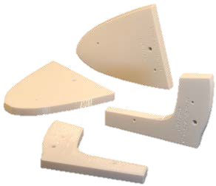
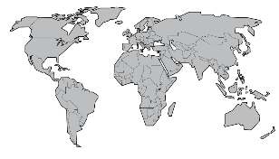


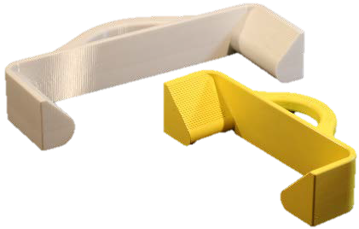
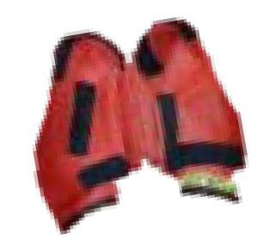






Additive Manufacturing
Agile Combat Support
Today
Decentralized Applications Mainly Polymer Based
Tomorrow
Centralized Applications
Future
Agile Manufacturing
Engineering Application Site
Operations Site
Technical Design Package
Feedback Addl part ID
Engineering Drawings Specifications Standards Performance
Quality Assurance Reliability Data Modeling Data
= Engineering Application Site
= Operations Site
No…
Configuration control
Part/material validation
Process standardization
Rigor or IT security
Limited dedicated engineers/ operators
Fixtures, tools & stands
Vehicles & transportation
Weapons systems
Qualify parts/components
Address AM challenges
Build AM capability
Establish process discipline
Global Mfg. Network
Cyber secure parts library
Future Operational CONOPS
Ensuring agility & flexibility for the warfighter; improving readiness & reducing cost
8

Slide 9

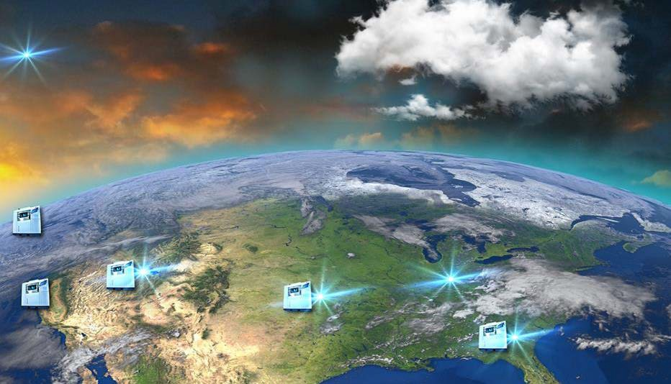
















Centralized Applications
Tomorrow
Cyber secure library of AM TDP’s
Design/ Innovation centers
  Identifying parts
Designated engineers, designing, printing, and qualifying parts
  Non-critical, non-rotating, non-aero and aerospace components
Production centers
  Certified equipment, certified operators utilizing network approach
9

Slide 10


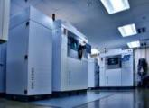
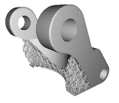



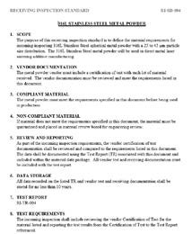

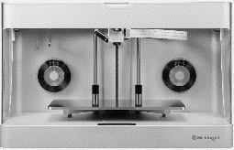

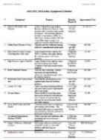



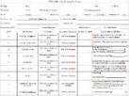
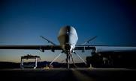






Additive Manufacturing Strategic Implementation Plan
NOW TERM: Establishing AM Capability in Metals and Polymers
Establish selective AM Capability: Depots & MAJCOM backshops
Qualify Target parts: Tools, fixtures, prototypes, non-structural non-critical parts, structural non-aerospace parts
Standard AM equipment, training, processes, and tools
Reverse engineering process & tools
Develop facility guidelines and post processing
NEAR TERM: Expanding AM Capability in Metals and Polymers
Expand AM Capability: Additional weapon system components, expanding across Depots, MAJCOM’s, & SPO Engineering
Qualify Target parts: Diminishing manufacturing, non-rotating, non-critical structural aircraft components
Demonstrate network capability and cyber secure library
Validate AM process controls, material characterization, process parameters, and reproducibility
LONG TERM: Expanded AM Network
Target opportunities: Print anywhere on-demand
Target parts: Rotating and structural critical aircraft
Global network of equipment and processes
AMSIP lays out the foundation for safely establishing AM…moving slow to go fast
10

Slide 11
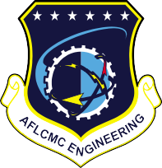

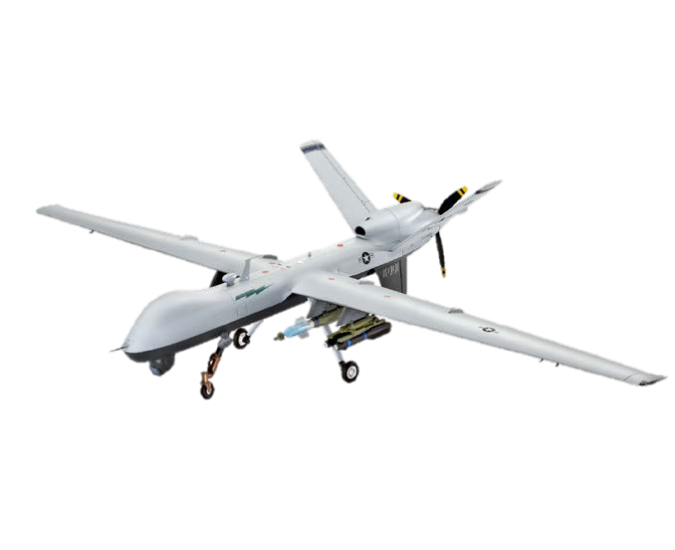
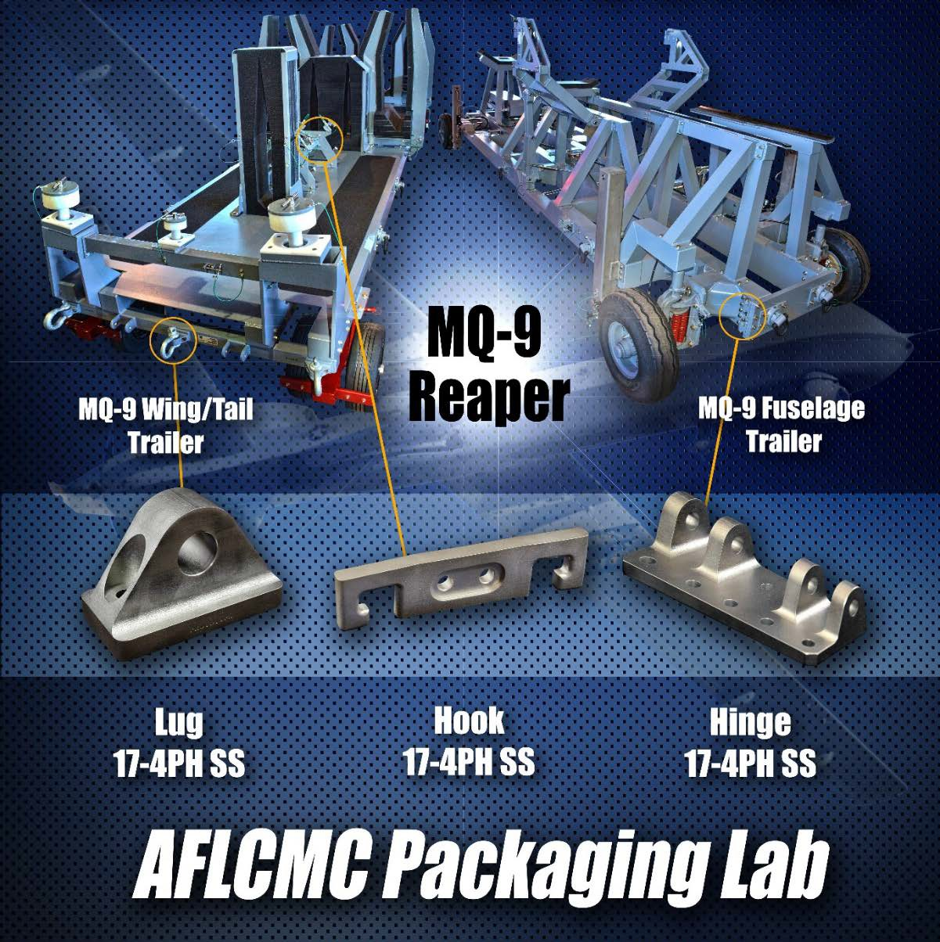


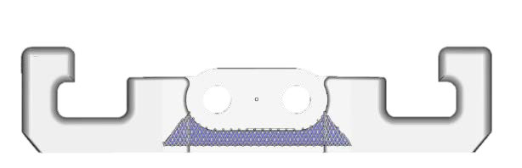

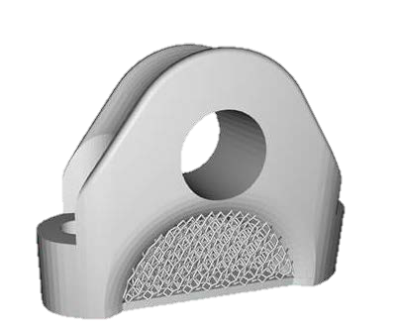

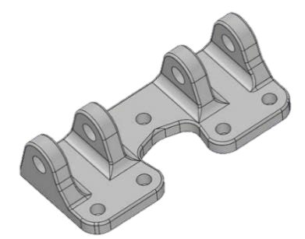
MQ-9 Reaper Trailer
Parts in Service (2016)
AM Optimization

Slide 12

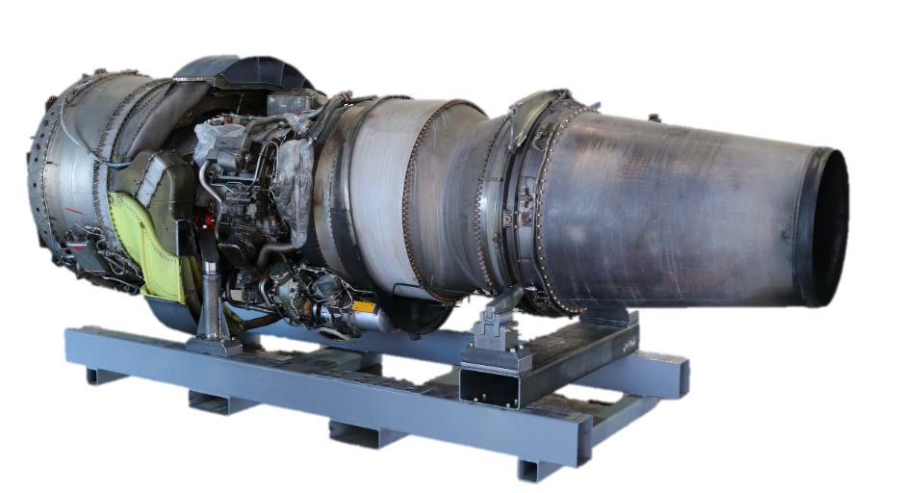
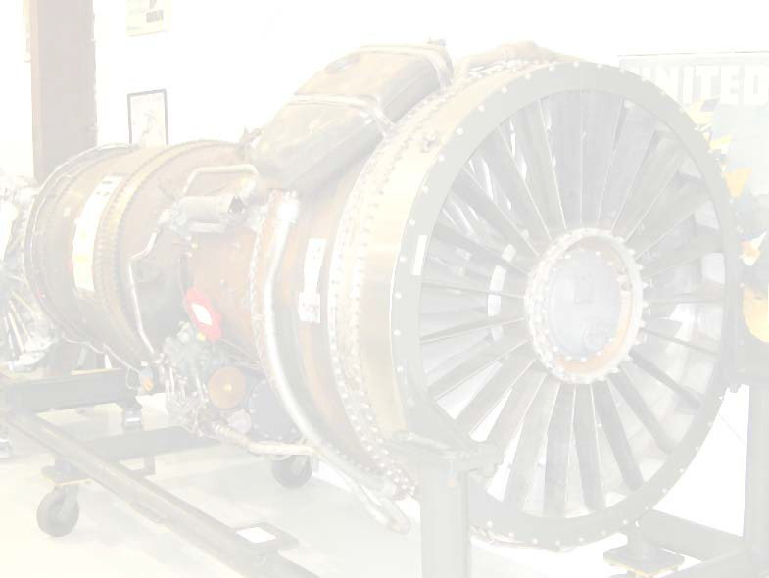




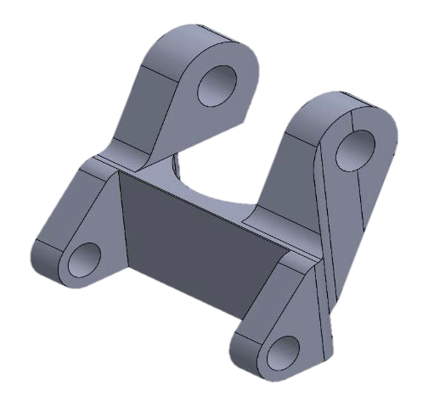
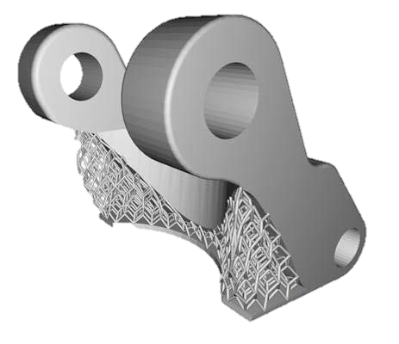





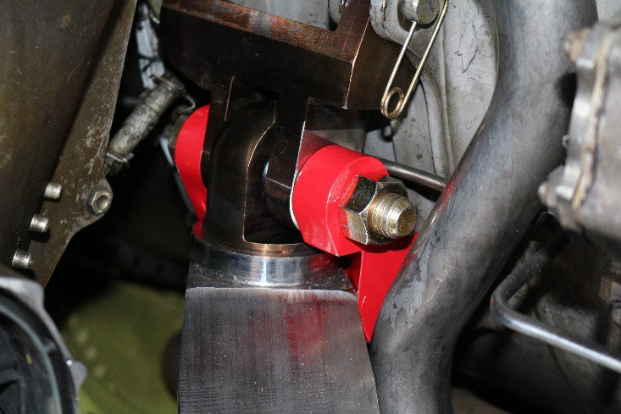

TF33 Engine Stand
Parts in Service (2016)
AM Optimization
Bracket 17-4PH SS
AFLCMC Packaging Engineering Lab

Slide 13
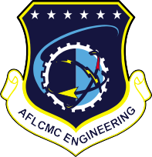


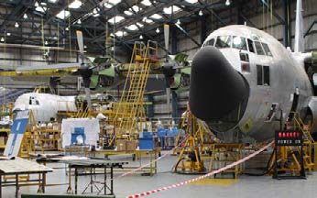
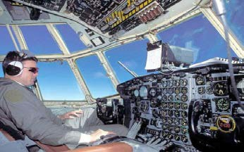

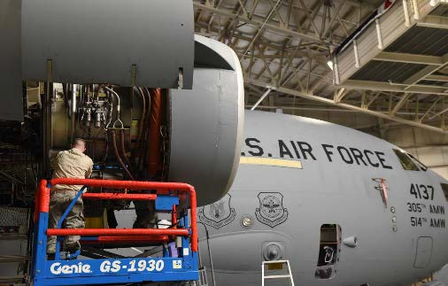
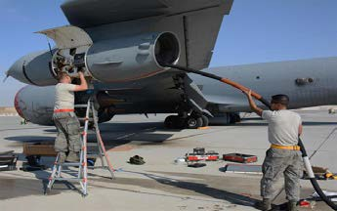
Corrosion Prevention and
Control
Corrosion Impacts Safety of Flight and Airworthiness!
Structural Integrity (ASIP) Avionics Integrity (AVIP)
Propulsion Integrity (PSIP)
Mechanical Integrity (MECSIP)

Slide 14
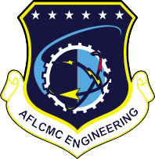







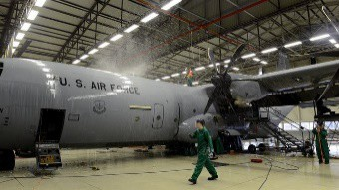
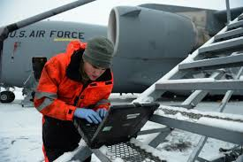
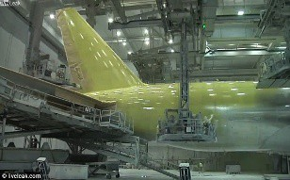
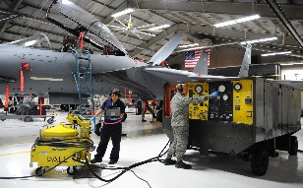


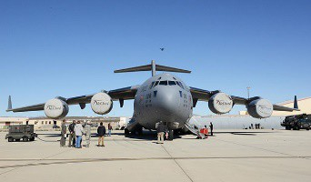
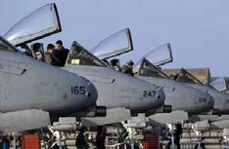
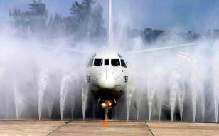
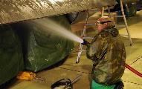
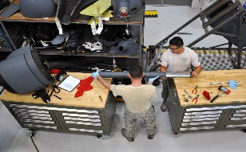
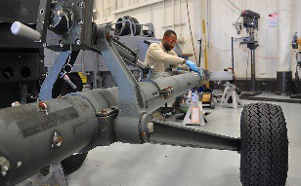
Impact on Readiness and Availability
Inspections
Maintenance
Non-Available Time
Washing
Repairs
Corrosion Negatively Impacts Availability

Slide 15
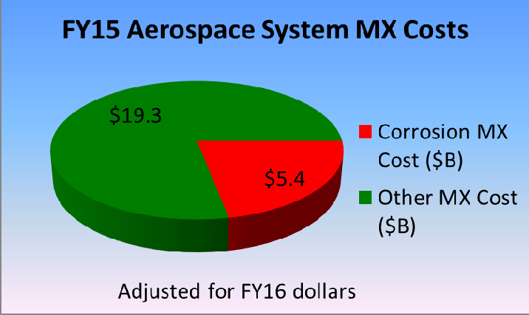
Cost of Corrosion
Preventative Corrosion Cost
$3,152,056,770
AF FY15 Aerospace System MX Costs
Inspect/ Test/ QA
$957,065,103
Treatment
$880,529,019
Clean/ Wash
$605,382,694
* 2016 AF CPC Report/ U.S. Air Force, 31 December 2016
Other
$709,079,954
Increases Weapon System Sustainment
20
B r e a k i n g B a r r i e r s … S i n c e 1 9 4 7

Slide 16










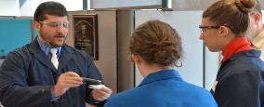
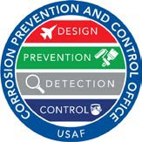




Where Are We Going?
AF Corrosion Prevention and Control Office Building a New Corrosion Enterprise
Increasing Engineering Staff
Increased staff from 5 to 20 engineers/specialists Corrosion/Field Mx SME Support
Doubled engineers to boost SPO support
Technology Evaluation and Integration
Corrosion Innovation Laboratory / Outdoor Test Site Coatings performance evaluations
Technology maturation and implementation
Process Guidance
Corrosion Prevention Control Plans
Corrosion Prevention Advisory Boards
Training
Provide world-class aerospace corrosion expertise, guidance and training to maximize mission effectiveness, increase safety and reduce cost through improved materials and
processes
21

Slide 17



































Where Are We Going?
Non-Cr Coating Systems
CBM+ for Corrosion Prediction
New Technologies
HHL for corrosion removal
Optimize washes based on environmental exposure
Update wash cycle TOs and
wash intervals based on
actual corrosion exposure
rates
Transition non-chrome coating systems to USAF aircraft for OML applications
Robotic snake for corrosion detection
Get Ahead of Corrosion!

Slide 18

















Hand Held Laser
HHL for Aircraft Coating Removal
Numerous testing completed
Modifications completed for metallics
Conducting last round of metallic tests
HHL for Support Equipment
Approvals granted for use on support equipment
Purchasing systems for field demonstration
Next Steps:
Field demonstrations
HHL for Small Area Paint and Corrosion Removal
Initial focus on support equipment and vehicles
• 300W and 1000W pulsed Nd: YAG lasers
– 1064 nm wavelength
Next Steps:
Four field units targeted for 2 year field demo starting in FY17:
  Kadena AB JA
  Hickam AFB HI
  Travis AFB CA
  Patrick AFB FL
Next Steps:
Airworthiness Certification
Complete color recognition sensor
Composite testing
Checklist for installation
Operation and training
Monitoring and feedback
AFCPCO has hand held laser
23

Slide 19




















Robotic Applications
Robotic Corrosion Inspection
Robotic De-Paint Confined Space
Robotic Laser for Surface Prep
Robotic NDI
Robotic Paint
- Increase mission readiness
- Decrease maintenance costs
- Provide significant cost savings and reduction in process flow time
Replace current labor-intensive plastic media blast removal process
Reduce damage potential from media blast process
- Decrease labor intensive
nature associated with NDI processes
Replace manual cleaning processes prior to painting
- Provide significant cost savings
Reduce process flow time
- Provide significant cost
savings and
al
reductions in tot
process times
- Eliminate
- Enable full aircraft inspection
and greatly
hazardous environment work
increase
t
hroughput
capacity
26

Slide 20












Large Area Robotic Stripping
For Surface Adhesion
Low Observable Coatings
Composites
Capability for a production-ready system for coating removal using either:
  1 kW nano-pulsed fiber laser
  20 kW CO₂ continuous wave laser
Qualifying 1 kW nano- pulsed laser and CO₂ continuous wave laser
Targeting C-130, RQ-4 and C-17
Laser Surface Prep: Elimination of solvent cleaning and Pre-Kote surface treatment
Exploring use of 300 W laser to clean substrate surface prior to top coat/paint application
Conducting prescreen tests to define parameters/gauge tech maturity
Qualifying nano- pulsed laser and CO₂ continuous wave laser
Targeting B-2, F-22, F-35
20Kw and Co2 Nano Pulse Lasers Being Qualified
27

Slide 21
Summary
AFLCMC’s Approach - Big Rocks Initiatives
Revolutionary Changes to Improve
  Mission Readiness
  Cost Effectiveness
  Asset Supportability
Promotion of Enterprise Mindset
  Enterprise Impact!
Ensuring Faster Implementation of Technology Across the Enterprise
22

