Slide 1
Fluorescence-Based Nondestructive Evaluation of Incipient Heat Damage in Aircraft Composites
a presentation for the
2017 DoD Advanced Composite Maintainers
Technical Interchange Meeting
Hill Air Force Base, Utah
22 August 2017
Daniel W. Merdes, 814- 863-4145, dwm@arl.psu.edu
DISTRIBUTION STATEMENT A. Approved for Public Release. Distribution is unlimited.

Slide 2
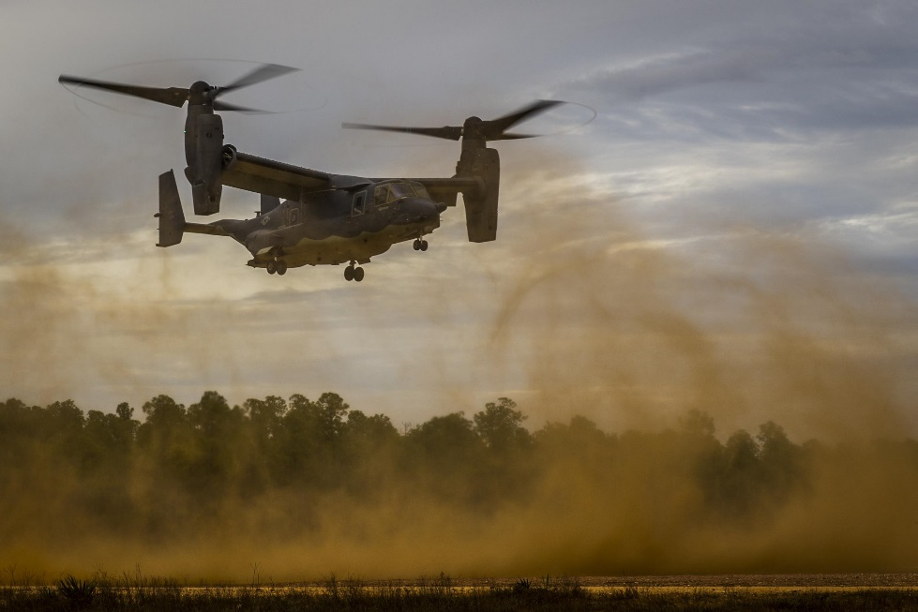
Incipient Heat Damage Happens to Aircraft Components
Heat-Damage on a Composite Aircraft Wing
Source: https://aviation.stackexchange.com/questions/888/what-happens-when-an-airplane-gets-struck-by-lightning
Structural damage to Bombardier CS100 wing, showing burn marks surrounding penetration by turbine disk segment
Source: Borbardier Inc. published in Uncontained Turbine Rotor Failure Bombardier Inc. BD-500-1A10 (C Series CS100), C-FBCS Montréal International (Mirabel) Airport, Quebec, Transportation Safety Board of Canada Aviation Investigation Report A14Q0068, p 26, Photo 4, 29 May 2014, downloaded 07 Aug 2017 from http://www.bst-tsb.gc.ca/eng/rapports-reports/aviation/2014/a14q0068/a14q0068.asp.
Source: http://www.afsoc.af.mil/News/Article-Display/Article/1005561/osprey-flight-engineers-ensure-readiness/
Distribution A

Slide 3
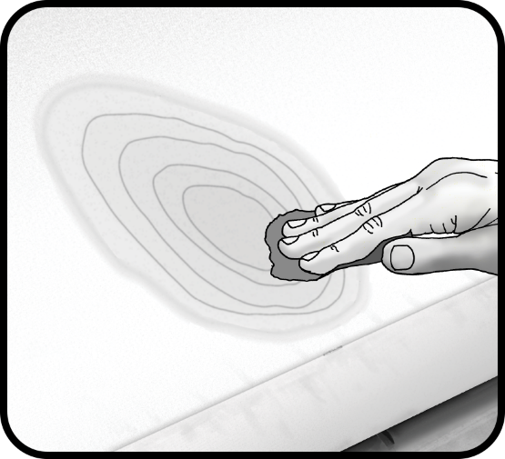
Preparing a Heat-Damaged Component for Repair
Uncertainty about Incipient Heat Damage can mandate replacing a major component of a modern military aircraft
Replacement cost of a wing can be in the $M
Aircraft down-time typically months to over a year
A small heat-damaged region can be patched by qualified personnel
How to know you’ve removed all the damaged material?
Easy to tell when fissures and/or delaminations are present
But Incipient Heat Damaged composite looks and feels just fine!
Heat damage alters the composite material’s fluorescence signature
Is That Enough?
Illustration © Andrei Krauchukl 123RF.com
Distribution A

Slide 4
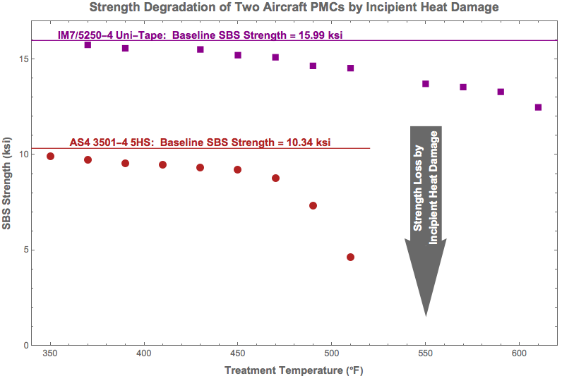
Incipient Heat Damage of Polymer Matrix Composites
Data courtesy Dr Raymond Meilunas, NAVAIR Code 4.3.4.4
Distribution A

Slide 5
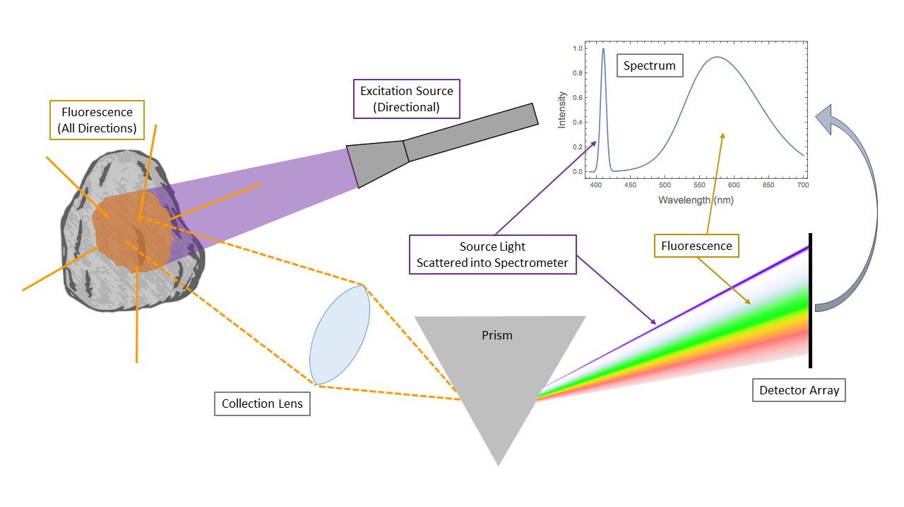
Fluorescence
© 2017 The Pennsylvania State University
Distribution A

Slide 6
Fluorescence Spectra of PMCs Change with Heating
Fluorescence Spectra of AS4 3501-6 5HS Carbon-Epoxy Composite Baked 1 Hr at Different Temperatures
Spectra of AS4/3501-6 5HS Specimens Heated to Various Temperatures
Degradation
Specimens from NAVAIR Heat Damage Standards, courtesy Dr Raymond Meilunas, NAVAIR Code 4.3.4.4
Distribution A

Slide 7
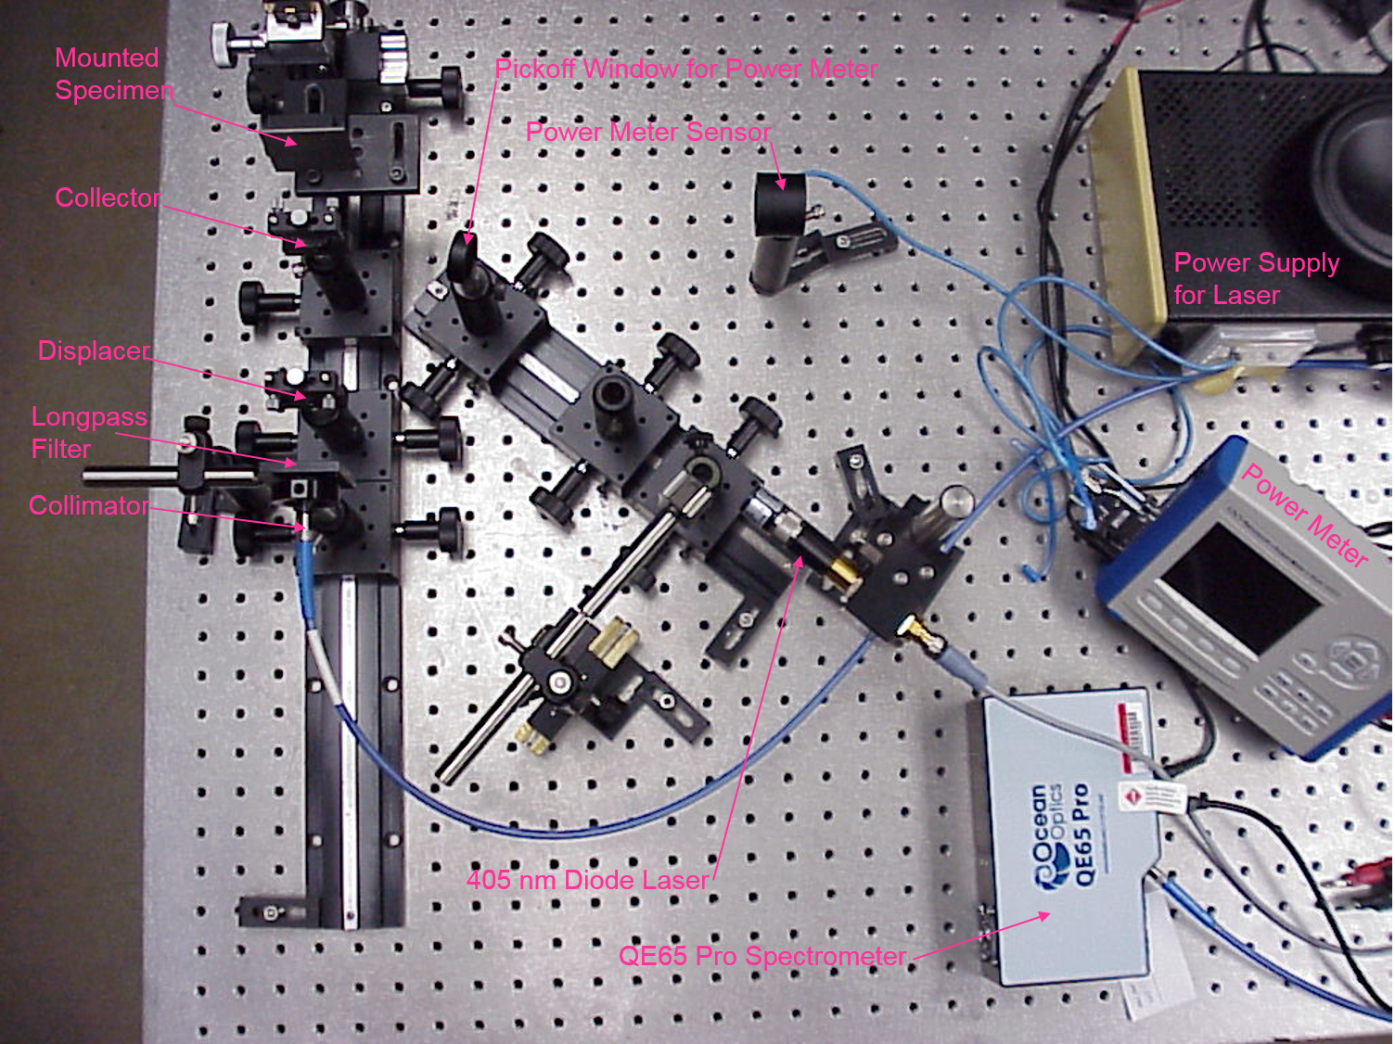
Assembled Gen II LIF NDE Breadboard Apparatus
Developed in 2013-2014 by ARL Penn State with ONR iMAST funding
405 nm diode laser irradiates a spot on mounted sample coupon ~15 mm in diameter
Fluorescence from a spot btw 2 & 10 mm diameter is collected into a COTS portable spectrometer
Spectra recorded for subsequent analysis
Fully operational breadboard system with interchangeable components and reconfigurable features.
Distribution A

Slide 8
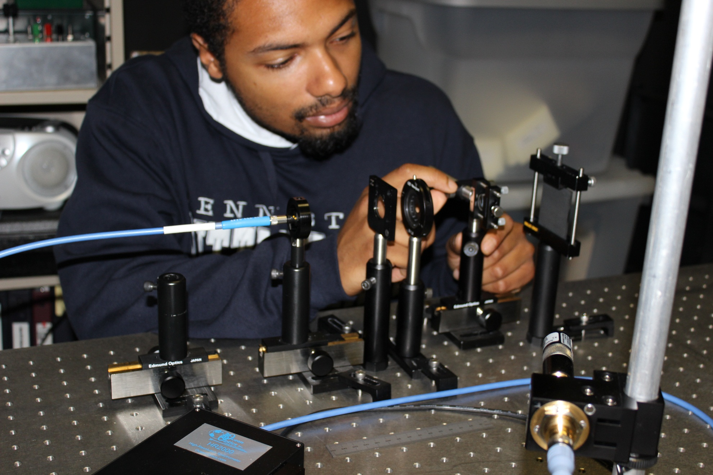
Developing the LIF NDE Gen II Breadboard Apparatus
Christopher M. Bowie, currently with Ocean Optics, Inc.
Distribution A

Slide 9
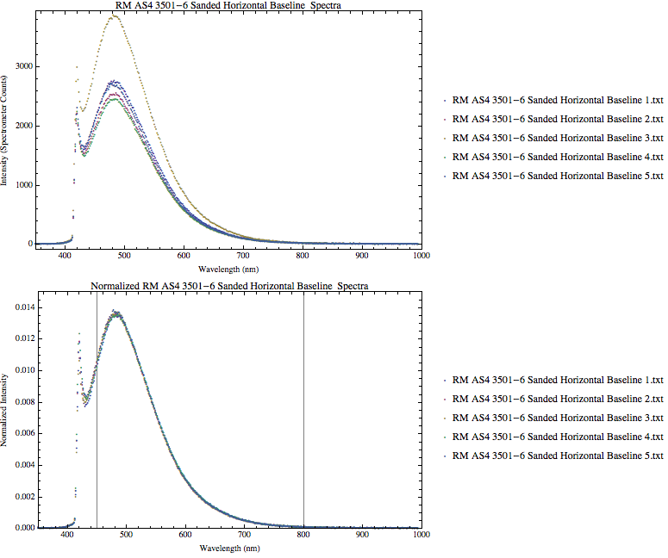
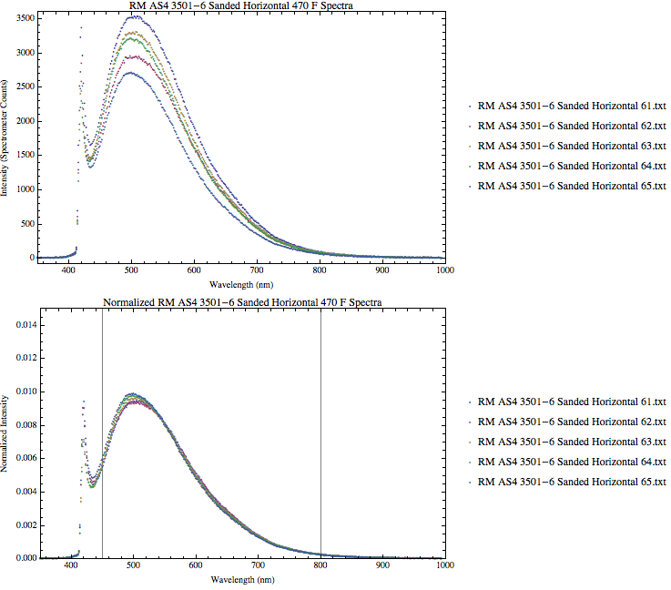
Data Preprocessing
Data Collected against NAVAIR 4.3.4.4 Registered Samples
of AS4 3501-6 Epoxy-based 5HS-Reinforced Composite
Epoxy Baseline (no additional heating)
Epoxy Heated to 470 °F for 1 Hr
Effect of Normalization
Effect of Normalization
Effect of Heat Treatment
Data Preprocessing Preserves LIF Spectral Characteristics
and Compensates for Variations in Resin Surface Area!
Distribution A

Slide 10
Performance Against 5HSAS4/3501-6 (Fabric Epoxy)
Predictive Model from Data on NAVAIR 4.3.4.4 Registered Samples
Centered Response Chart
Classification Validation Chart
Wavelength (nm)
Predictive model generated from data measured on 02 June 2014 – the Training Set
Model validated against data run measured on 06 June 2014 – the Validation Set
Model correctly classifies Pass vs Fail by the 80% criterion!
Distribution A

Slide 11
Performance Against IM7/5250-4 (Uni-Tape BMI)
Predictive Model from Data on NAVAIR 4.3.4.4 Registered Samples
Centered Response Chart
Classification Validation Chart
Wavelength (nm)
Predictive/validated model generated from measured data on 02 & 06 June 2014, respectively
Subtle fluorescence response variation from BMI matrix delineates thermal damage
Model correctly classifies Pass vs Fail by the 80% criterion!
Distribution A

Slide 12
Performance Against AS4/3501-6 (Uni-Tape Epoxy)
Predictive Model from Data on NAVAIR 4.3.4.4 Registered Samples
Centered Response Chart
Classification Validation Chart
False positives would appear in this quadrant
Pass!
Fail!
False negatives would appear in this quadrant
Wavelength (nm)
Predictive model generated from 60% of data measured on 30 July 2014 – the Training Set
Model validated against the other 40% of data run measured on 30 July 2014 – the Validation Set
Model correctly classifies Pass vs Fail by the 80% criterion!
Distribution A

Slide 13
Performance Against IM7/977-3 (Uni-Tape Toughened Epoxy)
Predictive Model from Data on NAVAIR 4.3.4.4 Registered Samples
Centered Response Chart
Classification Validation Chart
False positives would appear in this quadrant
Pass!
Fail!
False negatives would appear in this quadrant
Wavelength (nm)
Predictive model generated from 60% of data measured on 29 July 2014 – the Training Set
Model validated against the other 40% of data run measured on 29 July 2014 – the Validation Set
Model correctly classifies Pass vs Fail by the 80% criterion!
Distribution A

Slide 14
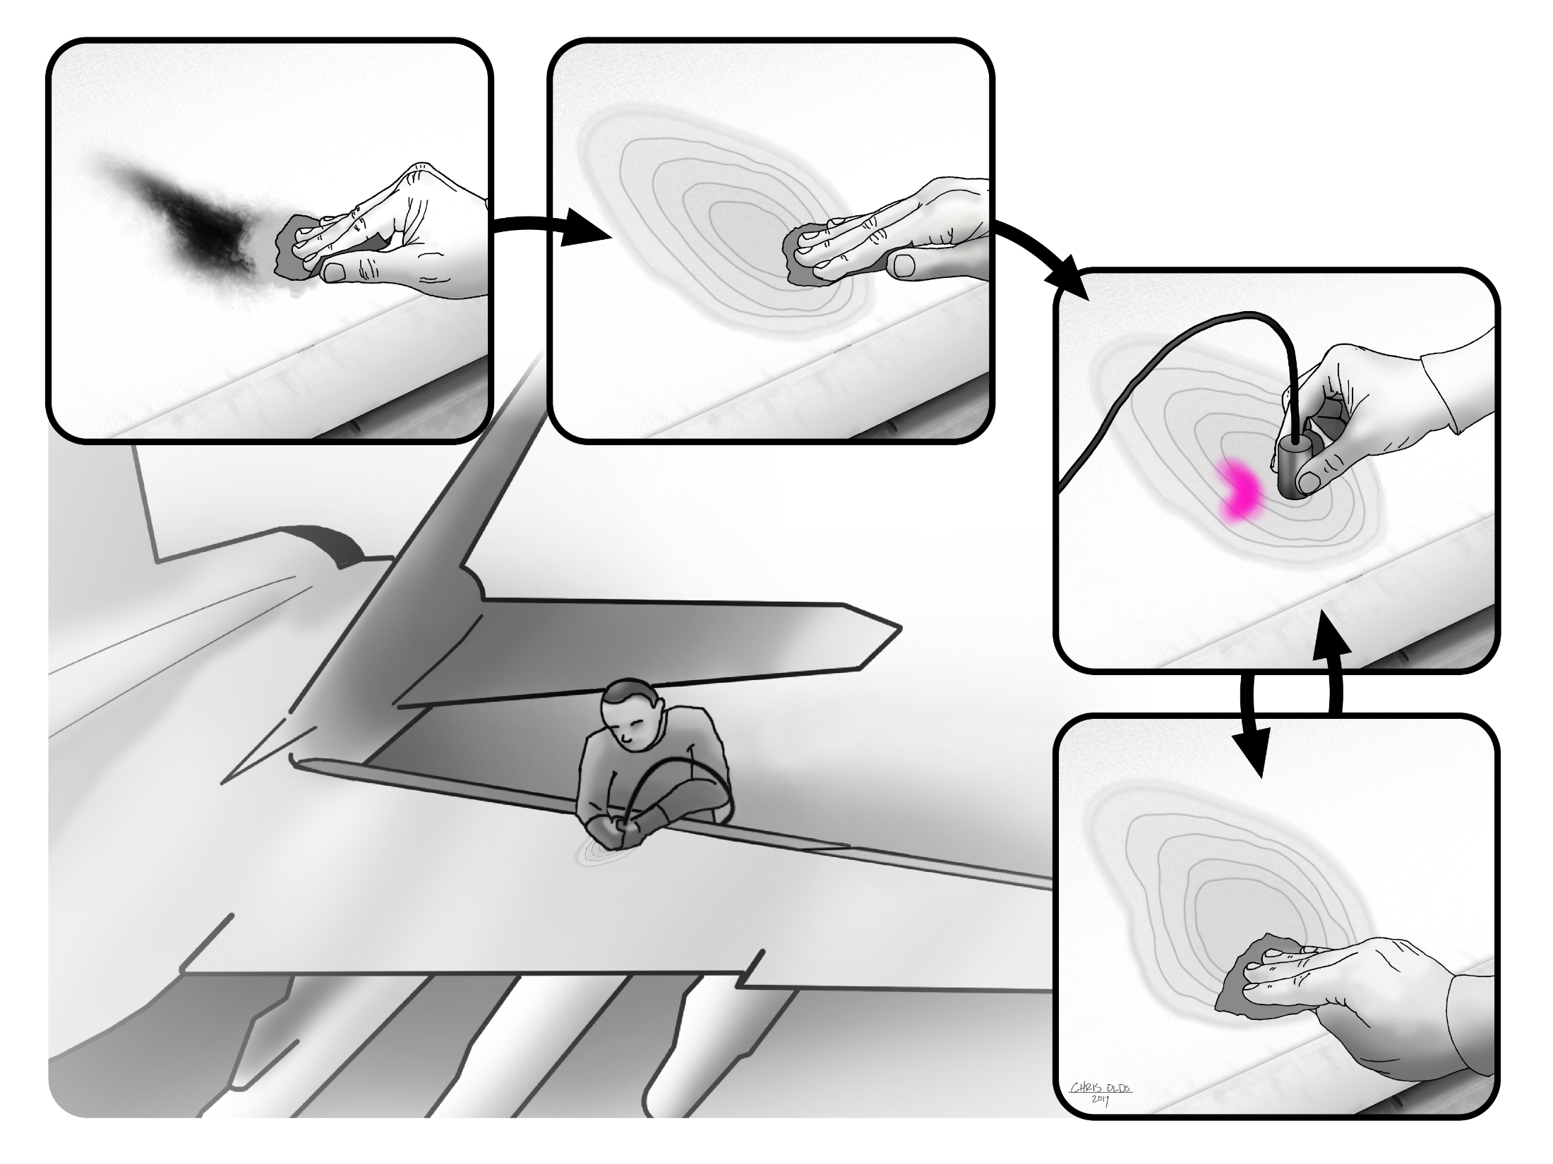
Distribution A

Slide 15
Fieldable Prototype Design Objectives
Package into a field-portable unit
Mechanical
Electrical
Computational
Replace Laser with LED
Swapable optical probes for inspection of different geometries
Flat or gently curved (e.g. wing surfaces)
Thin “pen” for interior of joints and other tight spaces
Probes connect to system using standard SMA-905 connector
Automatic self-calibration
Small, portable, battery-powered
All components COTS
Distribution A

Slide 16
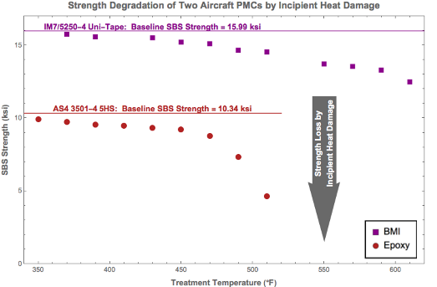
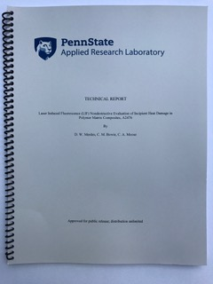
Our Report
Available in pdf format at
https://doi.org/10.18113/S19883
Distribution A

