Slide 1
Private Sector Ergonomic Sanding Tool Development
Temple Allen’s Wing Top Sander and Paint Stripping End-Effector
Robert Kent, VP - Industry Relations

Slide 2
Temple Allen Track Record
Predecessor Company - 5-story tall robotic arms for cleaning out nuclear waste storage tanks
TAI developed EMMA to address 787 need for new composite prep method
100% pneumatic - no electricity
Approved for use on all Boeing aircraft
Written into several Boeing specifications
Systems installed commercially at Boeing, Airbus, Lockheed, Northrop Grumman, BA, Gulfstream, Siemens, Brødrene Aa, SBB, etc.
Notes:
Good morning - I’m going to start with a very quick introduction so that you’ll believe I might be worth listening to for the next 20 minutes. Temple Allen Industries in Rockville, MD has been making what most people think are robotic sanding arms since 2003. They’re not actually robotic - I like to say they’re “pneucanical” because they are a 100% pneumatic mechanism which guides a tool according to operator inputs via a joystick or other control switches. The operator is in charge, but they are no longer having to hold onto the sander and apply pressure to a surface - our equipment does that for them. Anyone who’s ever had to hold a sander for more than 3 minutes and knows how numb their fingers get with all the vibration and how tired their arm gets holding a several pound sanding tool out in front of them or over their head will understand the benefit immediately.

Slide 3
Temple Allen Track Record
Military installations include: FRCSE Jax, Robins AFB, NAS Meridian, NAS Kingsville
TAI equipment has been used on B-2, C-5, C-17, F-15, F-18, F-22, T-45, and Global Hawk
Notes:
In addition to our extensive commercial experience, we’ve worked on quite a range of military aircraft and have installed equipment at several Air Force and Navy facilities.

Slide 4
New Tool Development Process
Tool Development Process
Temple Allen Examples
Wing Top Sander
Paint Stripping EEF
Lessons Learned
DoD recommendations
Q&A
Notes:
We’ll be talking today about how small and famously nimble companies in the private sector go about new tool development, with a focus on ergonomic tooling which addresses the challenges of paint stripping and surface preparation. Of most importance to you, presumably, will be how private sector companies can solve military sector challenges faster, better, and less expensively, and what you need to do to get your hands on the solutions you need. Our agenda for today is here on this slide – a discussion of the Tool Development process, two examples from Temple Allen, a short discussion of lessons learned and recommendations for the DoD, followed by time for Q&A.

Slide 5
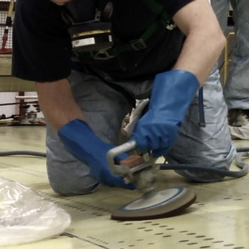
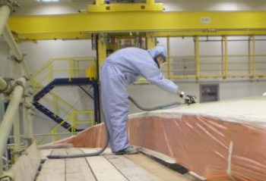
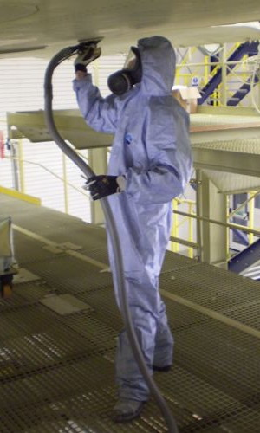
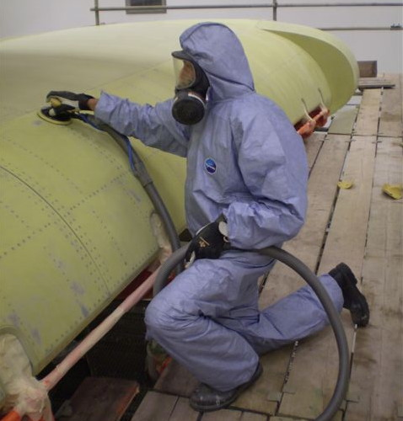
Successful New Tool Development
Understand the User to Understand the Task
Tool Development Process
Identify Problem
Understand User
Solve from User Perspective
Plan for Adoption
Set User Expectations
Establish New Tool as Best Practice
Notes:
When discussing new tool development, it is important to remember that what you want to do is create a tool that is eagerly adopted by the personnel charged with using it, that checks all the boxes on performance and safety improvements, and that pays for its own development with operational and ergonomic savings. It is both frustrating and a waste of your budget allocations to introduce a new tool your personnel won’t actually use - so it helps to keep the whole technology adoption cycle, outlined on this slide, in mind as you first start brainstorming about any new technology.
As the bold text is supposed to indicate, the most important task when developing a tool is to make sure it provides what the USER would call a solution - if you’ve done that, most of these other boxes check themselves.

Slide 6
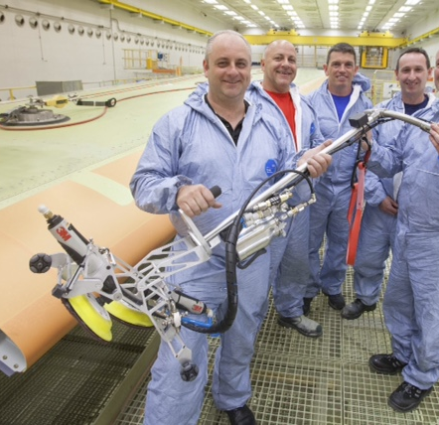
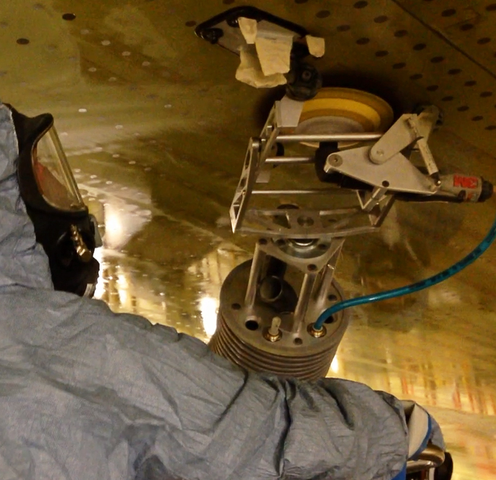
Temple Allen Examples
Wing Top Sander & Airbus A380
Notes:
The first example of tool development I’ll be talking about is our Wing Top Sander, which we developed having identified a need at Airbus Broughton. The project started when Temple Allen delivered two EMMA Stand Systems, seen in the right side photos, in Phase I of the program to address the ergonomic challenges of holding a sanding tool up over your head underneath the gargantuan wings of the A380. We did develop the EEF shown bottom right as part of this process, but the EMMA itself was COTS equipment. Phase II of the program focused on solving the ergonomic challenges of sanding the equally large wing tops.

Slide 7
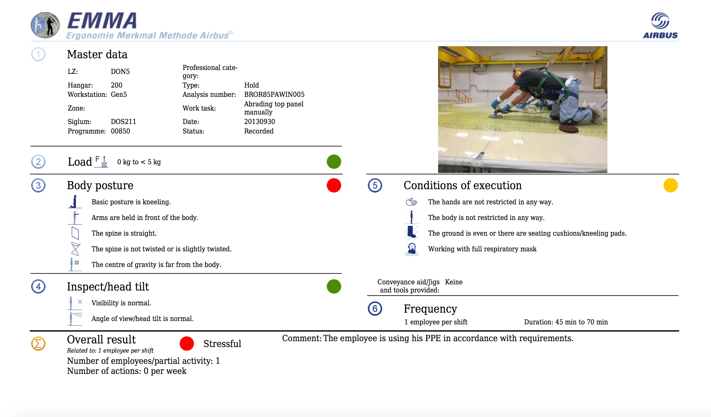
Temple Allen Examples
Identify Problem, Understand User
Phase II - Ergo nightmare of A380 wing tops ~ 9,100 sq. ft
on-knees posture
uncomfortable reach
vibration exposure
scrubbing motion
solvent - slippery when wet
Notes:
So - per our handy “Successful Tool Development” guide, our first steps are to identify the problem and understand the user. In the case of the A380 wing tops, the problem was obvious and the user was suffering from stress, fatigue, knee pain, shoulder pain, neck pain, and absenteeism.

Slide 8
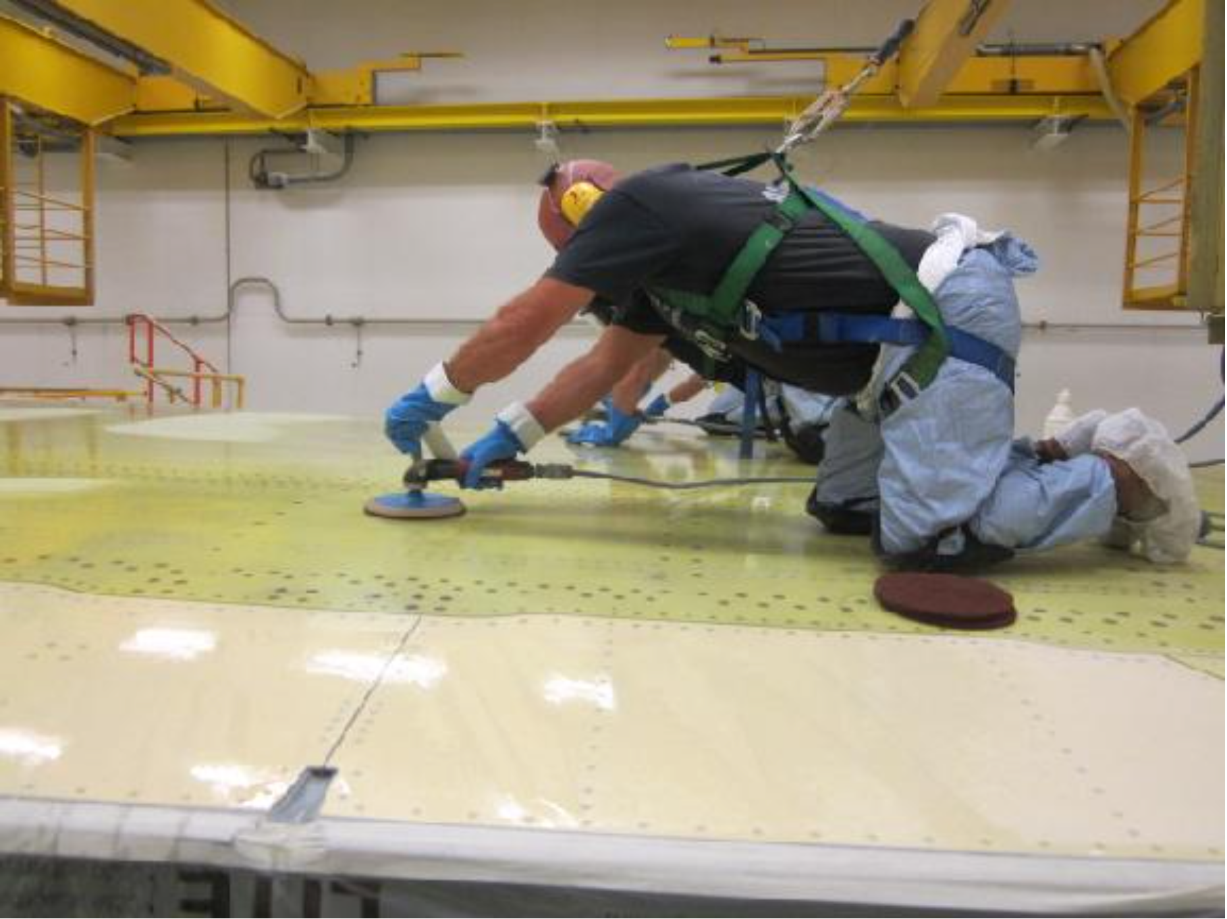
Temple Allen Examples
Solve from User Perspective
Solution Requirements
Improve ergonomics (get operators off their knees)
Match current quality
Match current productivity
Fluid delivery for process
Notes:
Our first priority, not surprisingly, was to get the workers up off their knees, and not otherwise make the process less attractive for Airbus – so at a minimum we needed to match the current levels of quality and productivity. They also hoped we’d be able to incorporate fluid delivery into our systems to prevent operators from having to carry bottles of the solvent around with them.

Slide 9
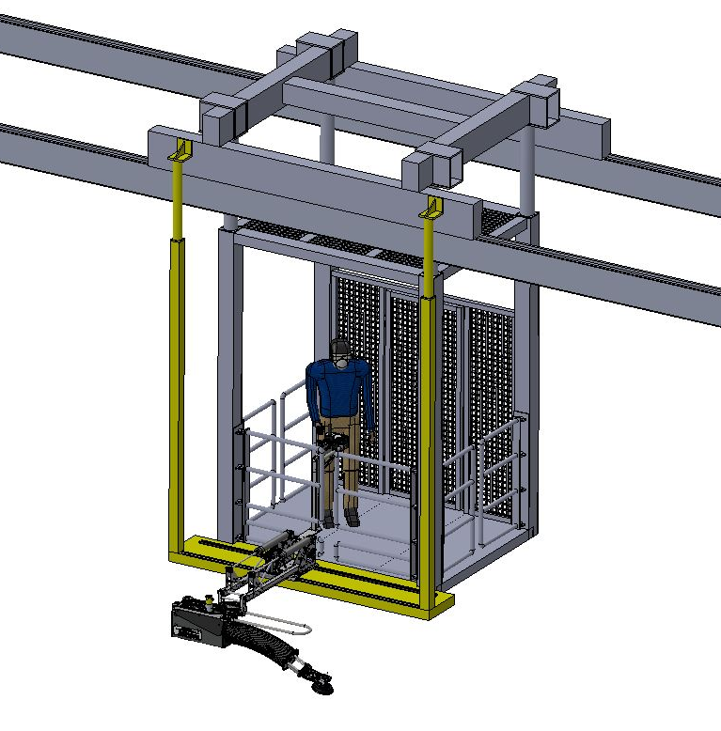
Temple Allen Examples
Develop Solution Options
First Idea
EMMA sanding down from gantry-deployed lifts
complex
expensive
significantly custom
positions operator too far away to see surface status
Notes:
The A380 Wing facility has overhead-mounted gantry platforms, and our first idea was to mount a version of our existing EMMA equipment to perform the work. This would have necessitated mounting EMMA rails – illustrated here in yellow - onto each lift, and creating a way to park EMMA units somewhere else when the gantry platform didn’t need them. While all this could have been achieved, there was no way to get around the fact that the operator would not be, and could not be, positioned to see the surface very well.

Slide 10
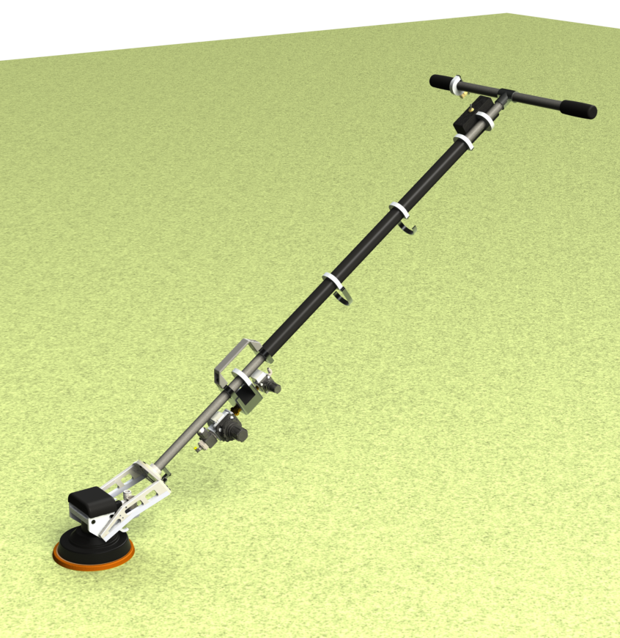
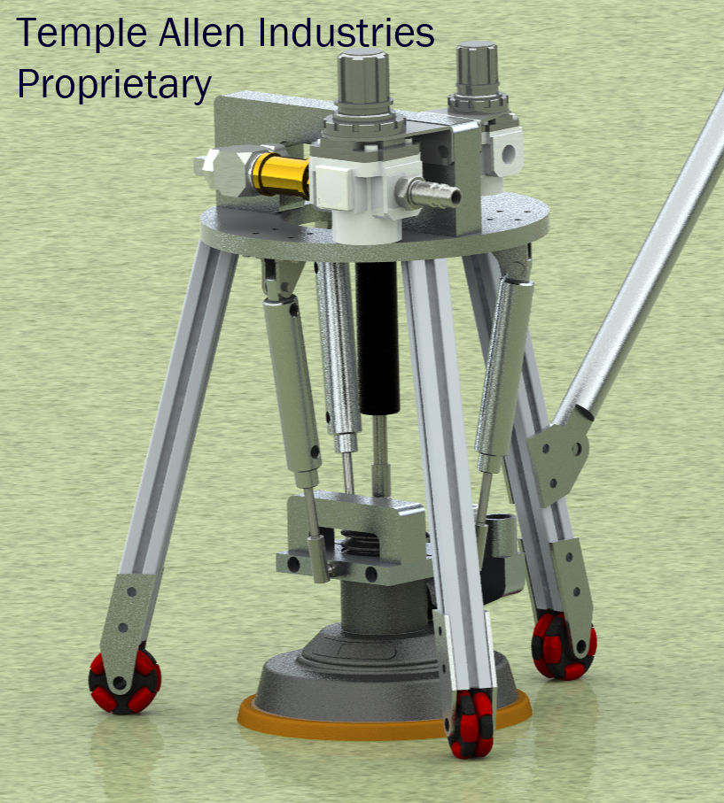
Temple Allen Examples
Develop Solution Options
Better, Simpler Idea
Ignore the Gantry lifts, focus on the operators
Concept - a pneumatic version of existing drywall sander
3 quick iterations ~ 3 months
v 1.0 stick/wand & EEF
v 2.0 - add piston tripod
v 3.0 stick/wand with vibration element
1.0
drywall sander (electric)
2.0
3.0 (as delivered)
Notes:
Our second idea was better, and generated a solution that addressed all the ergonomic challenges, but was also faster, lighter, and easier for the operator. It was also a lot less expensive for Airbus. The customer had bought and tested a conventional drywall sander - not at all the right tool for their application (in that it was electric, underepowered, didn't suppress vibration, and was unable to handle solvents) - but they hoped that we might be able to produce a more powerful pneumatic equivalent able to survive wet-sanding operations and reduce operator exposure to vibration. As you can see, we worked thru a few variations, and delivered a system about 6 months later which ticked all those boxes.

Slide 11
Temple Allen Examples
Wing Top Sander Iterations - What Worked
V 1.0 – stick & EEF
Worked - Posture & Ergo
Didn’t - Vibration
V 2.0 - piston tripod
Worked - No Vibration
Didn’t - Heavy, Cumbersome
V 3.0 - stick with vibration element
Delivery June ~ 6 months R&D
Worked - Posture, Ergo, Vibration, Weight, Usability
Didn’t - EEF not ideal for application
V 4.0 - Follow-up Delivery ~ 3 months
Worked - Everything
1.0
drywall sander (electric)
2.0
3.0 (as delivered)
Notes:
Let’s look briefly through those 3 iterations, to better understand the development process. (Read Slide thru 3.0).
As it turned out, we were not done once we delivered version 3.0, as Airbus asked us to go through one more round of development on the end effector to see if we could supply them with something even better for their solvent scrub application. The result was the 4.0 system you see on the next page - with a Dual 3,500 RPM 7” 1.0 hp Rotary Sander, variable contact angle, solvent-resistant BUP, and T-hooks interface - which was then written up in the next month’s Airbus One magazine

Slide 12
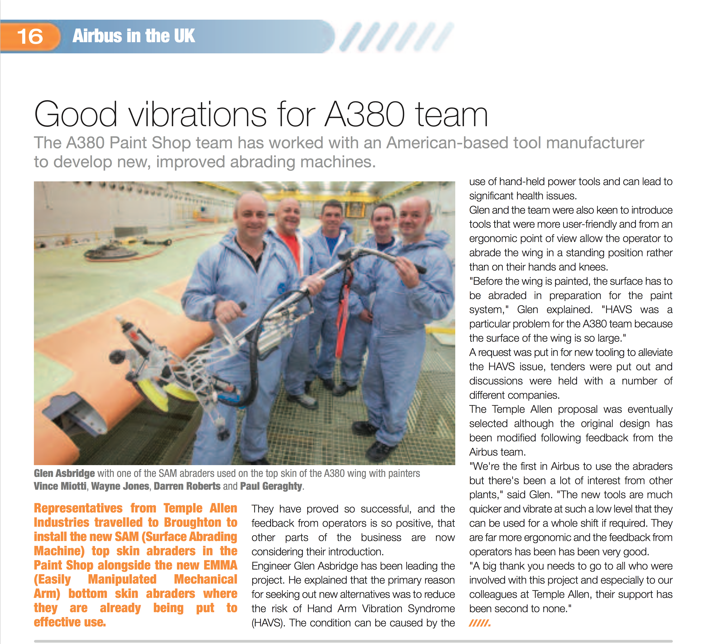
Notes:
Note that I have a print out of this article if you’d like to see it more closely. THIS is the kind of customer feedback you’re looking for - they discuss positive buy-in from operators, the problem (vibration exposure) being solved, and appreciation for all the vendor support.

Slide 13
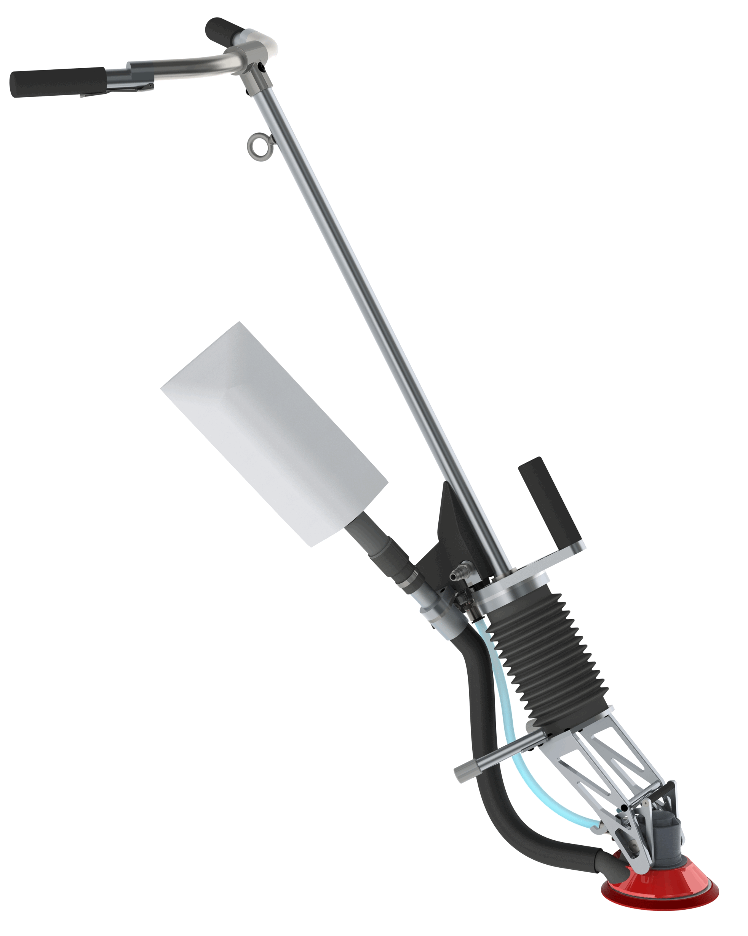
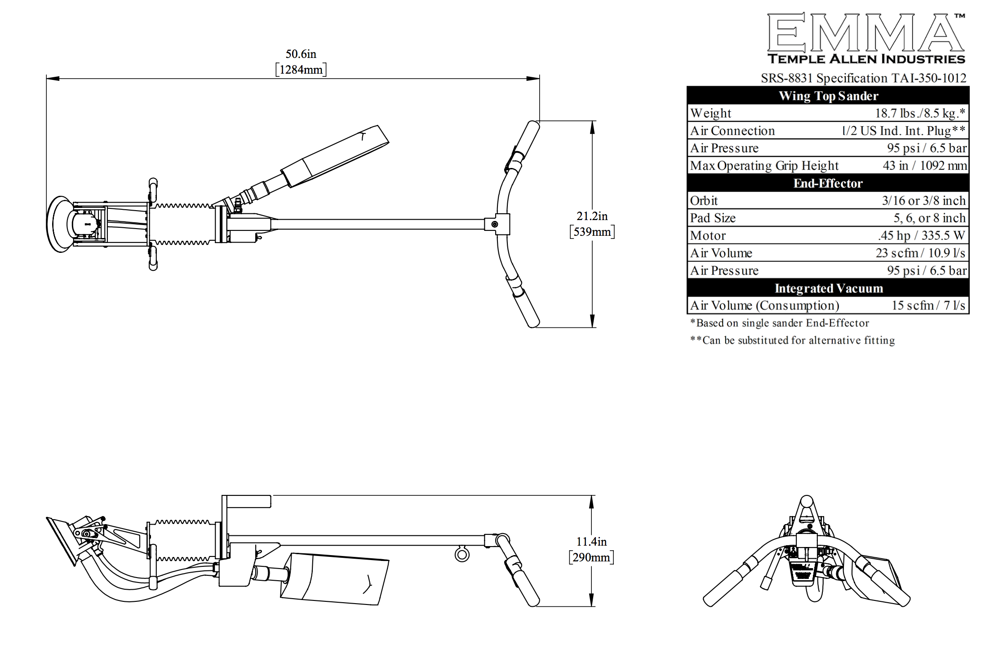
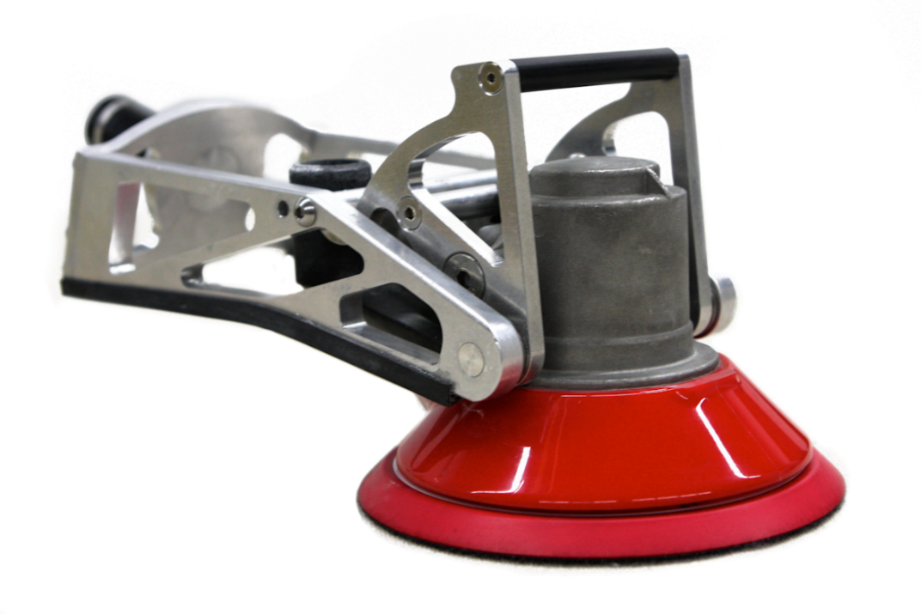
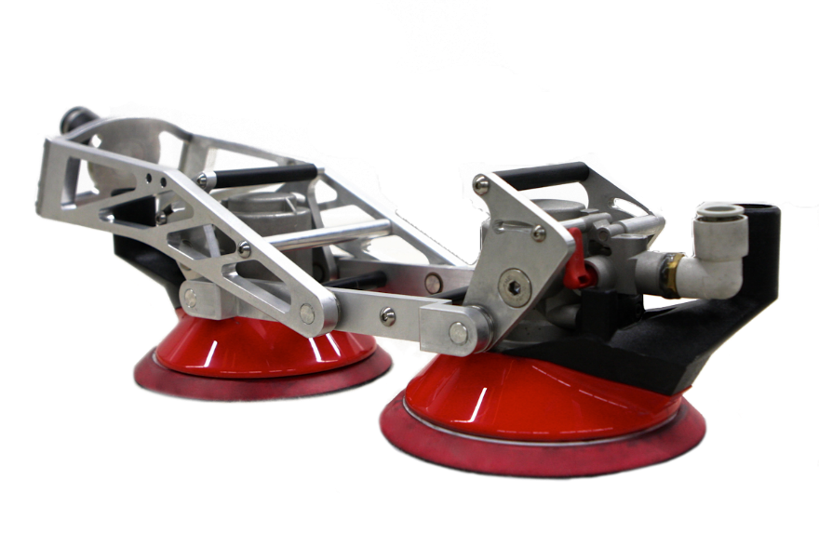
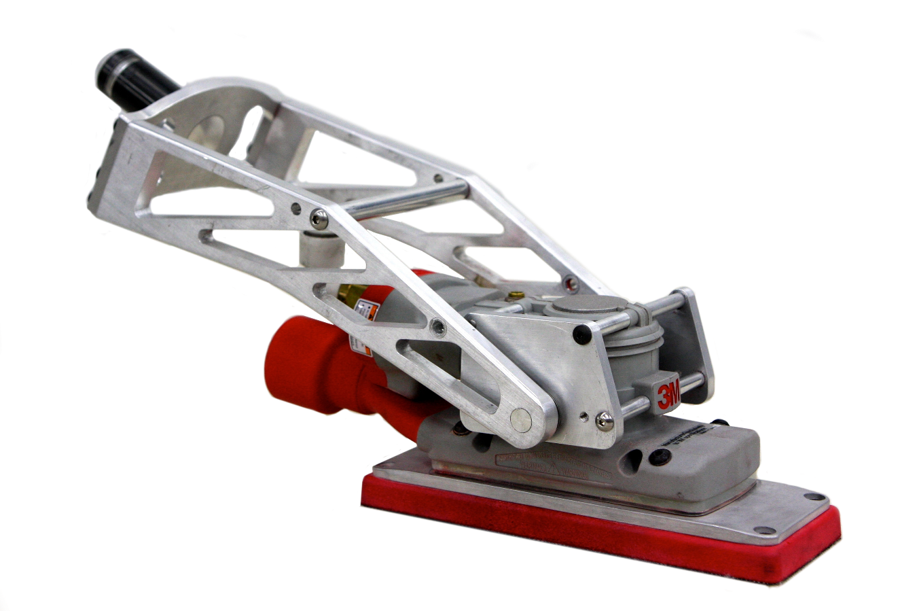
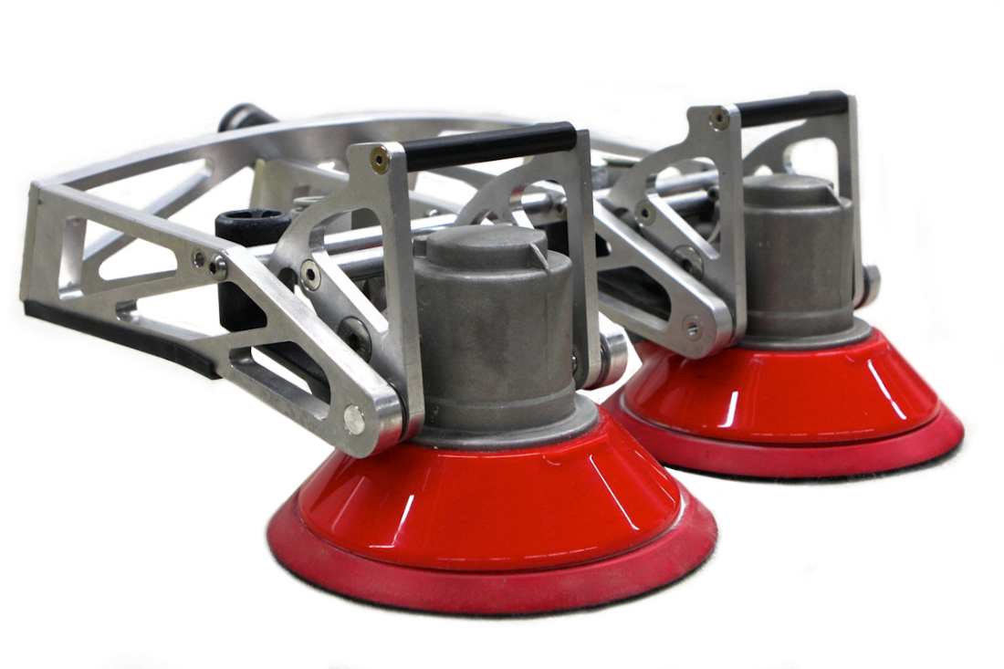
Temple Allen Examples
Wing Top Sander Current Status
We have one here
less than 20 lbs
.45 hp DA sander
integrated vacuum
Dozens in use at multiple clients, sites
Multiple tooling options, some more aggressive than others, but contact pressure currently limited to gravity
Notes:
To bring you up to the present, this is the current status of the Wing Top Sander. I have one here and will have it at our table for you to look at more closely
Before I move onto the work we’ve done with a paint stripping end effector - does anyone have any questions you’d like answered now about Wing Top Sanders?

Slide 14
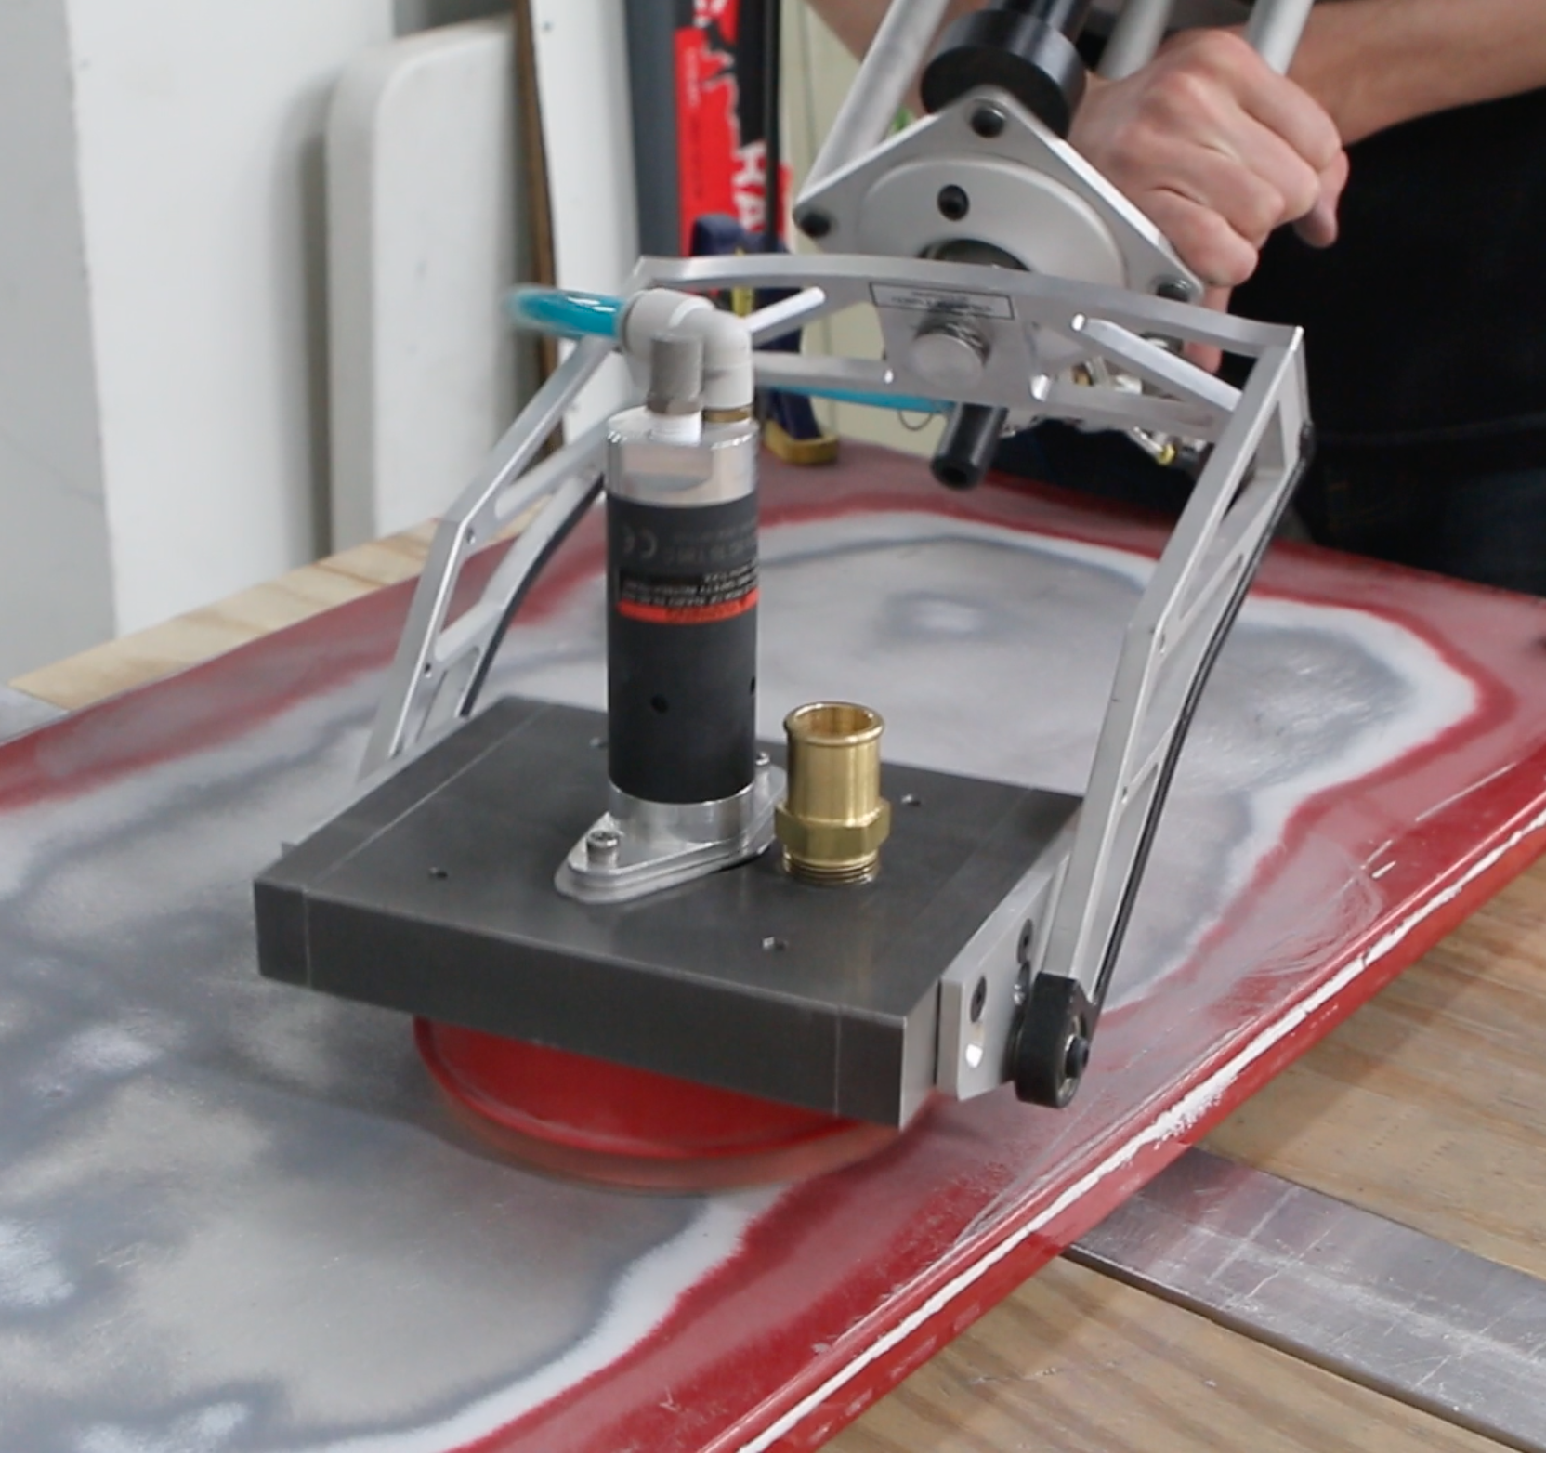
Temple Allen Examples
Paint Stripping End-Effector
Notes:
Our other example of tool development is still a work in progress. That it’s hard to develop a good paint-stripping sanding tool is proven by the fact that nobody has managed to do it yet. Let’s look a little more closely at the problem.

Slide 15
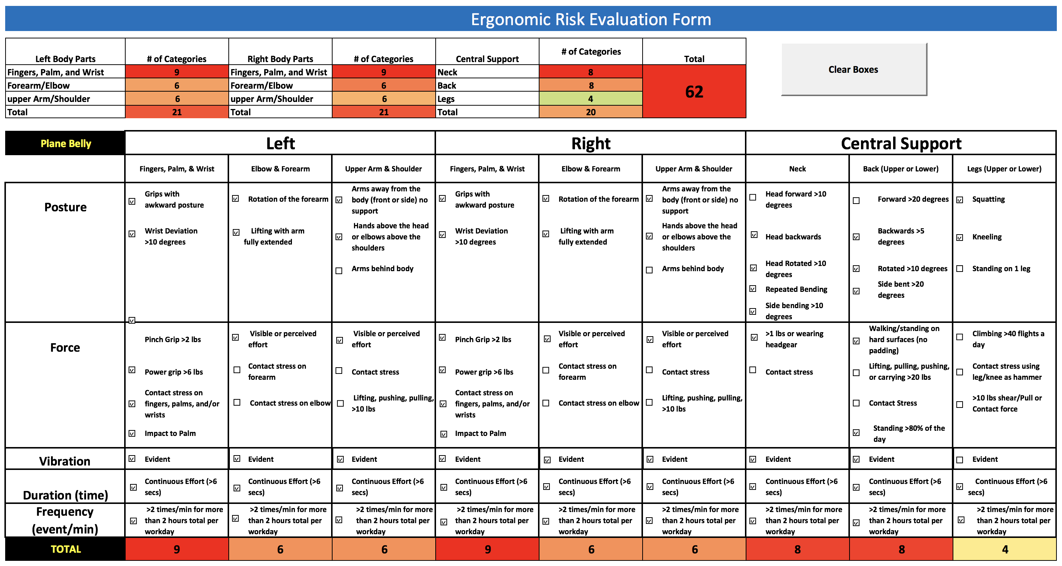
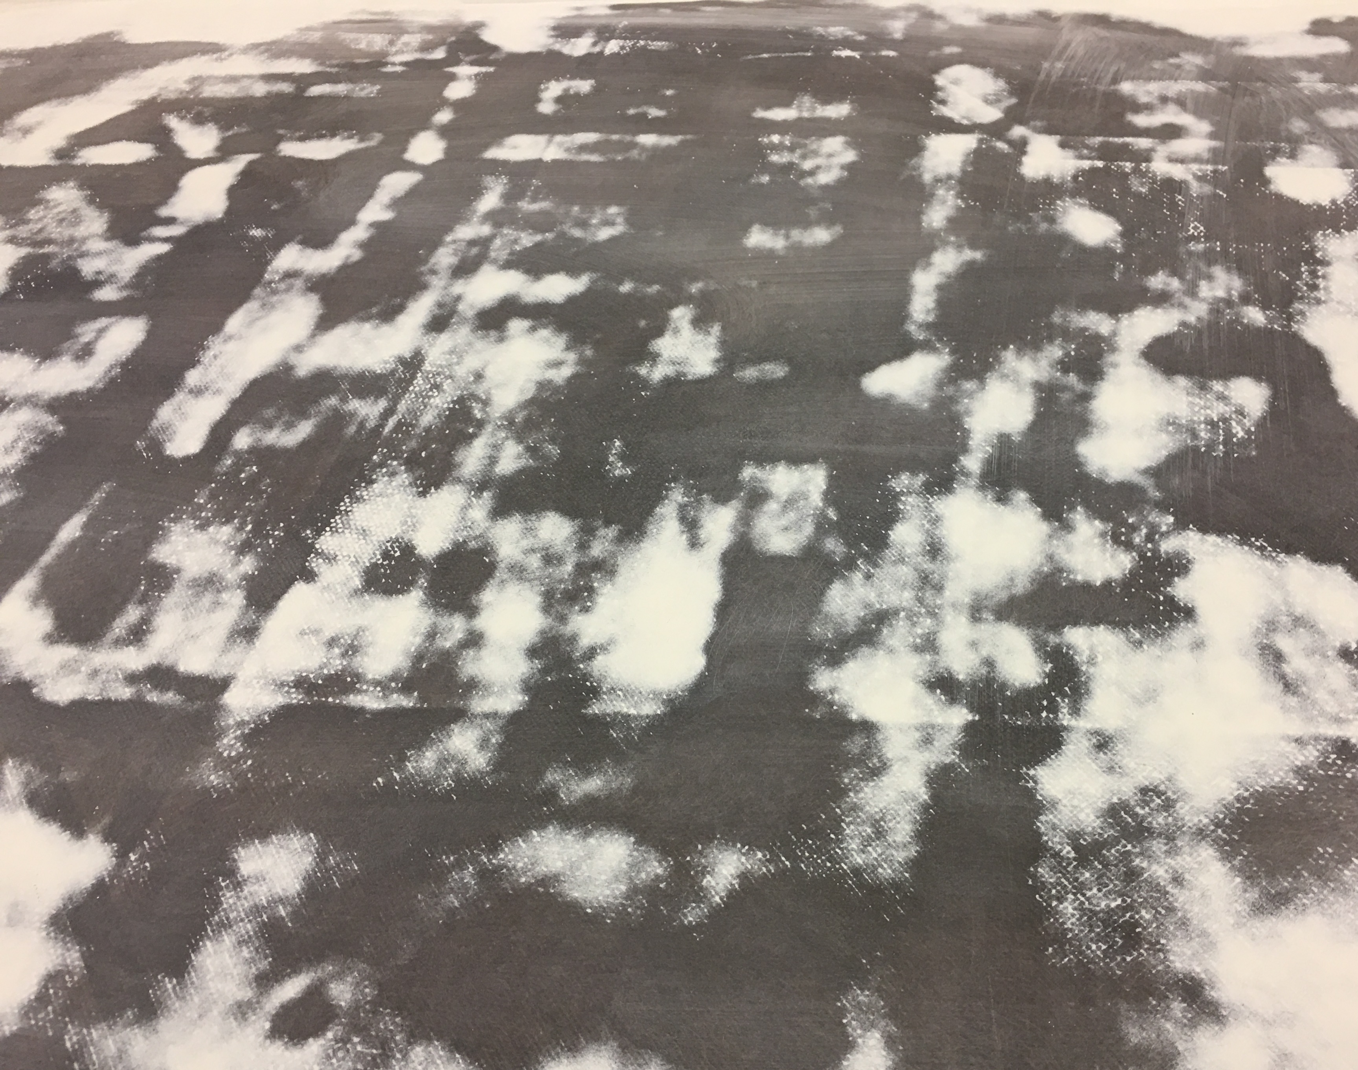
Temple Allen Examples
Identify Problem, Understand User
Paint Stripping
longer sanding time
more pressure required
progress always seems slow
uneven prior paint layers
temptation to tilt sander
risk of part damage
Notes:
I’m not trying to disparage the industry when I say that nobody’s developed a good paint-stripping tool yet. I say that because even with popular, well-made tools from numerous manufacturers, all these issues remain (read slide).
In addition, we have to understand that “paint stripping” means something different to everyone
Have to understand: what material being stripped? Are we talking about hex chrome primer or topcoat?
Have to understand: what sanding finish is desired? Are you looking to produce a spotted cow or sand clean to bare composite?
Have to understand: how fast must the job be done?
Have to understand: whether the job requires the sander to tip, or is the priority to protect the plane by staying flat?

Slide 16
Temple Allen Examples
Solve from User Perspective
Solution Requirements
Improve ergonomics
Improve morale
Eliminate injuries
Attract new workers
Match current quality
Boost current productivity
Notes:
Abrasive paint stripping, because of the longer times and greater pressure, is even more of an ergonomic disaster than sanding in general. I’ve zoomed in on the ergonomic risk assessment form here - this one filled out for paint stripping the belly of an aircraft, to make the point about how terrible for workers this process can be. Note that the company we got this ergonomic risk assessment from requires management action for any score over 20, and this task weighs in at 62.
The last bullet here deserves a few comments. Normally, we modify and incorporate existing tools from 3M, Dynabrade, or other high quality manual sanding tool manufacturers. Tools which do a good job when held by artisans simply do a better job when they’re deployed by EMMA systems or our Wing Top Sanders, and all the ergonomic and health issues go away. In the case of the paint stripping task however, there are no hand-held tools which do as good a job as we would like - so we’re having to develop our own tool, potentially taking advantage of the fact that EMMA can safely wield a heavier and more powerful tool than an artisan can.
We are of course aiming to not only solve the ergonomic challenges, we’re working to make the abrasive paint stripping process fast enough that more shops have the option of choosing mechanical abrasion rather than having to face the environmental impacts of media blasting or nasty chemicals.

Slide 17
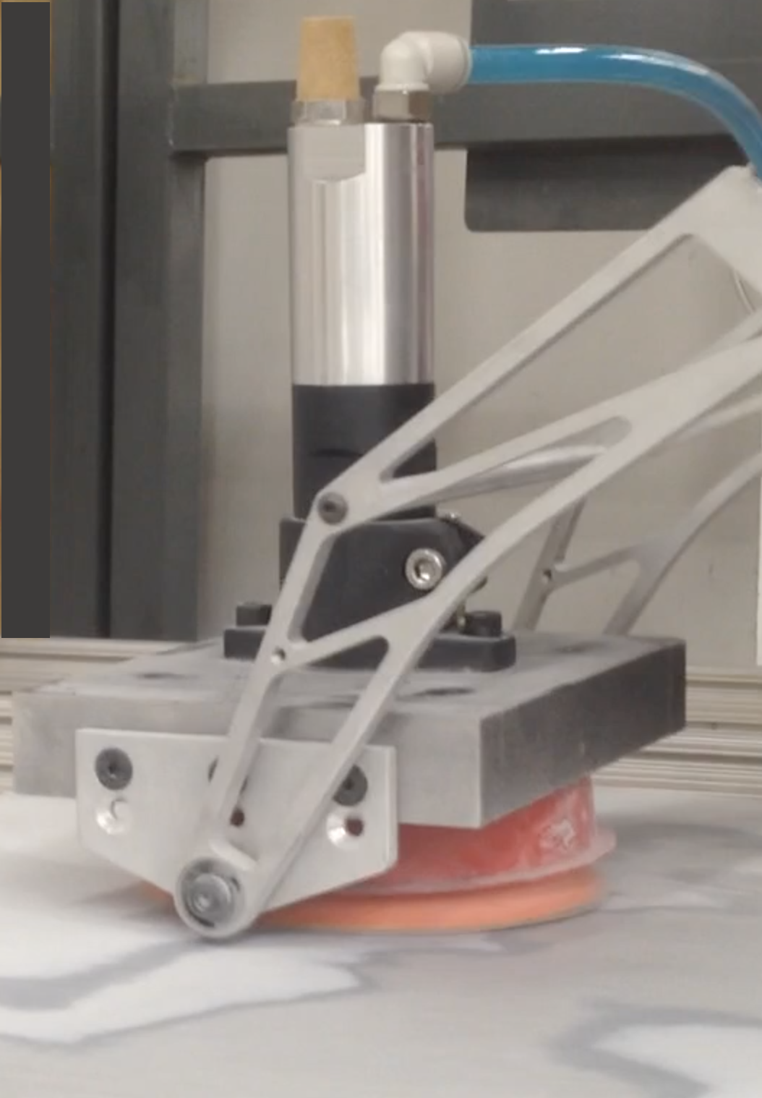
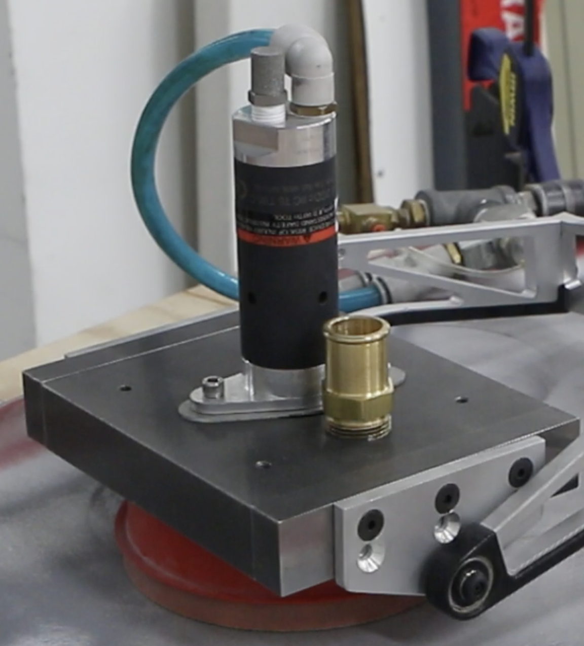
Temple Allen Examples
Develop Solution Options
1.0
1.5
1.0 Heavy block, high rpm 1 hp motor, normal mounting geometry
hard to stabilize
high RPM would “work harden” the paint
2.0 Lighter block, low rpm 0.5hp motor, adjusted roll axis
much more stable
better paint stripping performance
2.0
Notes:
On this slide you see the first two approaches we’ve taken. With 1.0 we chose to integrate a really powerful motor with a heavy steel block, thinking that pressing down hard on the painted surface might allow abrasives to cut deeper, but found that the high RPM of that motor didn’t help at all, as high RPM can make the paint harder and more resistant to abrasion. We also found that the greater inertial mass of the steel block didn’t improve the system stability, but instead served to amplify the oscillation magnitude of the rotating tool. Version 1.5 replaced the 1hp motor with a 0.5hp version with lower RPM, and Version 2.0 replaced the steel block with aluminum, and we adjusted some of the component geometry. This dramatically improved the tool stability, and it seems to sand pretty effectively, but it’s not quite ready for prime time.

Slide 18
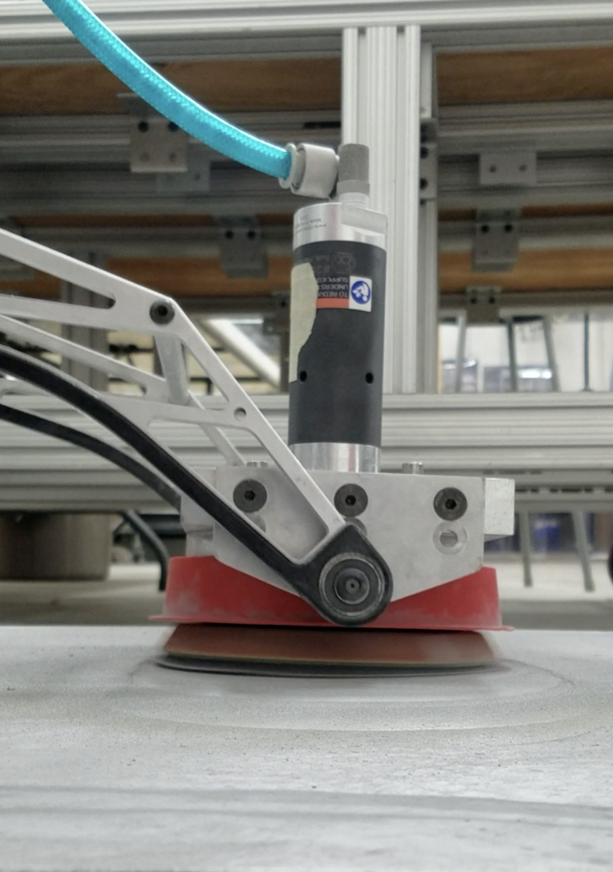
Temple Allen Examples
Develop Solution Options
Factors to optimize
weight distribution
roll axis and pitch axis alignment
abrasive characteristics
contact pressure
RPM
HP
Notes:
As we work on V 3.0, here are the primary factors we have to optimize, each often in direct correlation to one or more of the others, so it gets pretty complicated.

Slide 19
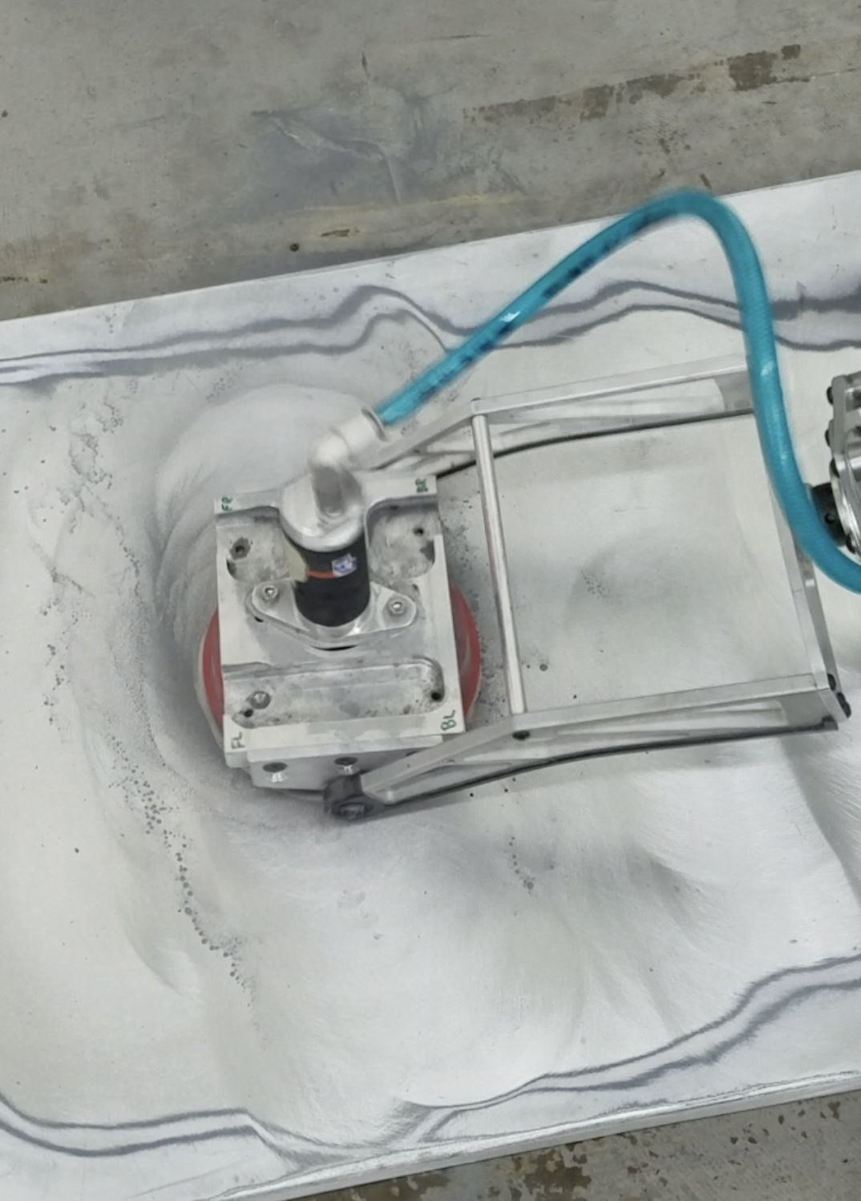
New Tool Development Process
What’s Next for TAI?
Go back to Clients
get feedback on their priorities
get sample panels of their actual paint for testing
lock down success metrics for paint stripping
on-site trials
Notes:
The next steps for us are to reconnect with existing clients who’ve expressed an interest in an improved paint-stripping tool, and find out in more detail exactly what they’re looking for, get some sample panels, lock down the tool design, establish a testing regimen, and conduct onsite trials.

Slide 20
New Tool Development Process
Lessons Learned
always be willing to learn more about client and their process
embrace change - don’t get stuck on first good idea
be willing to challenge existing product line
improvise, adapt, and overcome (w/ all due credit to the USMC)
Notes:
So - what have these development efforts taught us at Temple Allen? (read slide)

Slide 21
New Tool Development Process
Dod Recommendations
Identify Problem
Understand “day in the life”
TALK to us early in process - we exist to solve problems
Doesn’t take much funding (SBIR) to get what you need
Might not even take SBIR (smaller budget for demo/trial)
Notes:
In keeping with our own experience, I’d recommend any of you responsible for sourcing new tools make sure you’ve interviewed the workers who’ll be using those tools to make sure not only that they FEEL included (which will help buy-in later), but that they actually ARE included - because successful tool development simply can’t happen without them.
If you think a small company might have, or be able to generate, the tool you’re looking for, consider if the SBIR process is appropriate to your situation, and if so - use it - it can work well. If you’re in more of a hurry, talk to your favorite small company about demonstrations and trials.

Slide 22
New Tool Development Process
questions & Answers
Q&A
What tools are you looking for?
What processes are your biggest headaches?
Where are the injuries happening in your shop?
etc.
Notes:
I’ve put some of my questions on the slide — but this is the chance for you to ask your questions . . .

Slide 23
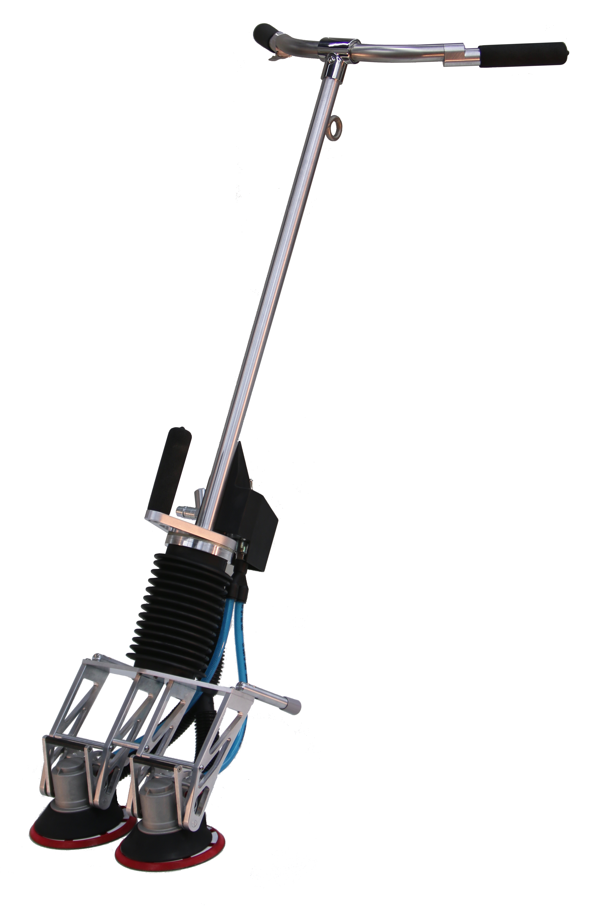
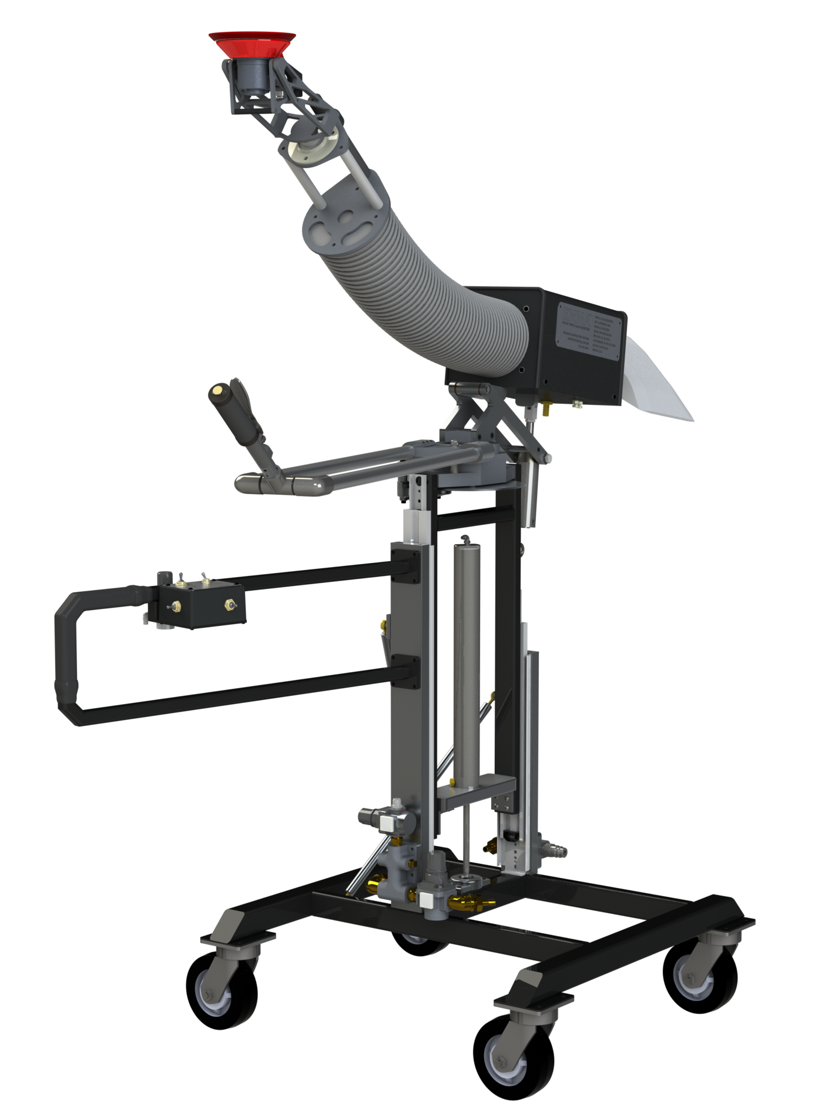
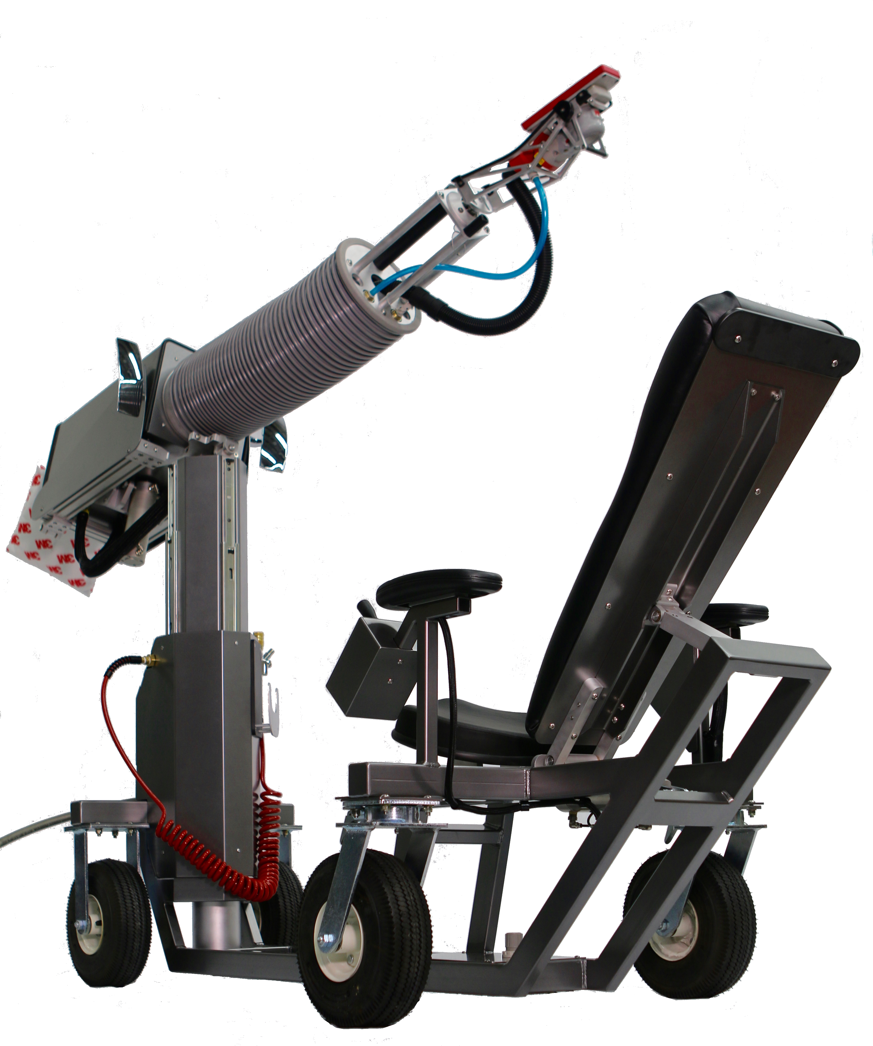
Contact Info
Temple Allen Industries
Robert Kent - Industry Relations
Temple Allen Industries
Rockville, MD
rkent@templeallen.com
240.888.6536
also here this week:
Cele. Bryan - General Manager
Temple Allen Industries
Rockville, MD
cbryan@templeallen.com
240.888.6931

