Slide 1
DRILLIN’ FOR DUMMIES
OR
NEW INNOVATIONS IN HINGE FITTING REPLACEMENT
JEFF RUSHTON 533rd CMMXS
HILL AIR FORCE BASE

Slide 2
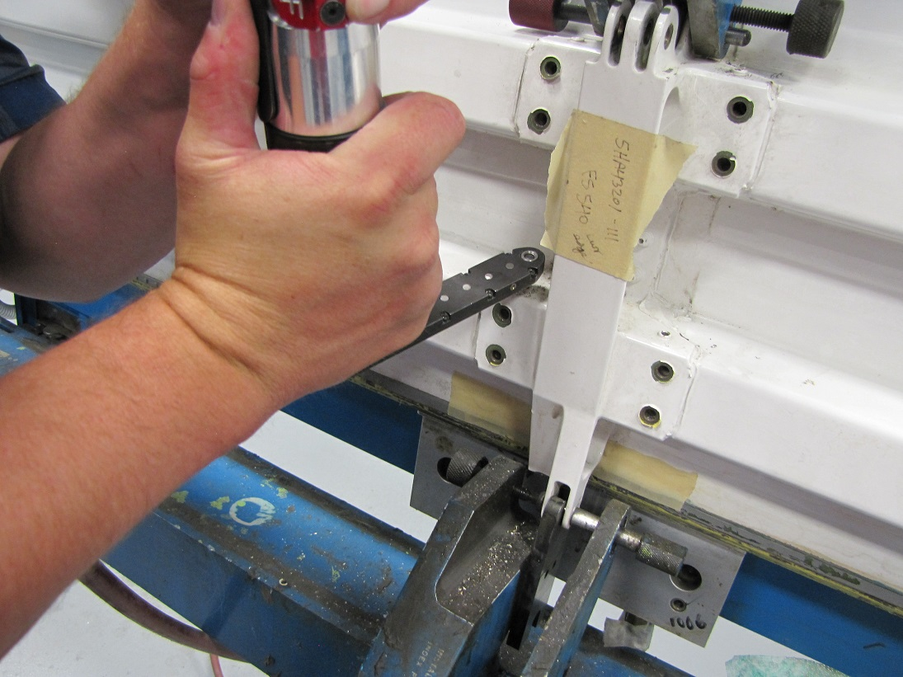
FASTENER REMOVAL

Slide 3
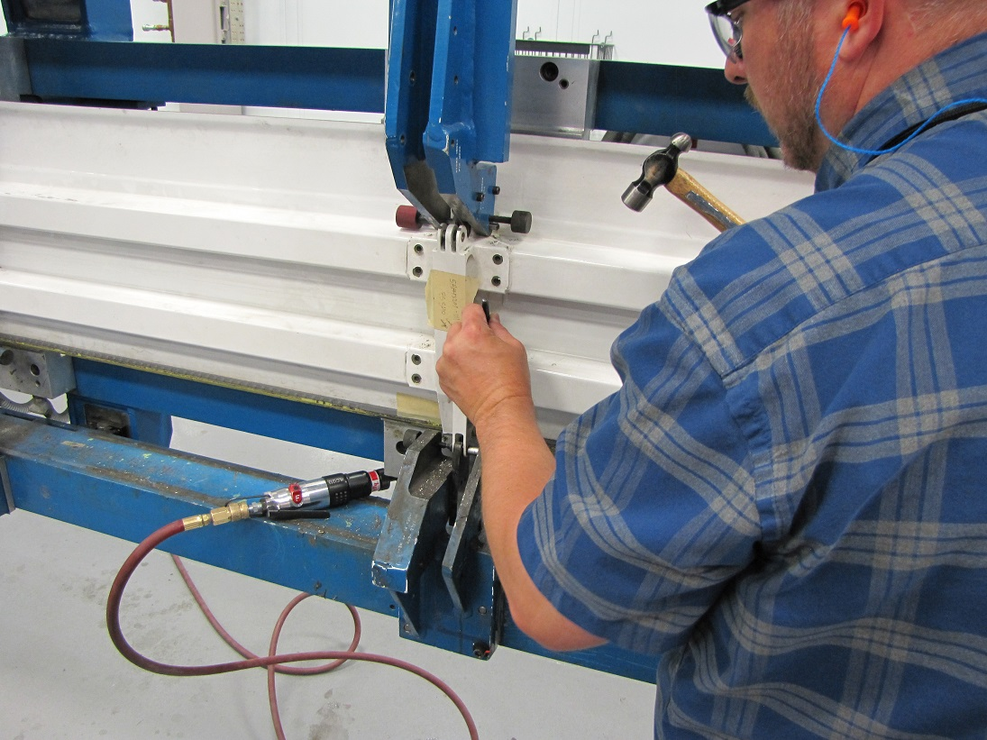

Slide 4
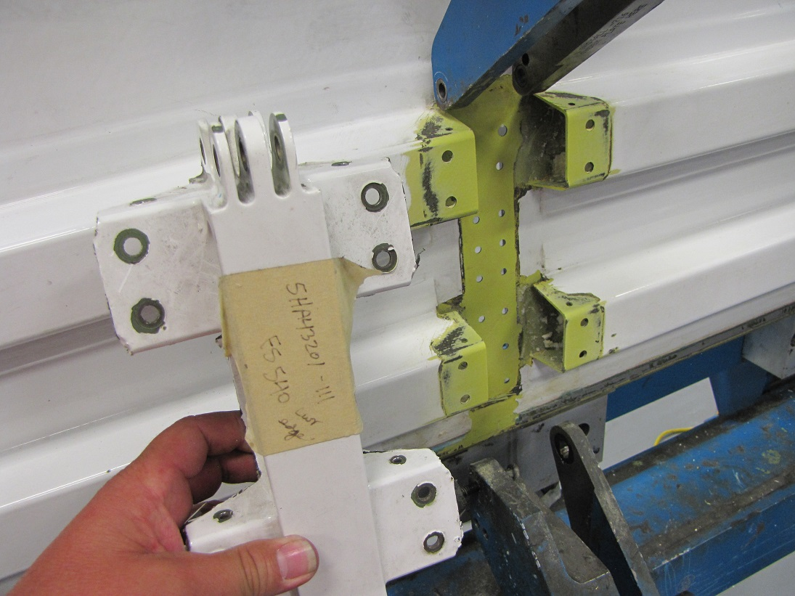

Slide 5
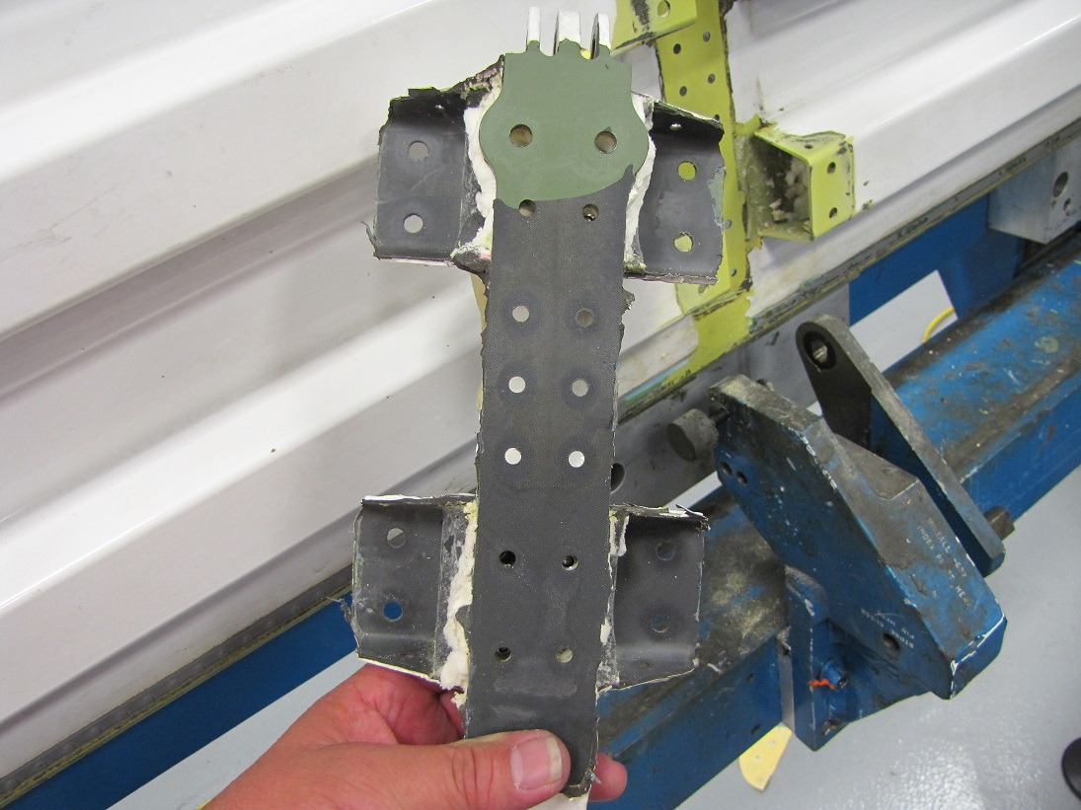

Slide 6
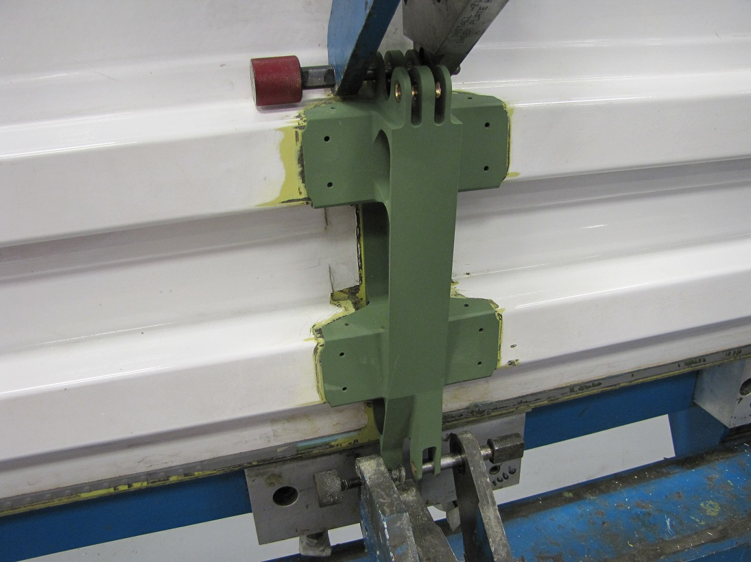

Slide 7
THE PROBLEM

Slide 8
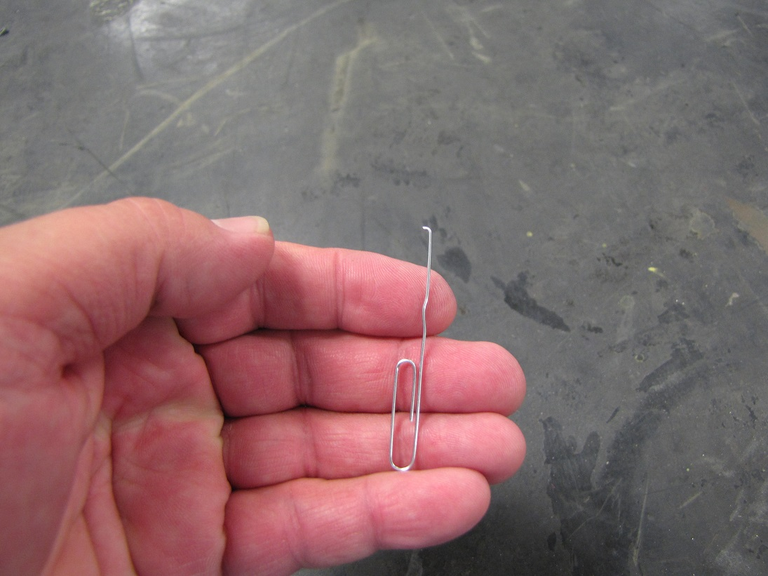
THE SQUIRRELOTOMETER

Slide 9
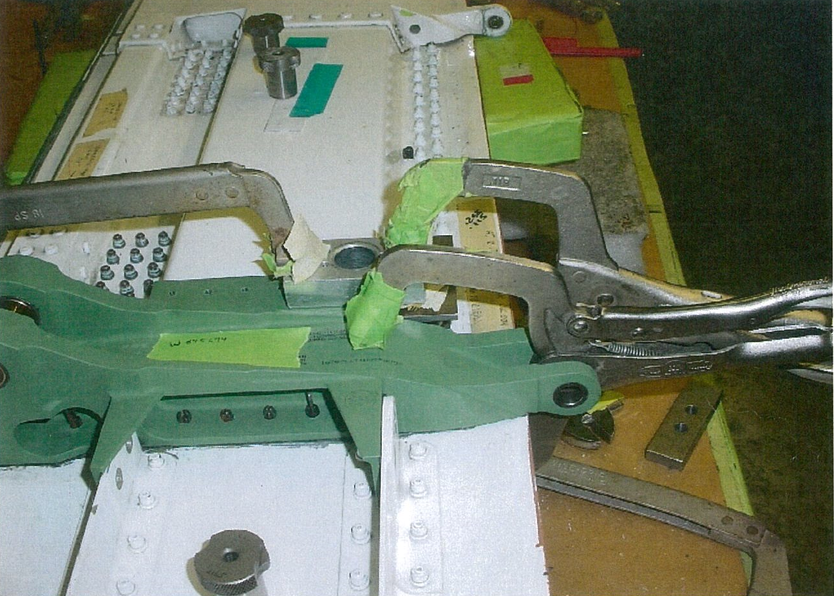
ORIGINAL METHOD
DIFFICULT TO HOLD BUSHINGS IN PLACE
CAN DAMAGE COMPOSITE SKIN
INNACURATE HOLES

Slide 10
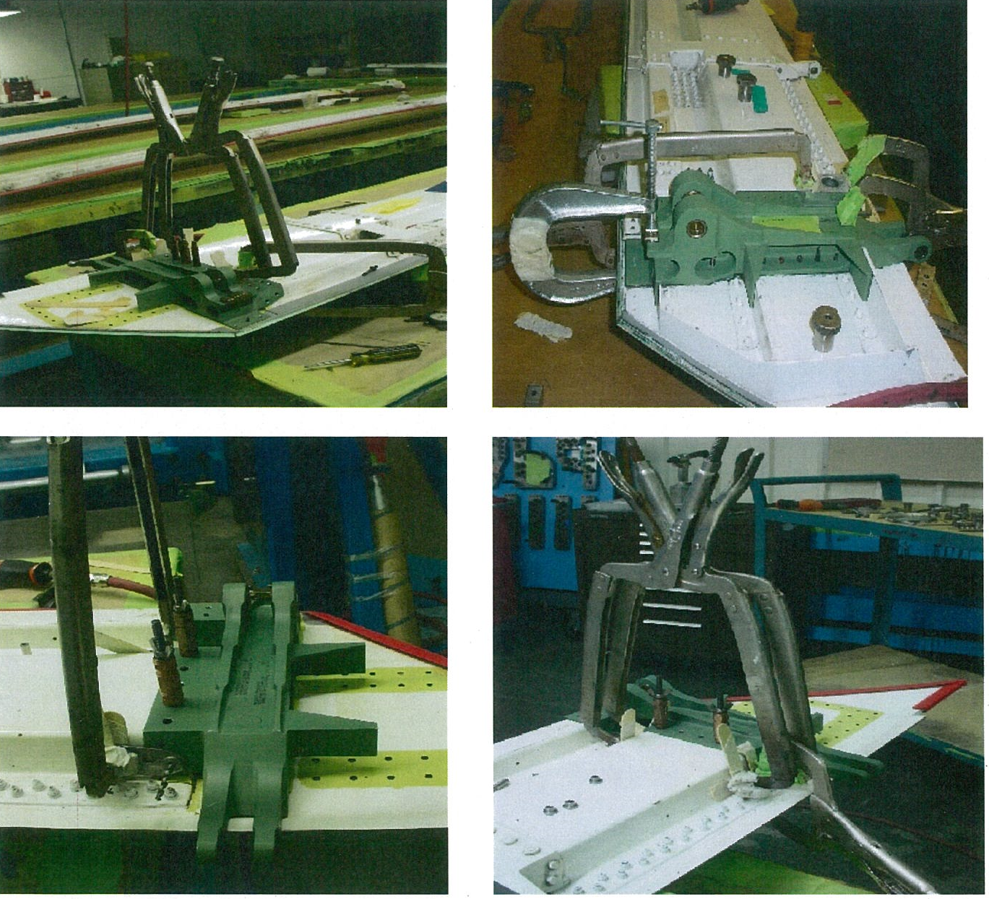

Slide 11
THE HISLOP METHOD: A NEW HOPE

Slide 12
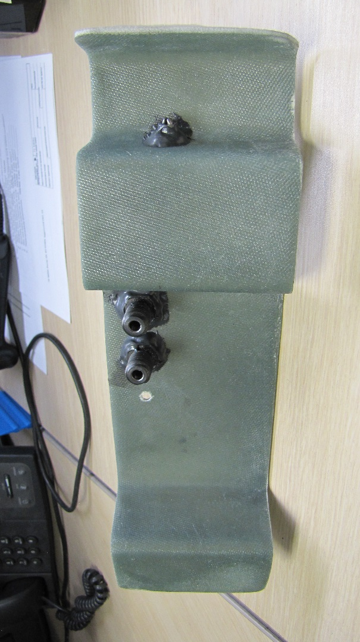
MORE ACCURATE DRILLING NO DAMAGE TO COMPOSITE SURFACE TIME CONSUMING

Slide 13
TIME TO TRY A NEW APPROACH

Slide 14
YOU DON’T HAVE TO BE SMART,
YOU JUST NEED TO KNOW SMART PEOPLE

Slide 15
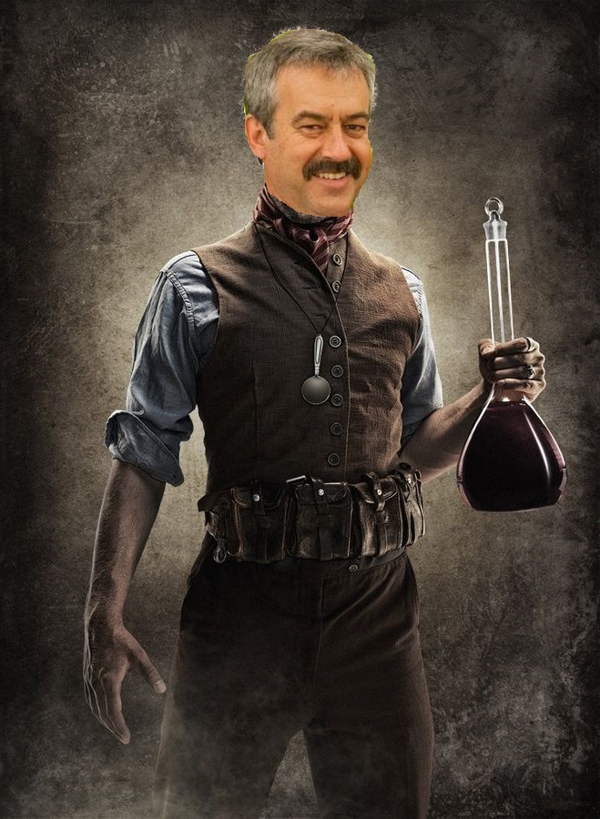
ALAN
CLARK
SUPER
GENIUS

Slide 16
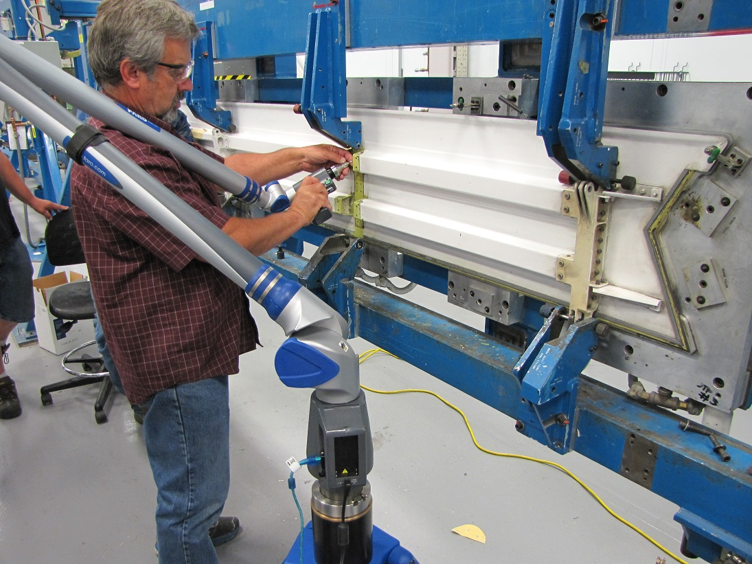

Slide 17
SCANNING THE CONTOUR AND HOLE LOCATIONS

Slide 18
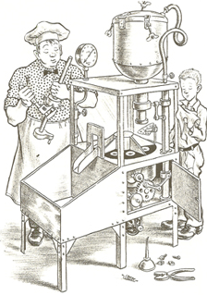
INPUTTING INFO TO 3D PRINTER

Slide 19
A MIRACLE HAPPENS

Slide 20
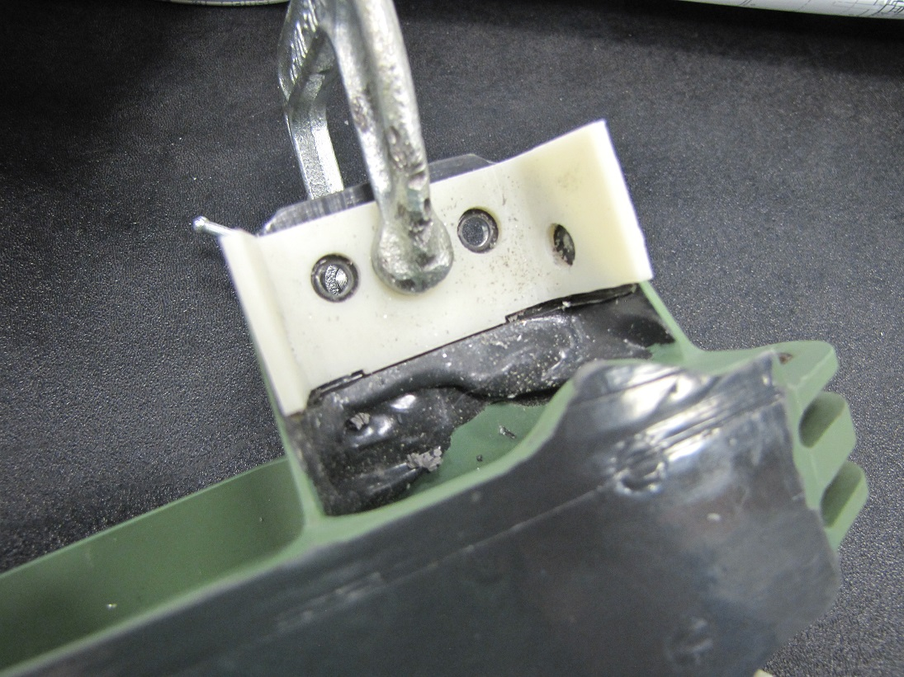

Slide 21
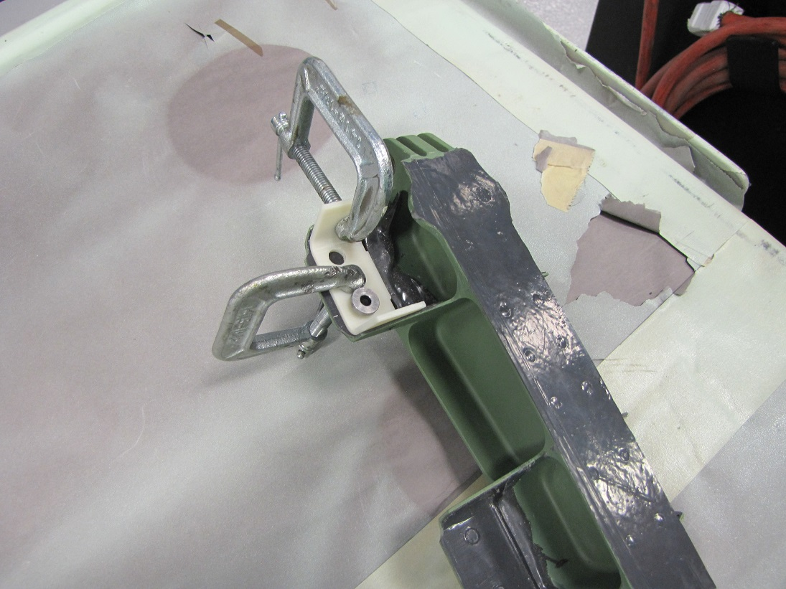

Slide 22
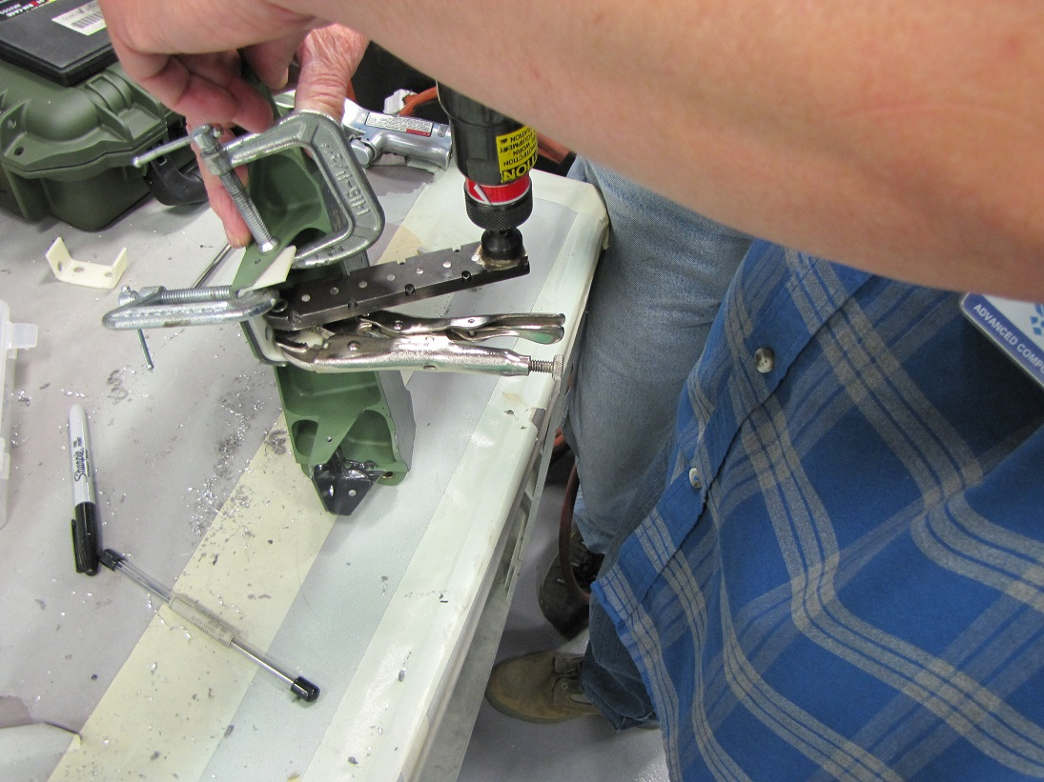
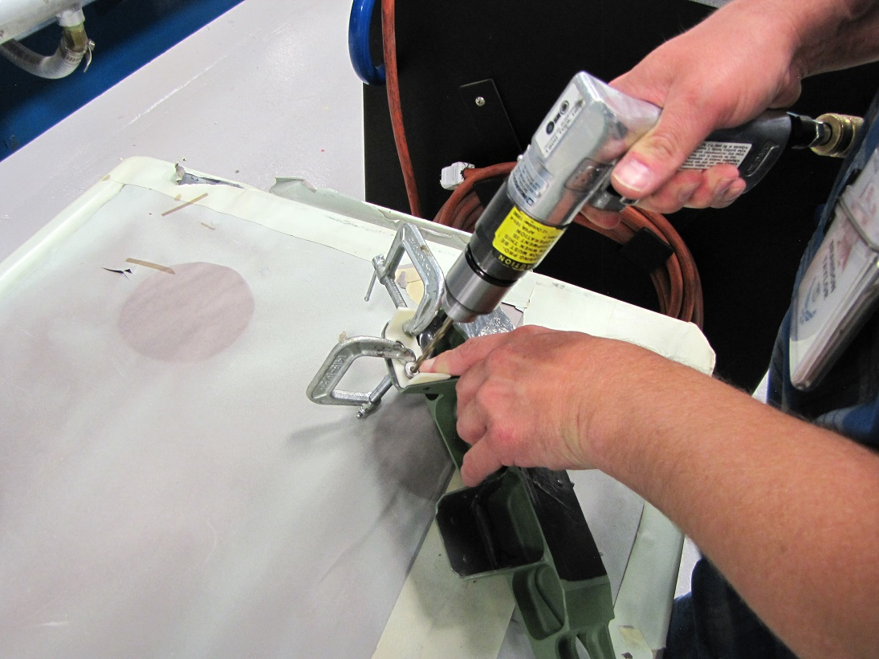

Slide 23
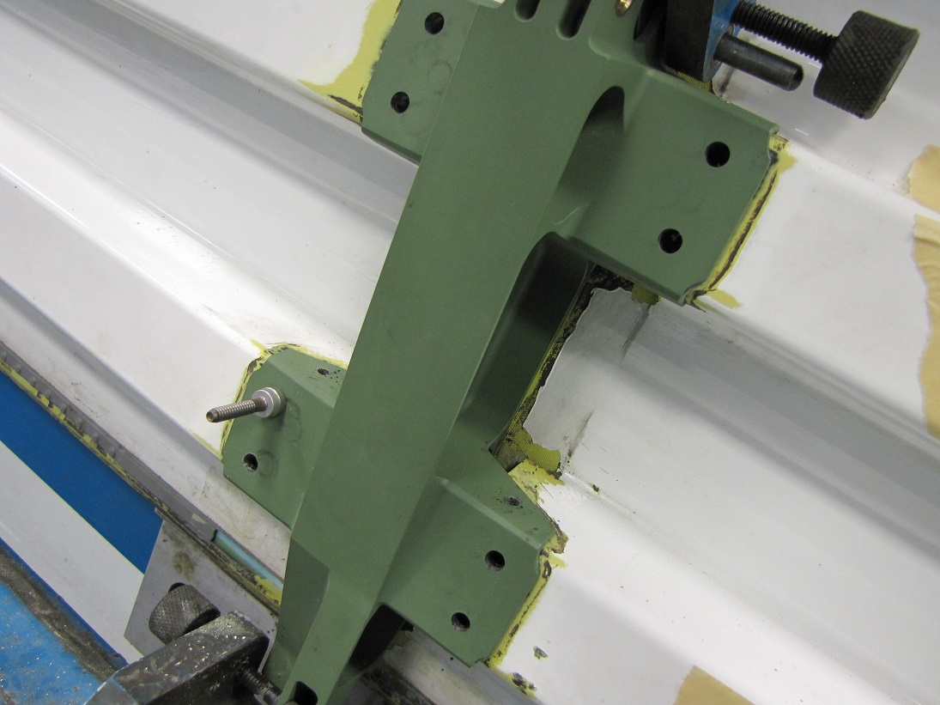
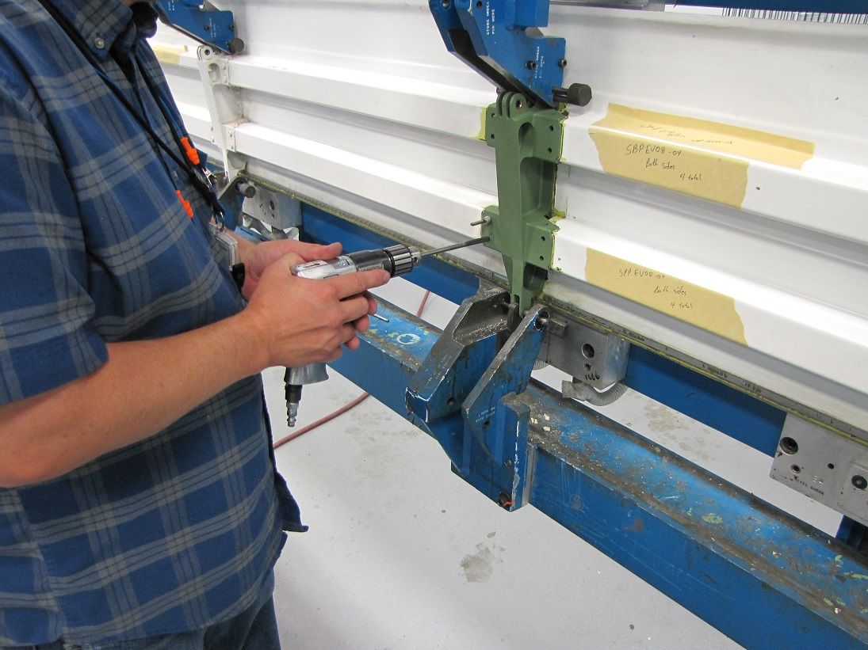
BRANDON TAYLOR, MAN OF ACTION

Slide 24
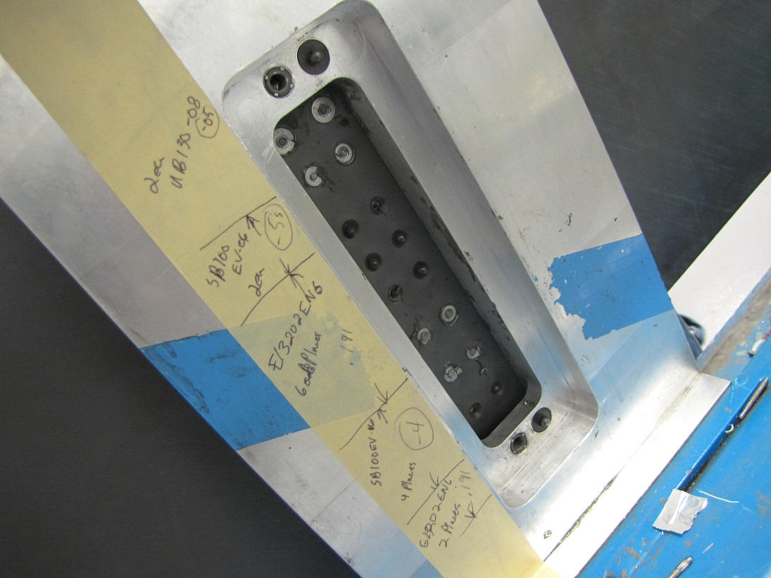
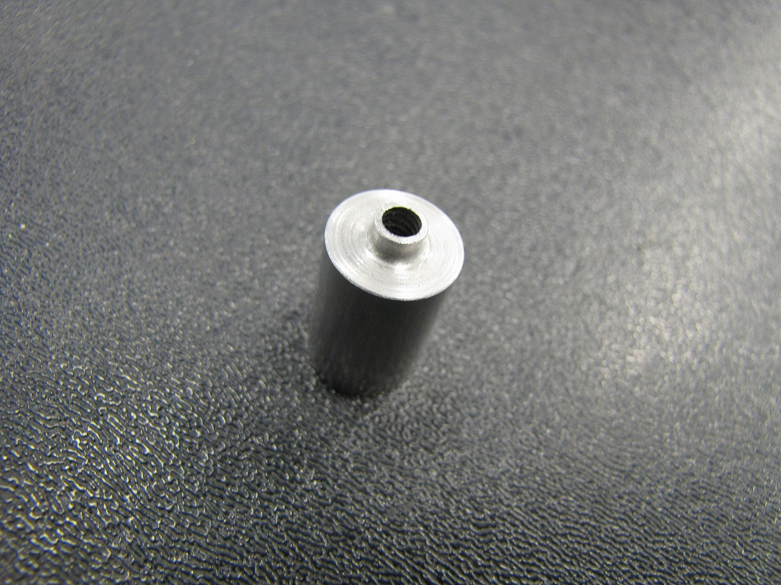
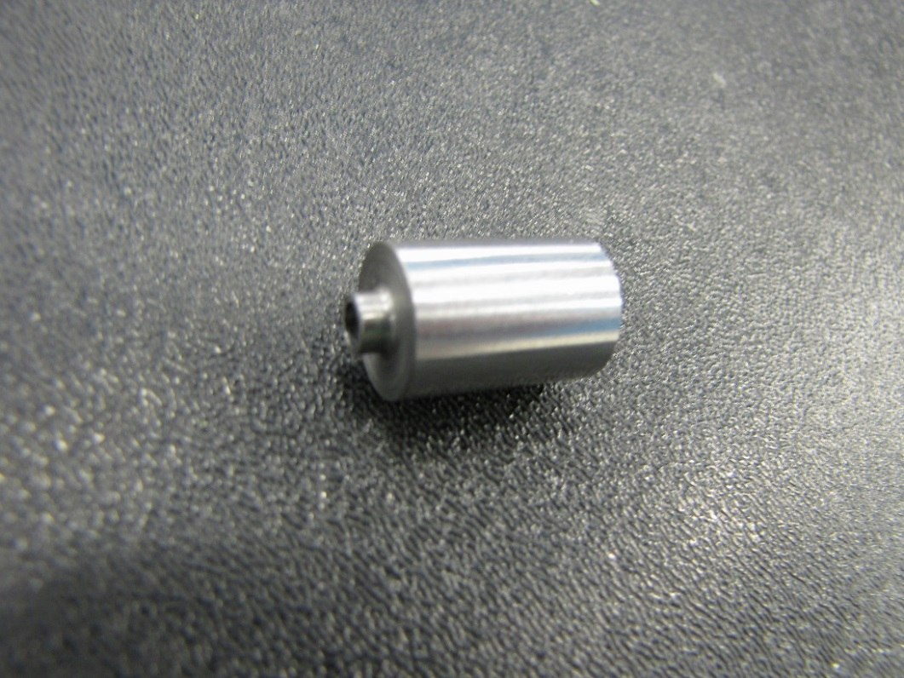

Slide 25
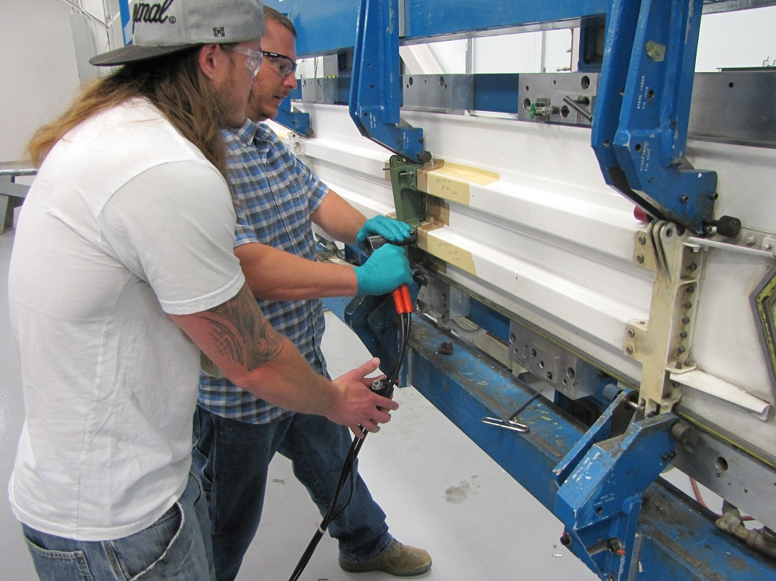
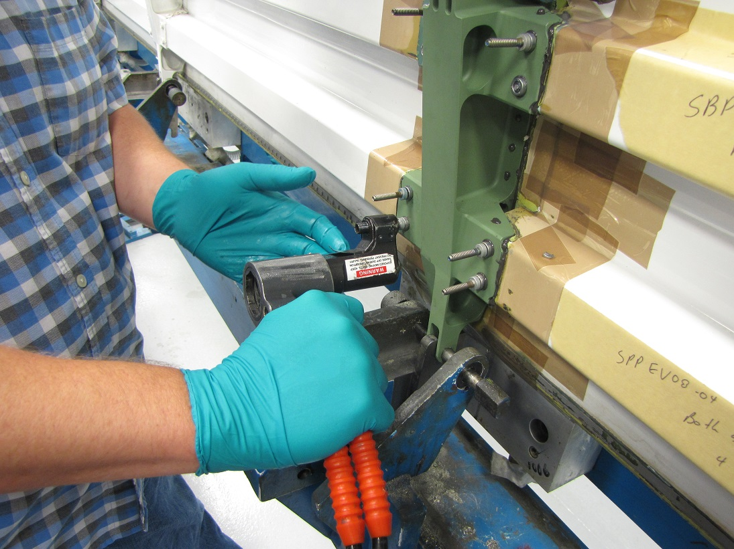

Slide 27
THE BENEFITS:
VERY ACCURATE HOLES DRILLED
ENABLES ANY MECHANIC TO LEARN TECHNIQUE
DROPPED DRILL TIME BY 30 MAN HOURS PER FITTING $$$
SPENDING MORE TIME WITH ENGINEER BUDDIES!!

Slide 28
QUESTIONS?

