Slide 1
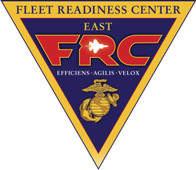
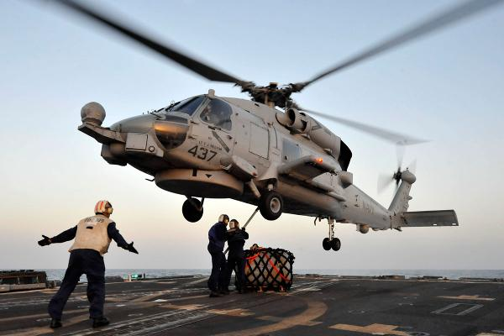
Shipboard Composite Repair Challenges
Mo Khalil
CH-53K Airframe Engineer
ISSC MCAS Cherry Point
FRC EAST Release 100-2017 Distribution Statement A – “Approved for public release; distribution is unlimited”

Slide 2
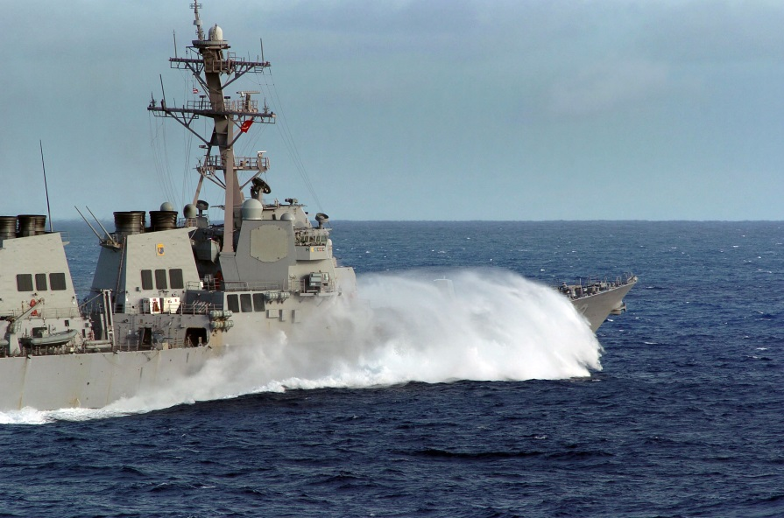
Shipboard Composite Repair Challenges
Based on engineering investigations, meetings and correspondence with maintainers and SME’s, and aircraft components damage repaired at FRC East, shipboard composite maintenance and repair faces a unique set of challenges due to:
Operating Environment
Operational Tempo
Limited Space
Flight and Landing Loads
Distribution A

Slide 3
Shipboard Composite Repair Challenges
Operating environment:
Encourages corrosion of both dynamic components (rotor blades) and airframe
Rotor blade replacement is a lengthy process
Most blade repairs are performed off aircraft
Airframe components are difficult to replace
Airframe repairs have more variables than standard dynamic components repairs
Drives more scheduled inspections to limit corrosion
Fleet aversion
Increasingly difficult due to size and number of composite panels
Distribution A

Slide 4
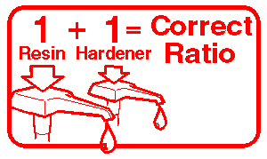
Shipboard Composite Repair Challenges
Operational tempo:
Limited number of shipboard aircraft
Requires short TAT for repairs
Results in “inventive” repairs
Remove and replace instead of repair creates a self-feeding cost problem
Distribution A

Slide 5
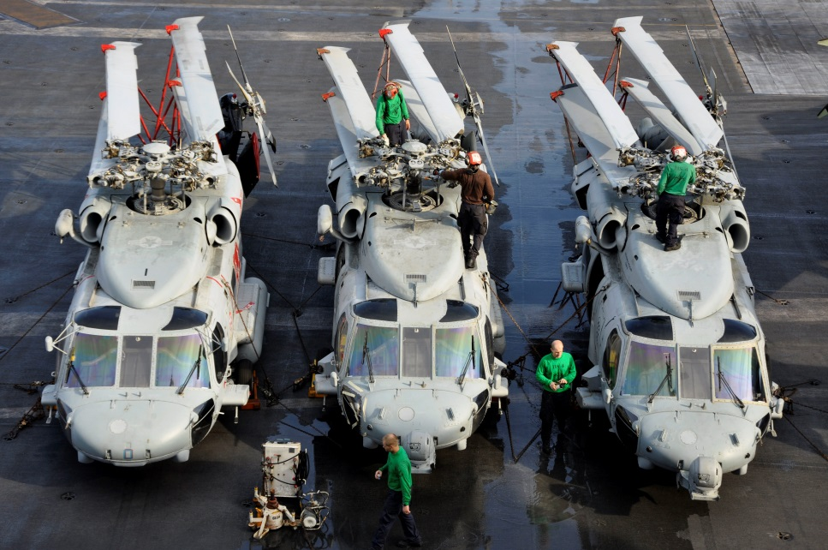
Shipboard Composite Repair Challenges
Limited Space:
Large impact on Pack Up Kits (PUK’s)
Limited storage space for Support Equipment
Limited storage space for materials
Increased potential of maintenance induced damage
Distribution A

Slide 6
Shipboard Composite Repair Challenges
Flight and Landing Loads:
Higher landing loads and increased potential for hard landing
Composite materials are more difficult to inspect
Interpretation of inspection limits can be subjective
STOVL/VSTOL exhaust configuration in fixed wing aircraft and prolonged hover of rotary wing induce airframe damage
Distribution A

Slide 7
Shipboard Composite Repair Challenges
Questions?
Distribution A

