Slide 1



Slide 2




The Hexagon Advantage
Shaping smart change with
information technologies

Slide 3


We are an
INFORMATION
TECHNOLOGY company
We believe in pushing the boundaries of innovation, enabling customers to
with information technologies that improve productivity and quality.

Slide 4

At Hexagon,
2054: Population
to reach 9 billion
Equal to a new
city every 5 days
means:
Middle-class purchasing power to triple
Viewing global challenges as a source of innovation and growth
Proactively and positively shaping business and industry landscapes in support of a sustainable future
Doing so while increasing your bottom line and competitive edge
Innovations increase
manufacturing demand
Emerging markets to
witness highest growth

Slide 5




Solution overview
Our solutions are concentrated in two application areas, with customers benefitting from our entire technology portfolio
Geospatial Enterprise
Solutions (GES)
Industrial Enterprise
Solutions (IES)
50%
of sales
50%
of sales
Sensors that capture the world
around us from land, sea, air and (fix) space
Software to understand and act
upon geo-referenced data
Sensors and software that
optimize manufacturing processes
and throughput
Software to design, construct and operate
industrial plants and offshore facilities

Slide 6

Fast facts about our Geospatial Enterprise Solutions
Industries Served
Core Technologies
Sales
Surveying
Infrastructure/construction
Safety
Mining
Agriculture
Defence
GIS (geographic information systems)
Mapping and 3D modelling
Surveying, scanning and monitoring
Positioning
Analytics
Machine control
Computer-aided dispatch
Decision-support software
1.6bn EUR (50% of total)
Software and services (%)
Direct sales (%)
Recurring revenues (%)
Emerging markets (%)

Slide 7

Fast facts about our Industrial Enterprise Solutions
Industries Served
Core Technologies
Sales
  Automotive
  Aerospace
  Chemical
  Consumer goods
  Medical devices
Metals and mining
Oil and gas
Power
Shipbuilding
Pharmaceutical
  CMMs (coordinate measuring machines)
  Optical and portable scanners
  Industrial metrology software
  CAD (computer-aided design) software
  CAM (computer-aided manufacturing) software
  Life cycle engineering software
1.6bn EUR (50% of total)
Software and services (%)
Direct sales (%)
Recurring revenues (%)
Emerging markets (%)

Slide 8
R&D – an integral part of our business strategy
HEXAGON
Geospatial
Enterprise R&D
Industrial
Enterprise R&D
INNOVATION HUB
  Investing more resources than peers in R&D:
  10-12%
  3,400+
  3,200+
  Of Net Sales invested in R&D
  Employees in R&D
  Active Patents

Slide 9



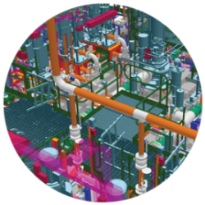
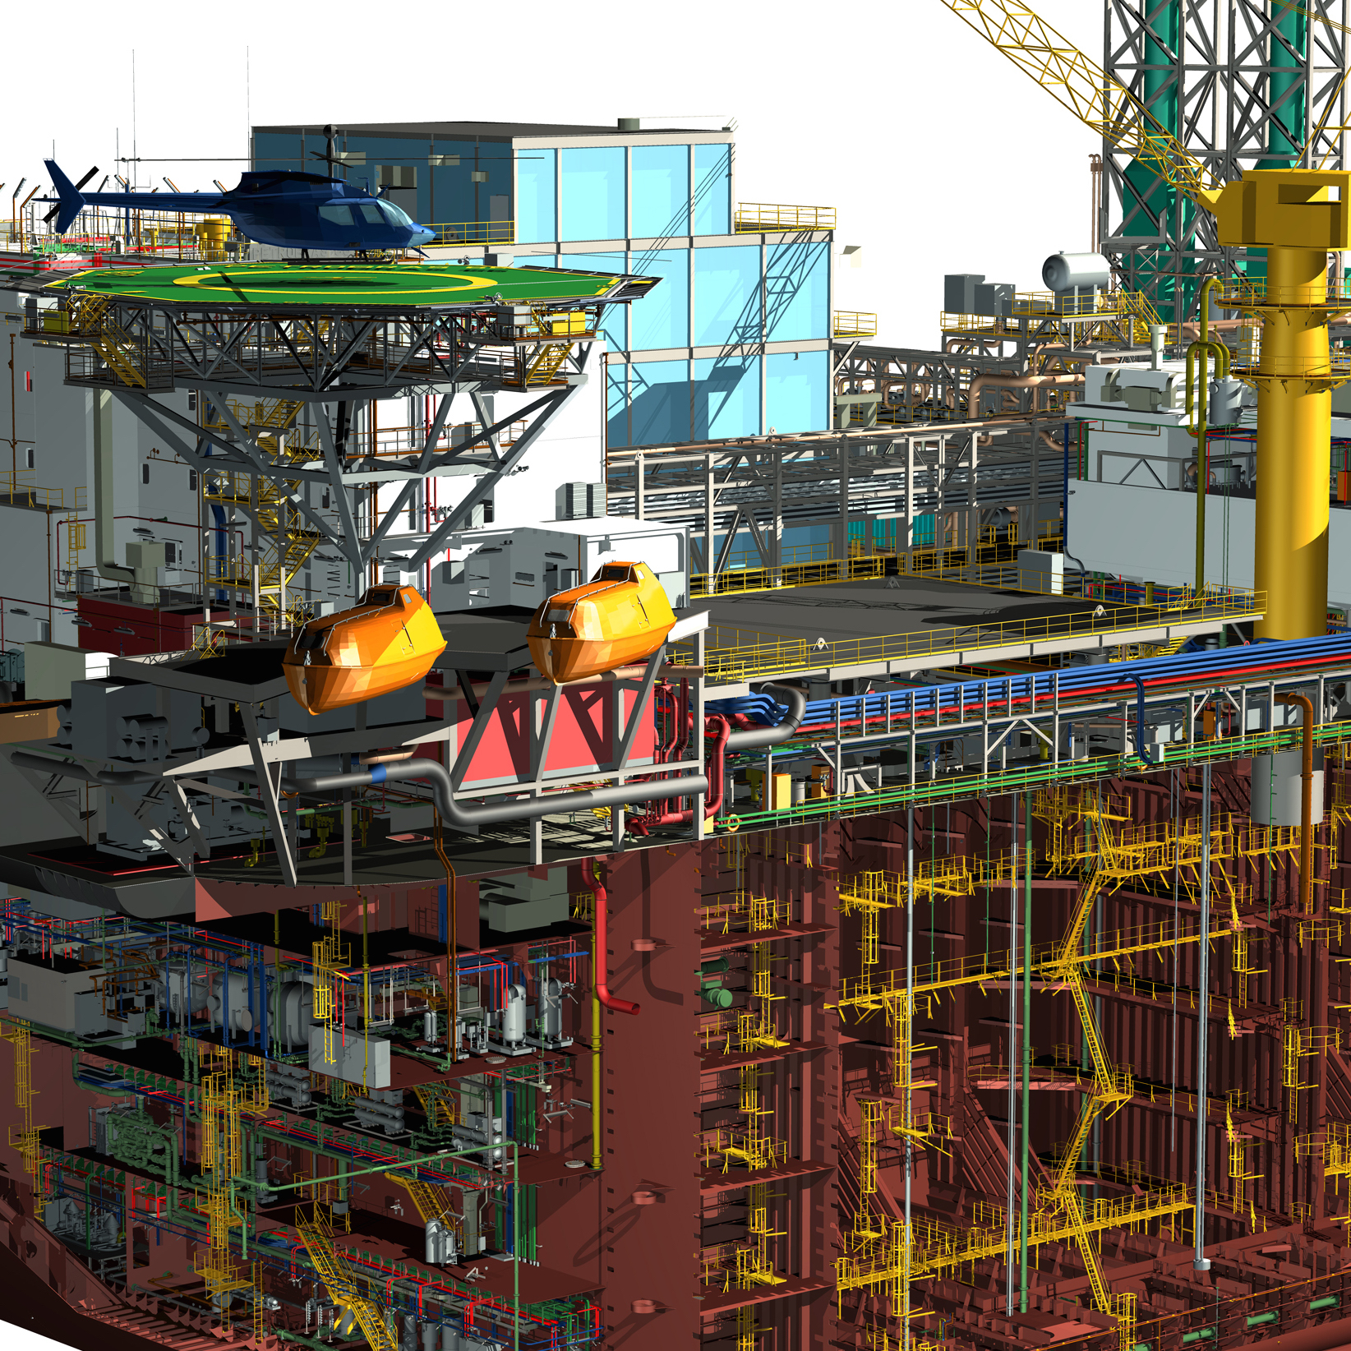



Information technologies
SENSORS
Fuelled by
information, Hexagon’s
information technologies are a driving force behind many of the transformative solutions shaping
our future
SOFTWARE

Slide 10


Fusing the real and digital worlds
SENSORS
Fusing the real and
digital worlds delivers dynamic data and actionable information
DIGITAL
World
ACTION
(as-planned/as-designed)
CAPTURE
(as-is/as-built)
REAL
World
SOFTWARE

Slide 11





Hexagon at a glance
Technology Solutions Provider
Established leader in information technologies
Solutions drive productivity and quality improvements
R&D Focused
10-12% of net sales invested in R&D
3,400+ employees in R&D
3,200+ active patents
Global Reach
Broad range of vital industries served
Approximately 18,000 employees in 50 countries
Strong Financials
3.1 bn EUR in sales
23.4% operating margin

Slide 12











Our businesses
Geospatial Enterprise Solutions
Industrial Enterprise Solutions
GEOSYSTEMS
Reality-capture solutions used to record distance, monitor movement, guide machines, capture Earth images and create 3D models of landscapes, infrastructure or entire cities
POSITIONING INTELLIGENCE
Satellite positioning and correction solutions for land, sea and air
AGRICULTURE
Smart agriculture solutions for automating and improving crop planning and resource utilization for optimum yield
GEOSPATIAL
LANDSCAPE
MANUFACTURING
LANDSCAPE
ENGINEERING
LANDSCAPE
GEOSPATIAL
Geospatial data management solutions that leverage the power
of mapping to enable a holistic understanding of change
MINING
Integrated, digital mine solutions for smarter, safer, more productive mines
MANUFACTURING INTELLIGENCE
PROCESS, POWER & MARINE
Manufacturing solutions that integrate sensing, thinking and acting capabilities – from people to machines – where quality drives productivity
Enterprise engineering software solutions that enable smarter design, build and operation of large-scale construction
SAFETY & INFRASTRUCTURE
Geospatial-based solutions that streamline operations, accelerate information ﬂows, and optimize resources
Notes:
12

Slide 13



HEXAGON
MANUFACTURING INTELLIGENCE

Slide 14














Evolving through brands AND technology
Entered the industry,
investment in software
Good, better, best approach; more portable technologies
Articulated arms added
to the portfolio
Multisensor
production software
Manufacturing Intelligence
2014-2017
2009-2013
2005-2008
2002-2004
2001

Slide 15














Advanced technology Solutions for the smart factory
Hardware
Coordinate
Measuring
Machines
Sensors
and Machine
Tool Probes
Portable
Measuring
Arms
Laser
Trackers
and Stations
White Light
scanners
Automated
Applications
Micrometers,
Calipers
and Gauges
Software
Services
Metrology
Software
Solutions
CAD / CAM
Statistical
Process
Control
Design and
Costing
Software
CAE
Workflow
and Data
Management
Services

Slide 16







Truly global and innovation-focused – 2016 Figures
North America
27%
Sales
Western Europe
29%
Sales
China
29%
Sales
Eastern Europe,
Middle East, Africa
6%
Sales
1500+ software
developers and engineers
500,000+ Software Licenses installed
Asia Pacific
(except China)
8%
Sales
11% of net sales
invested in R&D
Central and South
America
1%
Sales
Reached €1.1bn+
Net sales in LTM
~6000
employees
Customers and demo centres
Production facilities

Slide 17






Balanced revenue footprint across segments
Automotive
Aerospace
Electronics
Heavy Machinery
Precision Industry
Others
Our wide portfolio allows us to be competitive across industries
Bringing external expertise to develop further verticals
Electronics becoming more relevant last 2 years
Recent acquisitions enabling us to start to close loops in key verticals

Slide 18

































LARGE CUSTOMER BASE WITH A GLOBAL FOOTPRINT
Well capitalised blue chip companies with over 100,000 employees to small machine shops with only 50 employees and everything in-between benefit from Hexagon’s products
If you want to produce complex parts you need manufacturing quality
AUTOMOTIVE
AEROSPACE
ELECTRONICS
MEDICAL
MACHINERY

Slide 19

WHAT IS MANUFACTURING INTELLIGENCE?
Manufacturing intelligence is the software to bring a corporation's manufacturing data together from many sources for reporting, analysis and communication between enterprise-level and plant-floor systems.
Its primary goal is to turn large amounts of manufacturing data into real knowledge, hence driving business productivity.
Notes:
THIS is manufacturing intelligence

Slide 20
THANK YOU
HexagonMI.com

Slide 21
DISCLAIMER
This presentation contains forward-looking statements. These forward-looking statements reflect the views of Hexagon's management as of the date of this presentation. The forward looking statements may involve risks and uncertainties, including technological advances in the measurement field, product demand and market acceptance, the effect of economic conditions, the impact of competitive products and pricing, foreign currency exchange rates and other risks. Please read our earnings reports and our most recent annual report for a better understanding of these risks and uncertainties. All of these forward-looking statements are based on estimates and assumptions made by Hexagon's management and are believed to be reasonable, but are inherently uncertain and difficult to predict. Actual results or experience could differ materially from the forward-looking statements. Hexagon disclaims any intention or obligation to update these forward-looking statements. It should also be noted that past performance is not a guide to future performance and that interim results are not necessarily indicative of the full year results.
THIS COMMUNICATION DOES NOT CONTAIN AN OFFER OF SECURITIES IN THE UNITED STATES OR ANY OTHER JURISDICTION; SECURITIES MAY NOT BE OFFERED OR SOLD IN THE UNITED STATES ABSENT REGISTRATION OR EXEMPTION FROM REGISTRATION, AND ANY PUBLIC OFFERING OF SECURITIES TO BE MADE IN THE UNITED STATES OR ANY OTHER JURISDICTION WILL BE MADE BY MEANS OF FORMALLY DRAWN UP AND APPROVED PROSPECTUS.

