Slide 1


Presented to:
DoD Composite Maintainers TIM
US Army Advanced Composite Repair Standardization
Distribution Statement A- Approved for Public Release – Distribution Unlimited
Kristina Marshall
Materials Engineer
Dave Stone
Lead Materials Engineer
June 2016
Aviation Engineering Directorate
Aviation and Missile Research, Development and Engineering Center

Slide 2
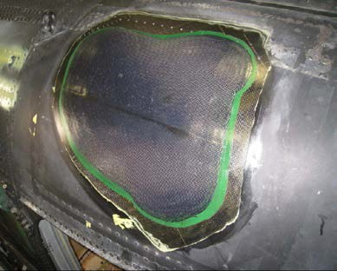
The Challenge
When Comanche was cancelled, advanced composite repair implementation was stopped
Programs fielded carbon fiber composite primary airframe structure without the resources to repair it
  Most components were remove & replace. Supply could not keep up.
  Vehicle/handling impacts easily damaged parts
Maintainers conducted unauthorized repairs with unauthorized materials
Maintainers had limited training & experience on advanced composite repair processes
Tools & equipment for advanced composite repairs were not available
Need new manuals
OEMs provided unique repairs for each component on the aircraft, especially between rotor blades and fuselage structure
DVD repair using factory process

Slide 3
What Really Matters
In Composite Repair
The technician, whether in the field, at depot, or in the factory, performing the repair is the “Material Manufacturer.” The competence of the technician has a direct impact on the strength of the repair and ultimately airworthiness.
Regardless of aircraft, all field repairs fall on the same soldier, 15G MOS. CCAD will likely see all of these aircraft as well.

Slide 4
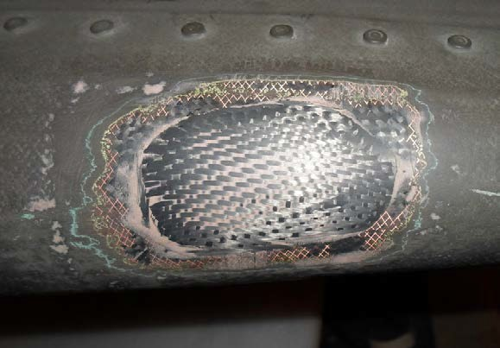
Benefits of Common Composite Repair
Repair materials availability
  Reduced supply chain
Consistent repairs
  Easier to train technicians
  Less downtime to rework repairs because procedures are consistent
Faster repairs
– Using hot bonders cuts repair time to hours instead of days with current room temperature curing resins
Repair of stabilator tip cap with unauthorized UAV materials by deployed unit
Lower costs
Standard repair materials reduce the number of qualification tests
Fewer spares required because units can repair structure at the lowest level
Better aircraft availability because aircraft are not having to be sent to higher level for repairs
More parts can be kept in service by better quality/lighter weight repairs
Fewer tools each program has to purchase

Slide 5
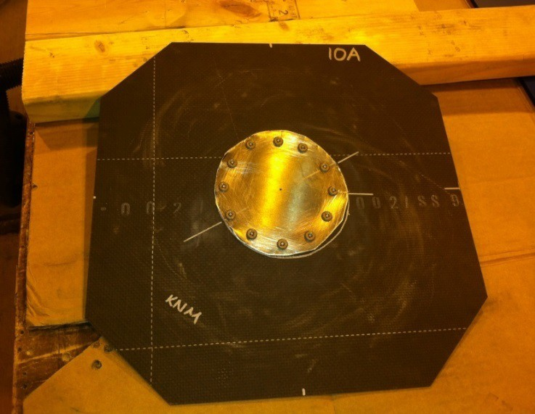
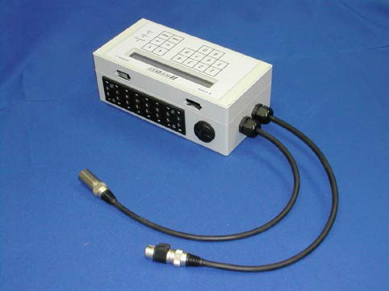
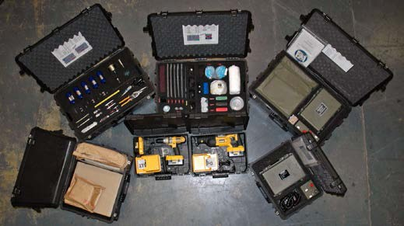
BDAR Repair
Must be man portable
No power to operate a hot bonder
No compressed air or vacuum
Phase 1 kit in production for existing blades and
secondary composite structure
Phase 2 kit being developed for carbon fiber primary structure
– Mechanically fastened metallic patches to meeting 45 minute repair requirement
BDAR Test Panel
Prototype battery powered hot bonder
Composite BDAR Kit

Slide 6
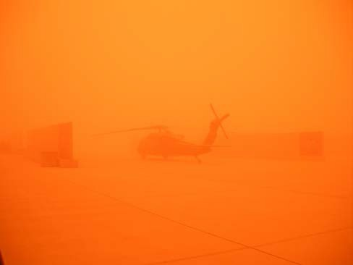
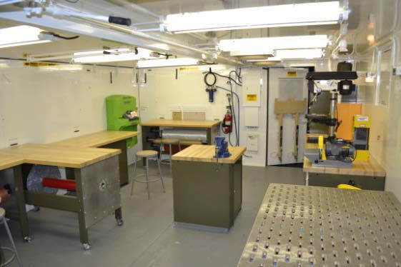
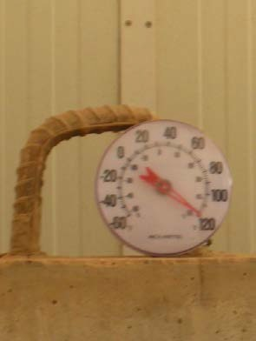
Field Repair
No refrigeration storage for prepregs
Must use wet lay-up/hot bonder repairs
  Repairs are stronger and done faster than current repair methods
No hangars available
Crews report that they catch up on maintenance during sandstorms.
Inside of the composite SPAM
Long pot life adhesives are necessary when the temperature in the shade is this hot.

Slide 7
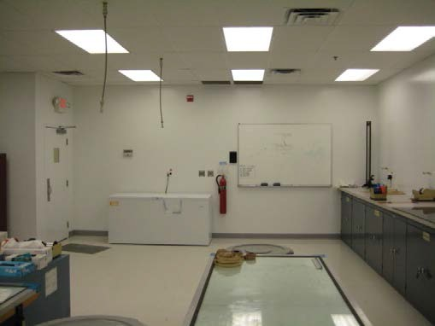
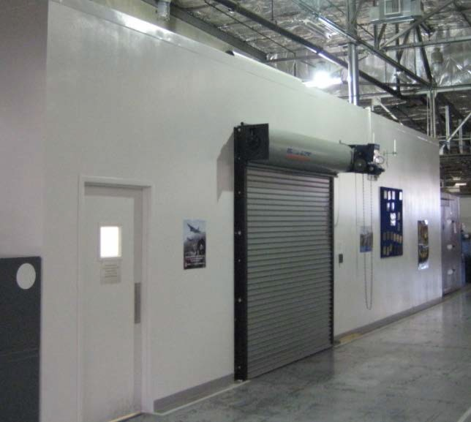
Facilities
Depot facilities must be equivalent to OEMs
CCAD is upgrading their airframe and blade shops
ALMD, TASMG, & other CONUS units may get more repairs done faster with a dedicated facility
Required to use prepregs and film adhesives
All repairs will be elevated temperature cure (autoclave or out of autoclave)
Composite Facilities White Paper provides a summary of requirements
  Develop equivalent CCAD facility spec
Air Force Advanced Composites Office clean room at Hill AFB
Field repairs are based on the Shelter Protective Aircraft Maintenance (SPAM)
– Limited environmental controls (A/C & filtering)

Slide 8
Materials
Developed list of standard repair materials for composite parts
  Minimize the number of materials, tools & processes across parts and aircraft
  Extensively leveraging existing Air Force, Navy, & FAA experience
Field
  IM7 plain weave carbon fiber fabric at 196 g/m²
  7781 fiberglass
  Skin/plug patches for all blades
  Hysol 9396 laminating resin
  Paste Adhesives: High viscosity (EA9394), Low viscosity (EA9359.3NA high or EA9309.3NA)
  Potting Compounds: Epocast 1633/1652
  Use bagging materials from composite shop set
Depot
  New thick components make wet layup repair impractical
  Prepregs/film adhesive allow lighter/larger repairs
  Preferably a single carbon & a single glass prepreg for all depot repairs.
    Materials have short shelf lives and large minimum purchases. CCAD already has freezers for frozen materials.

Slide 9
Processes
TM 1-1500-204-23-11 Advanced Composite Material General Maintenance and Practices for field repairs
  Leveraged TO 1-1-690 and NAVAIR 1-1A-21 and adapted for Army operational and logistics considerations
  Published August 2013
Advanced Composite DMWR for depot use seeking funding
  Will cover processes not covered in 204-23-11 such as ovens, autoclaves,
& large scale NDI equipment
Leverage updated carbon & glass work packages for fuselage structure (stabilators) and blades (plug patches, etc) across all platforms. Use for both primary & secondary structure
  Both wet lay-up/paste adhesive field and prepreg/film adhesive depot repairs
  Have standard carbon/epoxy wet layup, glass/epoxy wet layup, and secondarily bonded precured patch procedures to adapt for specific repairs
  Use Composite Shop Set tools for field repairs

Slide 10
Training
Maintainers have limited training & experience on advanced composite repair processes
  2-210th initiated revised curriculum in June 2013. Up from 44 hours to 105 hours in Oct 2016
  PIF “seeded” the fleet with >250 15Gs trained from 2-210th & field units
Evaluating commercial certification of civilian composite repair technicians
  Upgrade CCAD training requirements. Proposed breakout includes
    Apprentice: Wet lay-up on secondary structure
    Journeyman: Prepreg/DVD repairs on highly loaded critical structure
    Advanced: Capable of rebuilding aircraft components
  Recurring training
Process proficiency requirements for DVD and other special process lends to creating those capabilities at depot or factory
LARs & OEM Field Service Engineers/Reps
Military instructors move in & out of the unit and may not have composite training
Working with platform PMs on advanced composite repair requirements

Slide 11
What’s Next
Common repair materials & processes across platforms to make it easier on the technician
  General composite repair manual should be the baseline for field repair procedures
  OEMs can customize for each component (# of plies & ply orientation)
Continue to use AMRDEC Prototype Integration Facility to provide interim repair capability until organic maintenance capabilities are established
Complete fielding the necessary tools and materials for repair
PEO Aviation Composite Repair IPT
SOWs need to include repair programs
  Can be during EMD, LRIP or full production
  Need to provide engineering substantiation
  Must provide part specific repair manuals
  Earlier is better. Substantiation can be addressed in original qualification effort

Slide 12
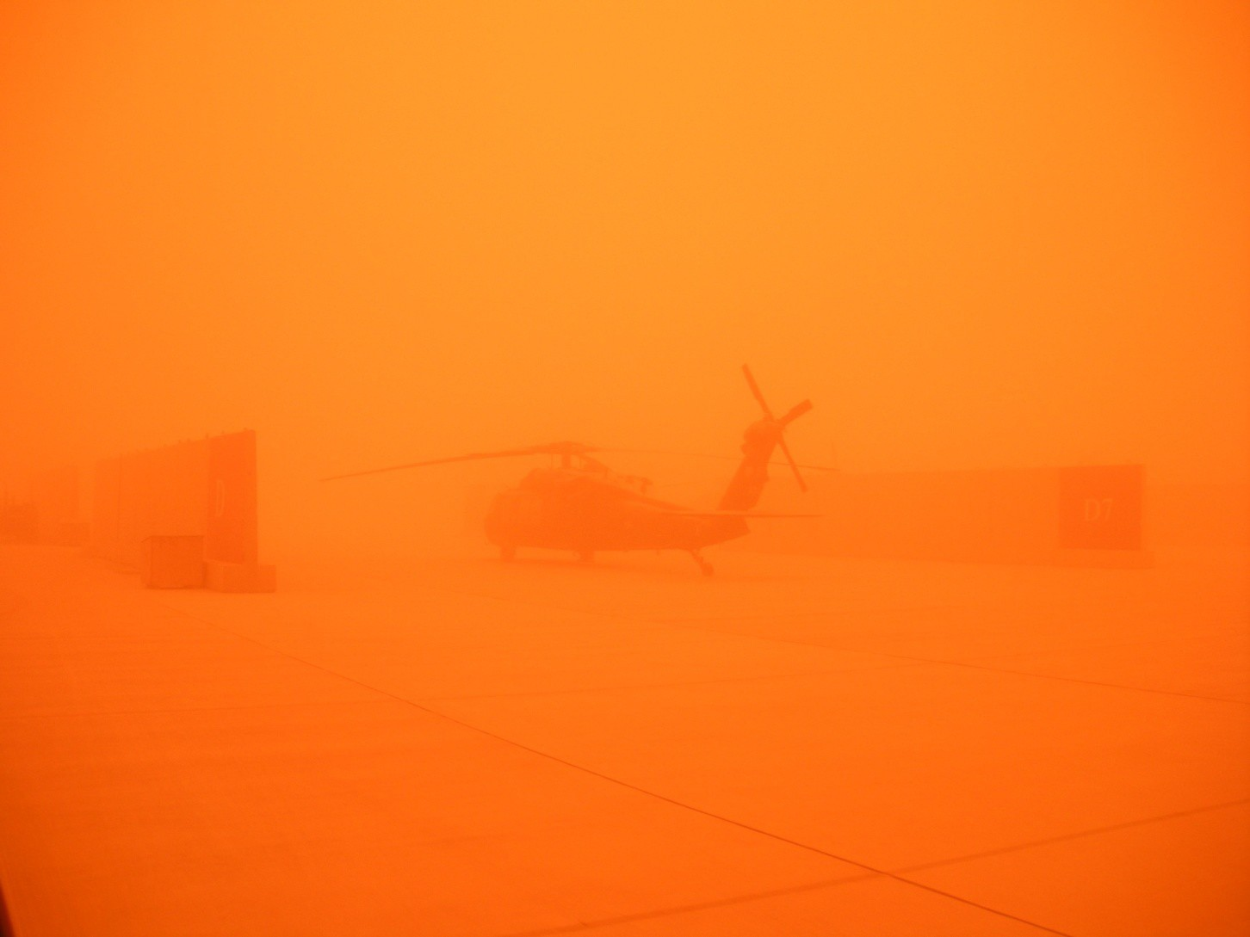
Questions?

