Slide 1
Transfer Molding to Facilitate Repairs
Splash Tooling

Slide 2
Daren Hislop F22-F35 Composites E&I 533 CMMXS, Hill Air Force Base

Slide 3
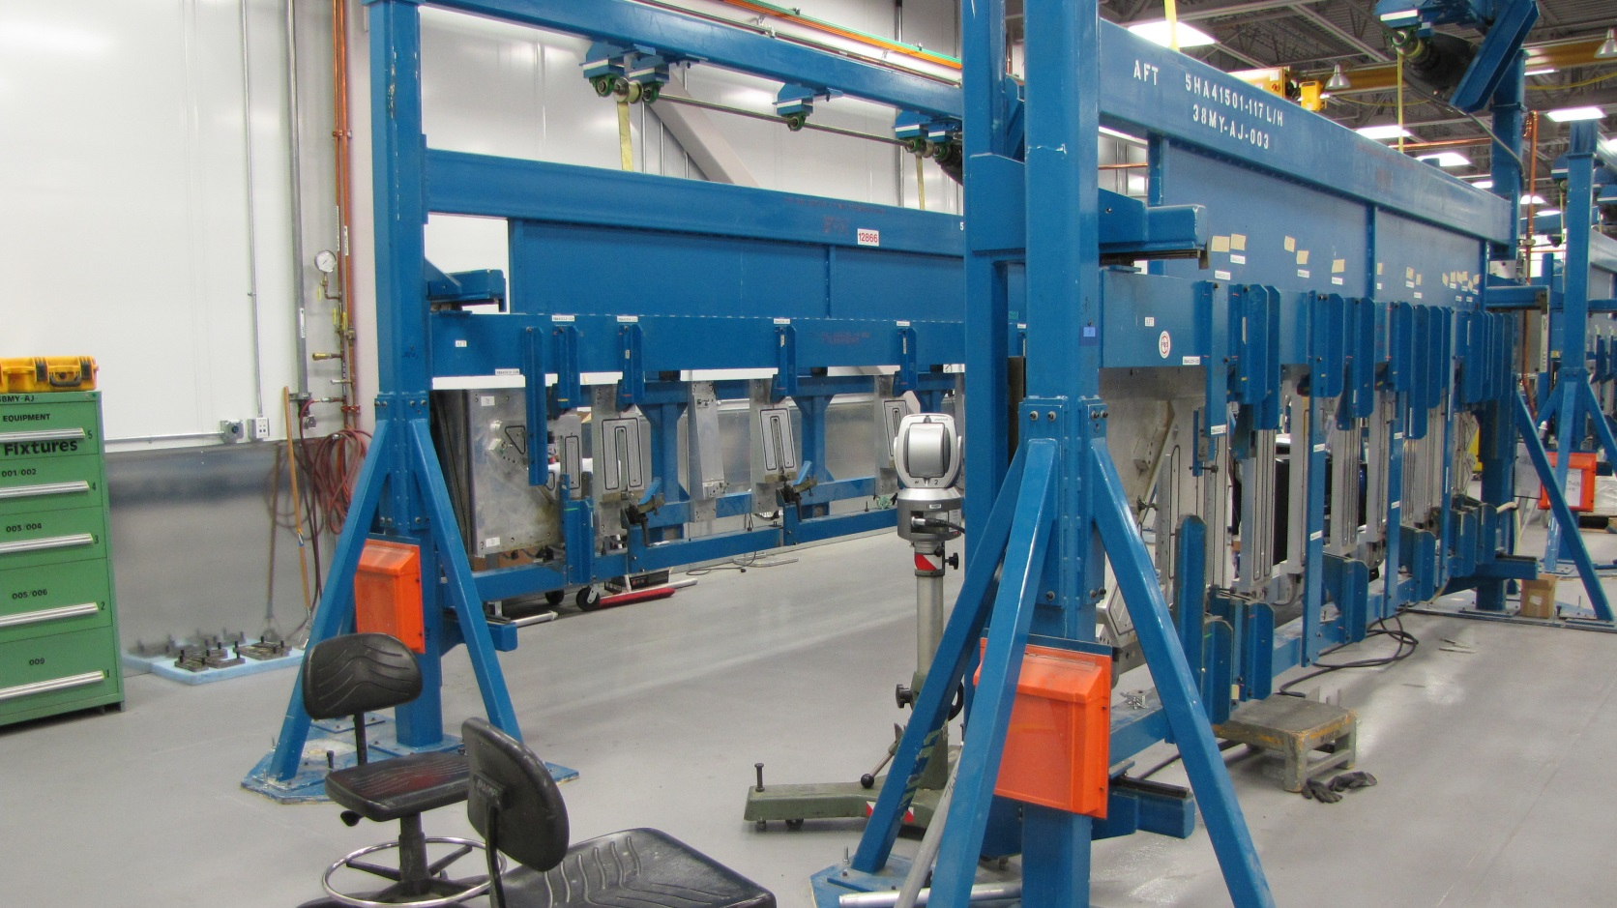
Complex Repairs Example of Hinge Fitting change
Main Weapons Bay Door Fitting removal and assembly fixtures

Slide 4
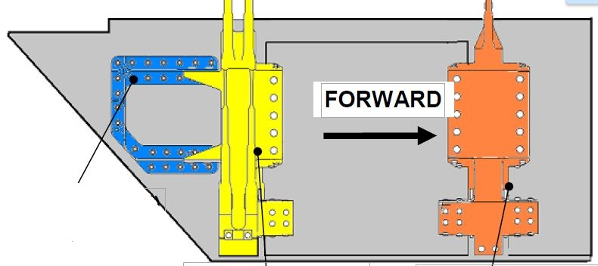
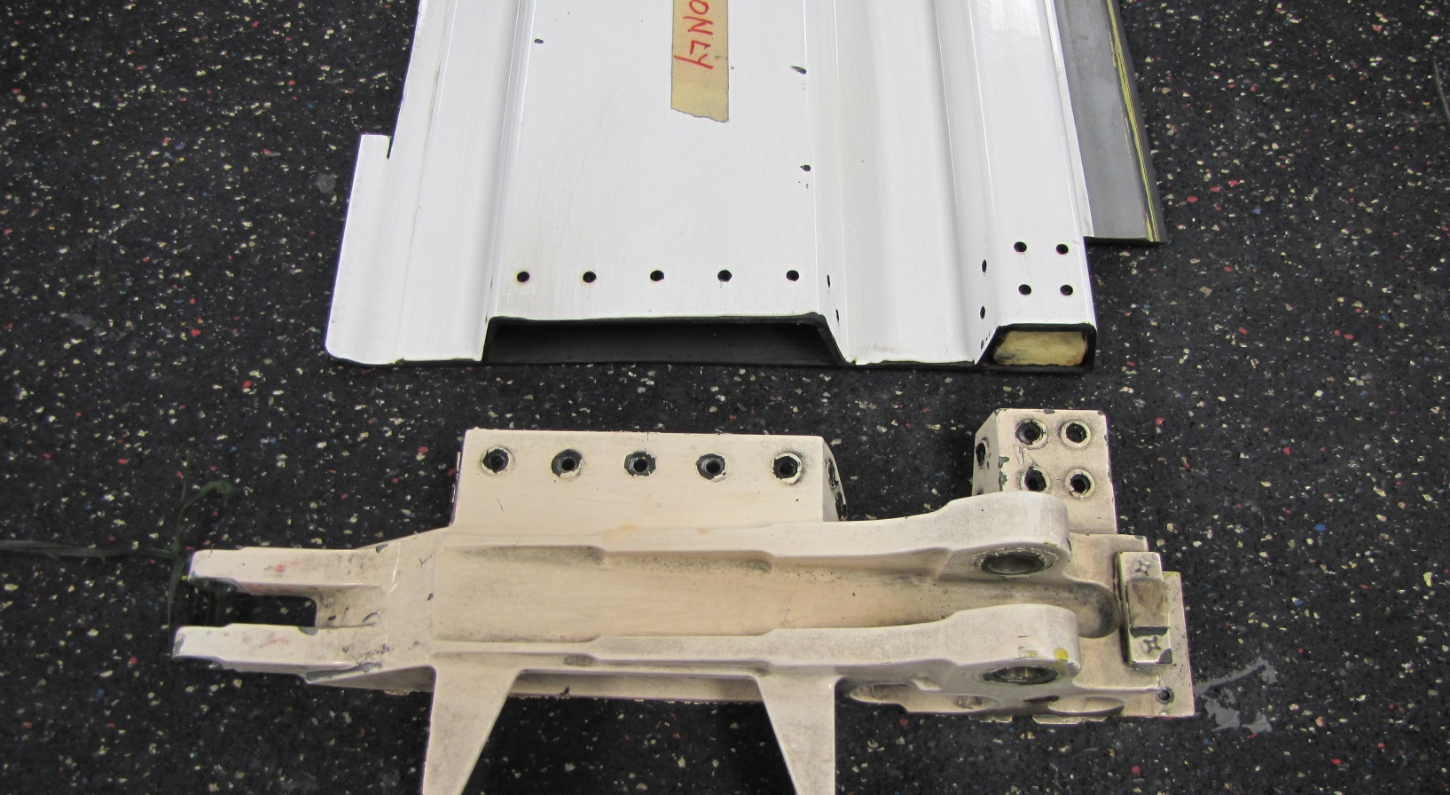
Damaged Hinge
Removing Hinge Fitting

Slide 5
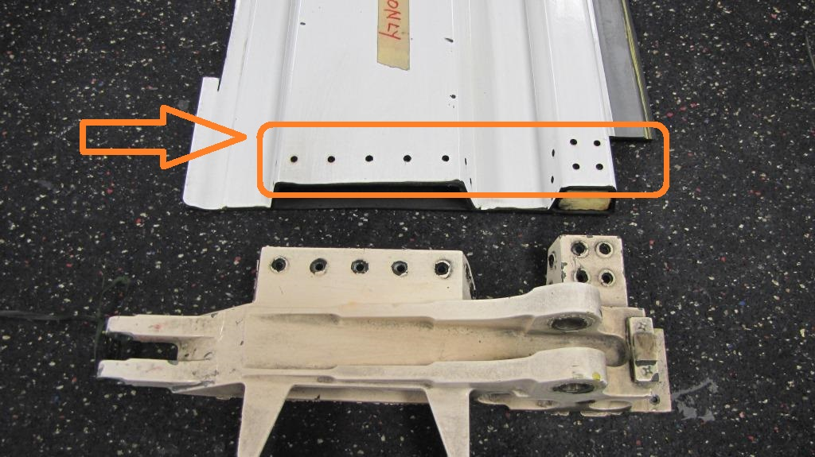
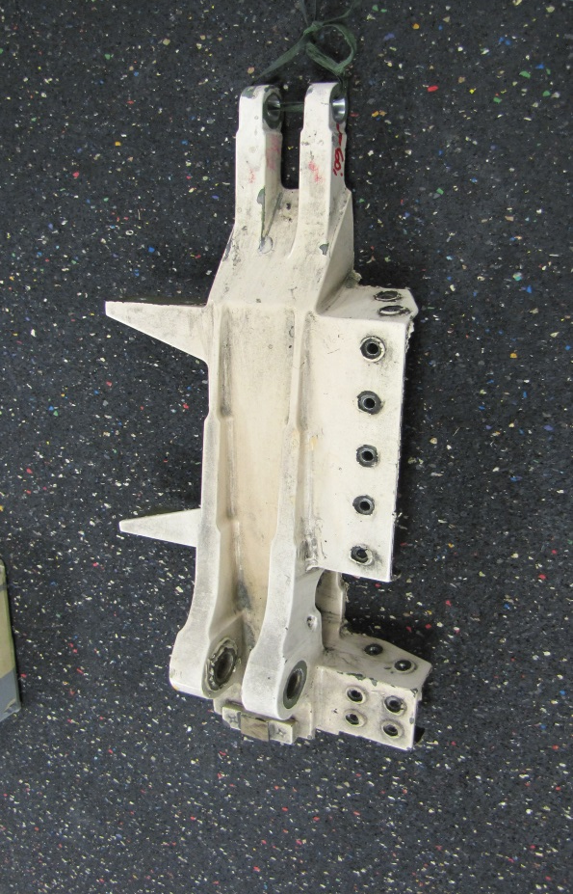
Engineering Procedures
Holes in the sub structure must be maintained.

Slide 6
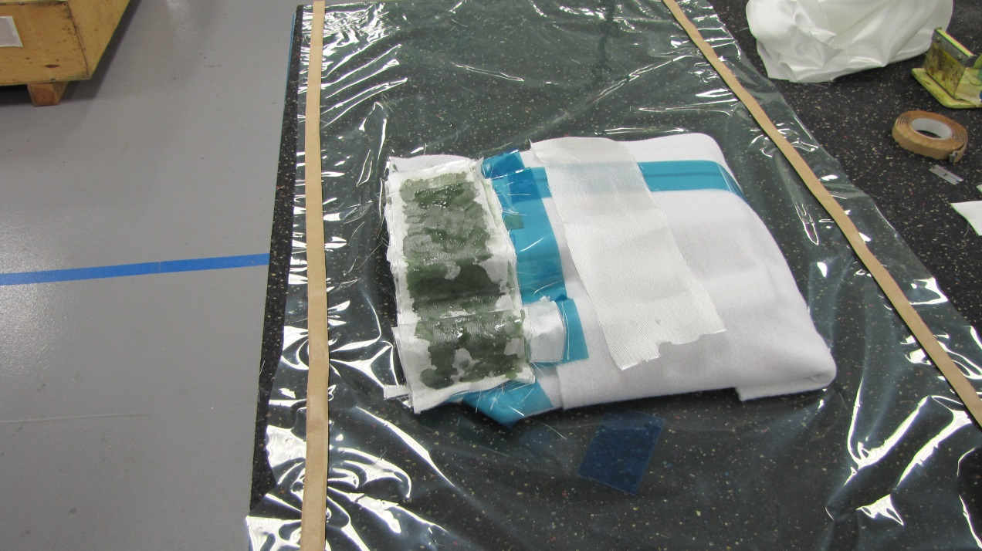
How to utilize Transfer Molding to capture hole locations with accuracy
Prepare substructure door with aluminum tape (dimple holes).
Wax/mold release area.
Wet layup any (low shrinkage) resin system and fibers approximately 1/8” thick

Slide 7
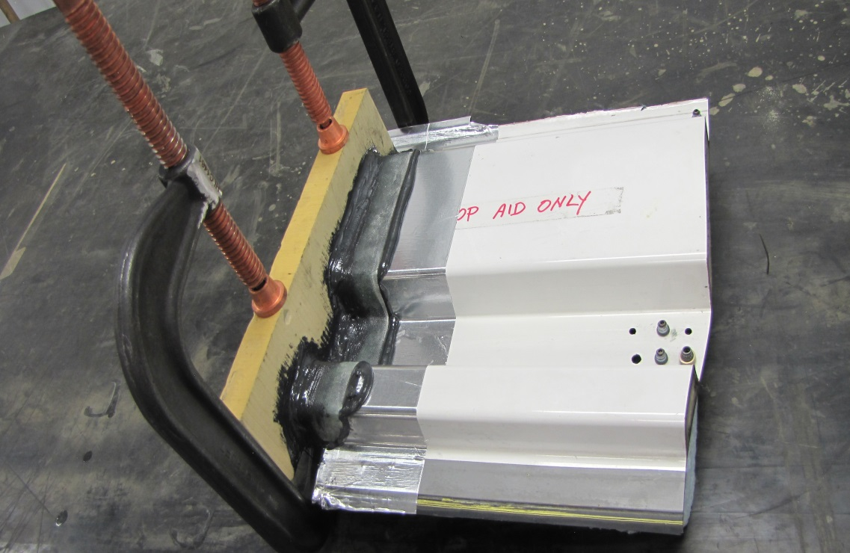
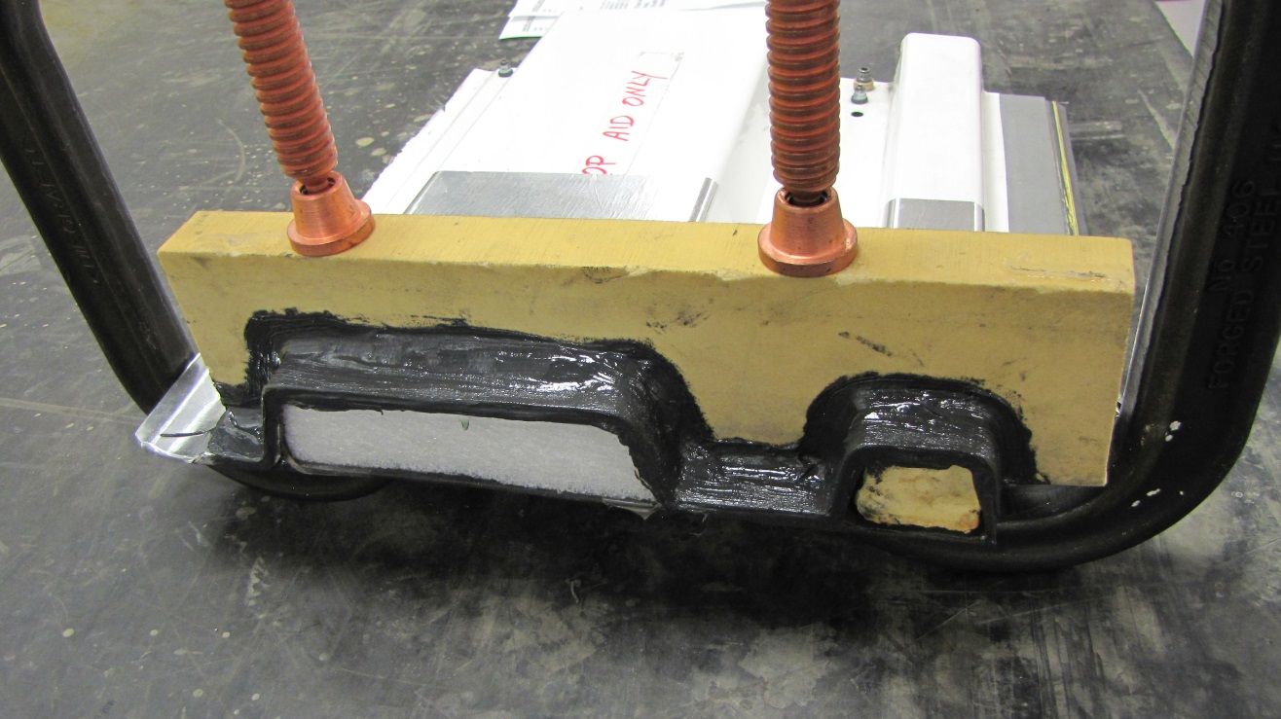
How to utilize Transfer Molding to capture hole locations with accuracy
Cut a stiffener (wood, hard foam, etc.) profile of door section.
Clamp bond stiffener in place.
This becomes a reusable profile tool for other doors.

Slide 8
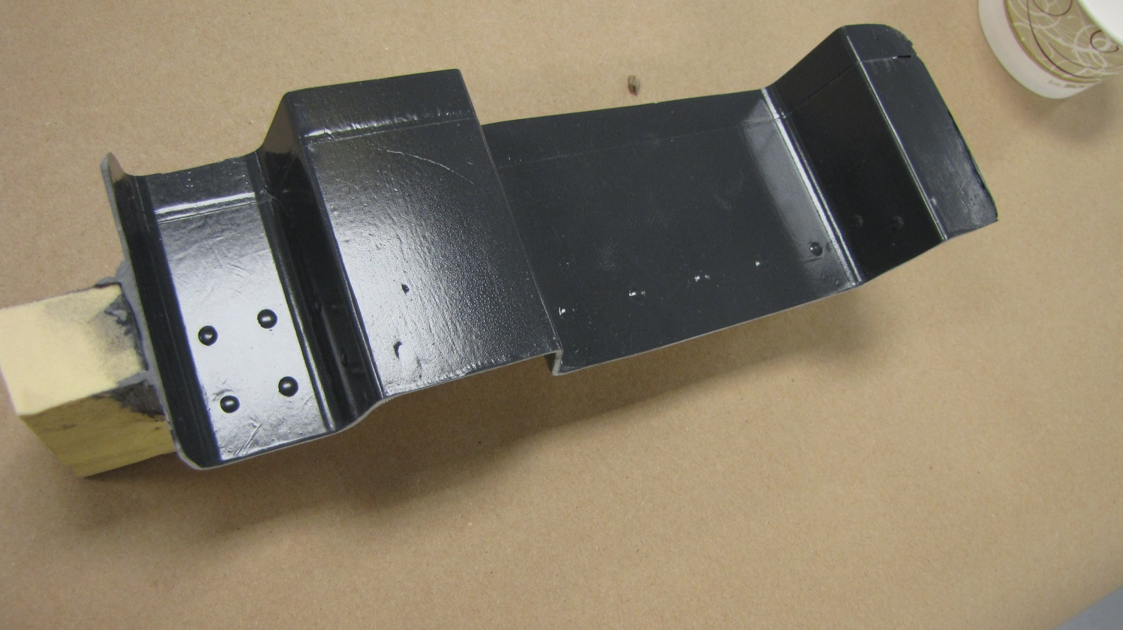
Transfer molding accuracy
Defined hole locations
Ready for drill template splash

Slide 9
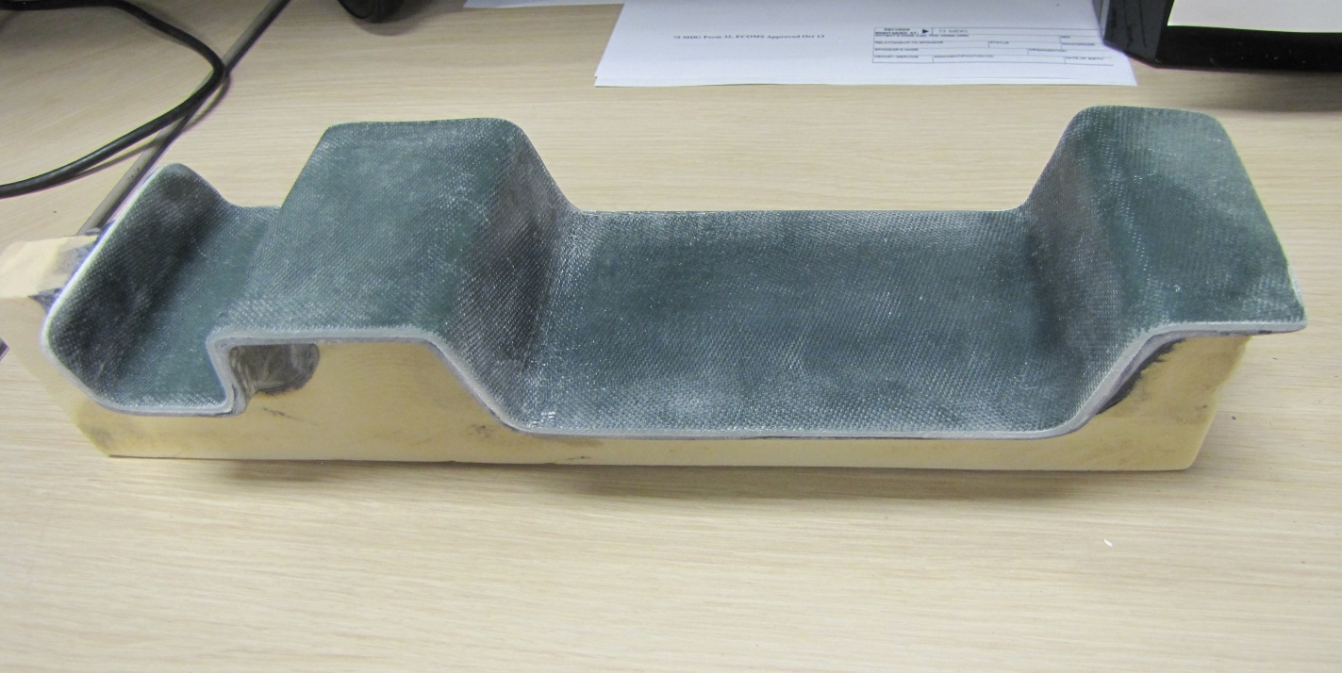
Layup of drill template
Can be open molded with (low shrink) resin fiber system
Layup approximately 1/8” thick
This will replicate door substructure holes and perimeter for drilling new hinge accurately.

Slide 10
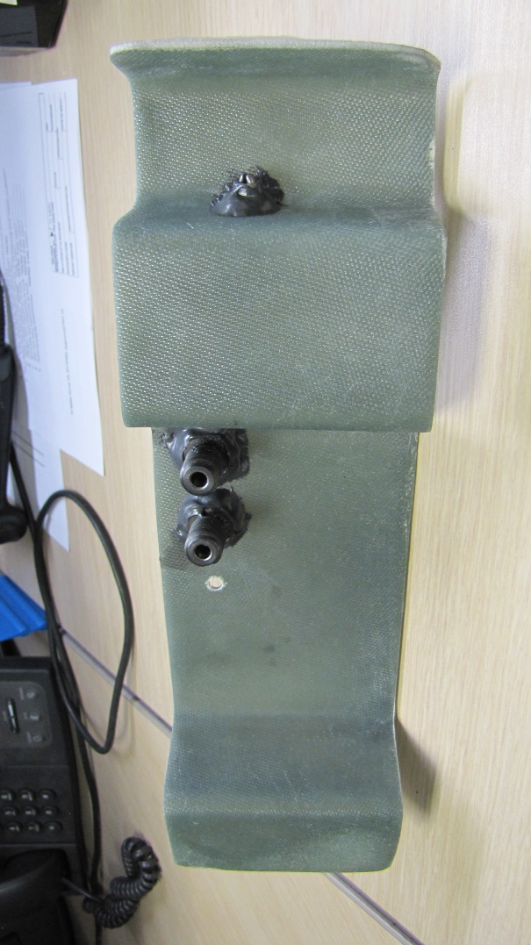
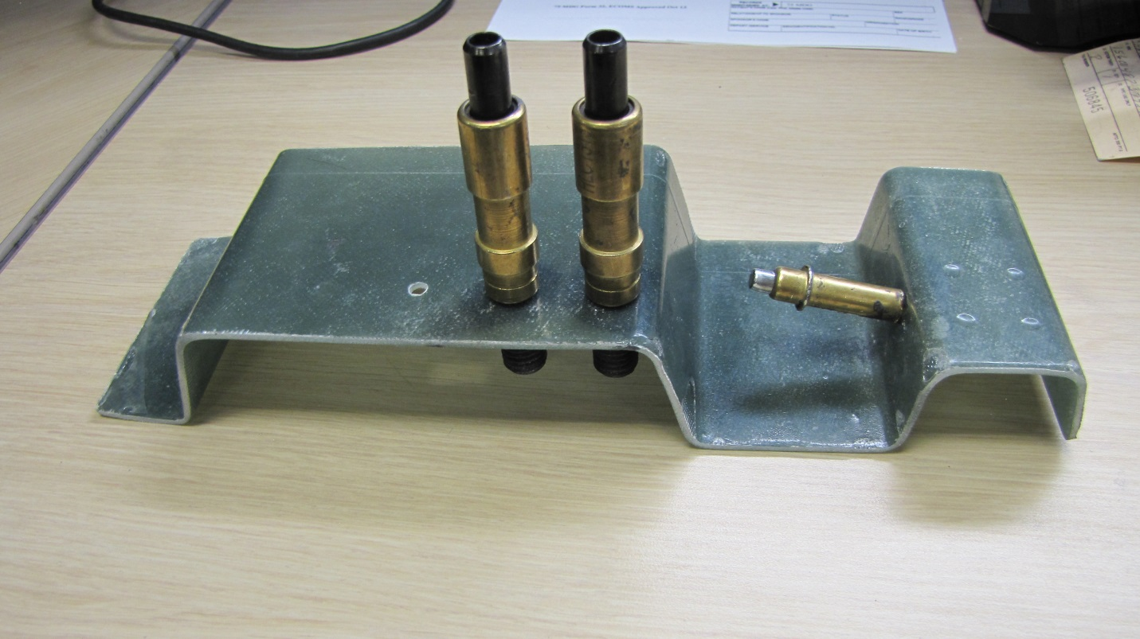
Bonding drill guides/Bushings
Allows accurate centering of drill angle and location
Drill bushings are removeable for next job

Slide 11
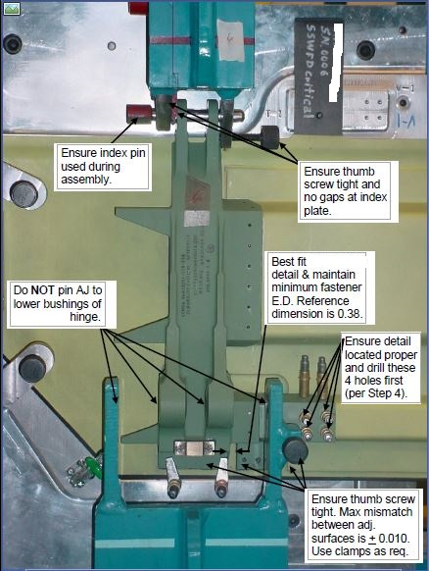
Locating new Hinge Fitting on Door as per Engineering specifications and Fixtures
Hinge can be liquid shimmed to the door in the locating fixture.
Forward and Aft Dimension of Hinge can be scored/marked on the door.

Slide 12
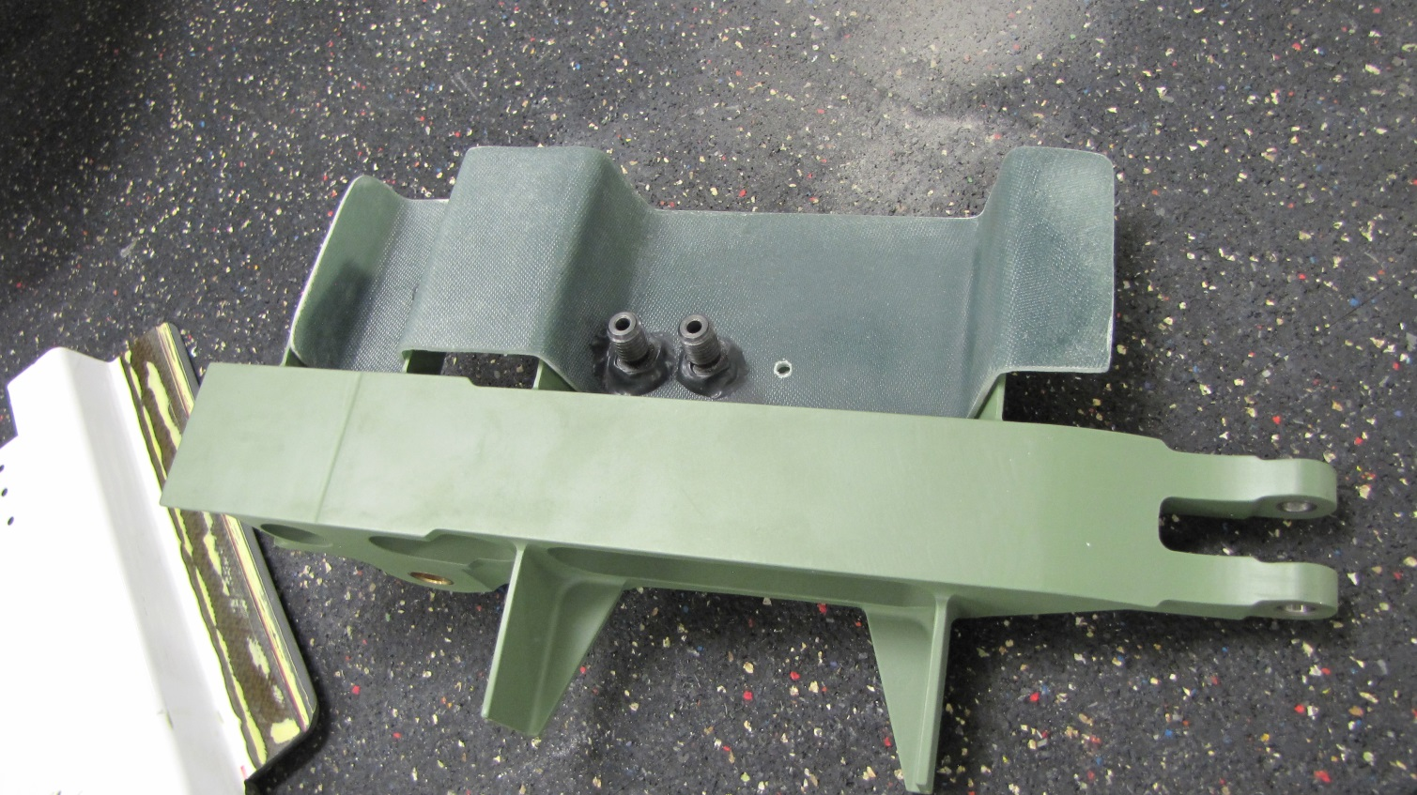
Drilling holes on Hinge
Hinge is now removed and composite template attached.
Final reaming to be done with new Hinge mounted on door.

Slide 13
Summary
Accurate simple replication of existing sub structure holes.
Consistent method of maintaining hole integrity.
Initial Transfer Molded stiffener is reusable for additional Hinge repairs.
Cost effective method, reduction in miss drilled parts scrap and engineering request/support authorizing oversizing fasteners.

Slide 14
Questions?
Engineering 533 CMMXS | Planning 533 CMMXS
Wayne Hillstead 801-586-6040 | Bob Ellis 801-586-4779

