Slide 1
Composites Manufacturing
Technology Center
Charles Rowe
SCRA Applied R&D
06/15/16

Slide 2
Disclaimer
This briefing does not represent the policy of Office of Naval Research related to Manufacturing Technology for Composites.

Slide 3
Outline
Navy Manufacturing Technology Strategy
Examples of Navy ManTech Projects
Process for Developing a Navy ManTech Project
Key Elements of a Navy ManTech Project
Barriers to Developing a New Project

Slide 4
Background
10 USC 2521 “The Secretary of Defense shall establish a Manufacturing Technology Program to further the national security objectives of section 2501(a) of this title through the development and application of advanced manufacturing technologies and processes that will reduce the acquisition and supportability costs of defense weapon systems and reduce manufacturing and repair cycle times across the life cycles of such systems.”

Slide 5
Navy ManTech Strategy
Focus on reducing manufacturing costs of major acquisition programs for six key Navy weapon system platforms
Develop projects that advance the state of manufacturing for those weapon systems
Develop a business case for a project based on savings of acquisition costs, then reduced life cycle costs

Slide 6
Navy Platforms
Virginia Class Submarine
Ohio Replacement Submarine
CVN Aircraft Carrier
DDG-51 Cruiser
F-35 Fighter
CH-53K Heavy Lift Helicopter

Slide 7
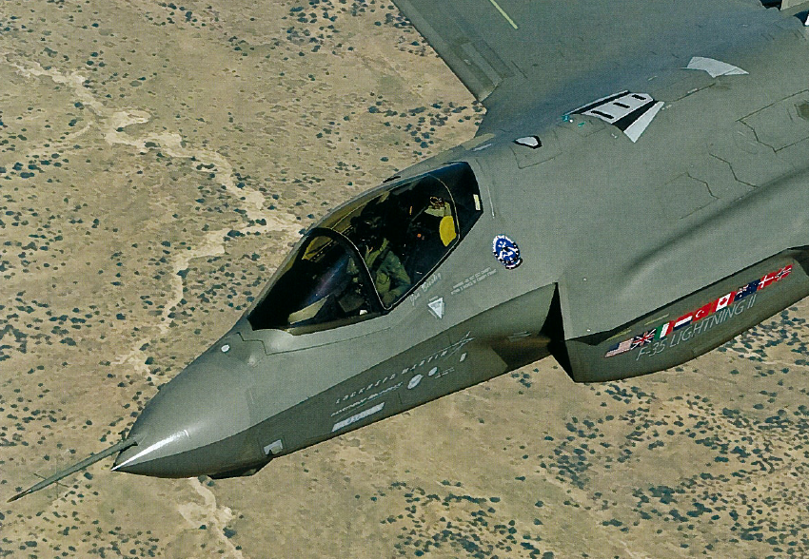
Fastener Measurement
Project Number: A2535
Title: F-35 High Fidelity Fastener Feature Measurement
Performing Activity: CMTC, Creare
Objective: Develop a hand held measurement tool to measure fastener flushness prior to filling
Start / End Dates: September 2013 – September 2015
Project Cost:
ManTech Investment: ~$ 500k
Weapon System: F-35
Performing Activities:
SCRA/CMTC – Program Manger/COE
ONR – Government sponsor
JPO – Platform Program Office
Creare – Process Development and Qualification
Technical Achievements:
System requirements document nearly complete
Initial hardware selections made and purchased
Early trials show that performance requirements are achievable
Module level testing progressing
Implementation:
System: F-35
Site: Creare, Hanover, NH
Schedule: FY14
Status: New Start
Payoff:
Cost Savings
Unfilled Fasteners - $13M
Countersink Depth - $9M
Filled Fasteners - $11M
ROI = 60
Rev C APR14

Slide 8
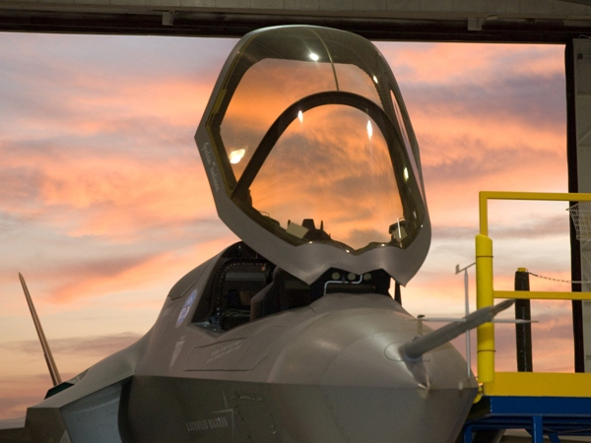
Canopy Polishing
Project Number: A2534
Title: F-35 Transparency Clean-up Automation
Performing Activity: CMTC, GKN ATS, AeRobotix
Objective: Reduce the overall cost of the F-35 Canopy by automating clean-up
Start / End Dates: November 2013 – January 2015
Project Cost:
ManTech Investment: ~$ 1,153,000
Weapon System: F-35 CTOL/CV and STOVL and others
F-35 Canopy
Performing Activities:
SCRACMTC – Program Manger/COE, Technical Oversight
ONR – Government sponsor
JPO – Platform Program Office
GKN-ATS – Process Development
AeRobotix – Automation Developer
NAVAIR – Navy Technical Authority
Technical Achievements:
Polishing system requirements defined
Initial sanding trials showing promise.
System concept progressing
Implementation:
System: F-35 CTOL/CV and STOVL
Site: GKN-ATS
Schedule: FY13
Status: Starting November 2013
Payoff:
Reduce cost of F-35 Canopies:
Eliminate hand sanding and polishing for mark-off and surface preparation
Reduce chance of damage to sensitive substrate by hand sanding
Reduce amount of highly skilled labor required
Reduce process variability
Meet the quantity requirements of F-35 production schedule
Technology applicable to F-18 canopies
Assume 3 – 5 year life, $4k cost savings per canopy
ROI = 42 - 85
Rev D APR14

Slide 9
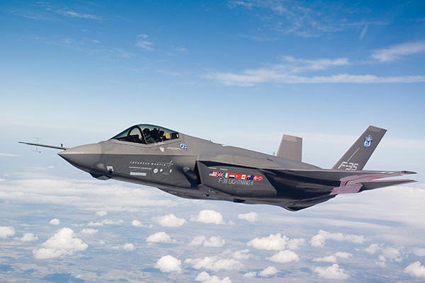
Boot Installation
Project Number: A2513
Title: F-35 Automated and Rapid Boot Installation
Performing Activity: CMTC, LM Ft. Worth
Objective: Reduce the overall cost of the F-35 Boot Installation Process
Start / End Dates: April 2013 – March 2016
Project Cost:
ManTech Investment: ~$ 2.1M (Phase I Only)
Weapon System: F-35
Performing Activities:
SCRA/CMTC – Program Manger/COE
ONR – Government sponsor
JPO – Platform Program Office
LM Ft. Worth – Process Development and Qualification
Cuming Microwave – Boot Thermoforming
ARC
Edison Welding Institute
Technical Achievements:
Complex Boot Fabrication Kick-Off Meetings were held
UBHC Gate Review successfully passed, first prototype demonstrated outstanding results
Adhesive Application documents being drafted for RFP to potential subcontractors
Implementation:
System: F-35
Site: LM Ft. Worth
Schedule: Expected to complete March 2016
Status: In Progress
Payoff:
Reduce cost of F-35 Boot Installation:
Ultrasonic Boot Hole Cutting
Complex Boot Fabrication
Improved Boot Adhesive Development
Reduced Labor Cost
Reduced Span Time
Improved Quality
Rev E APR14

Slide 10
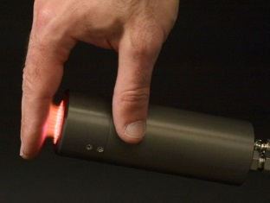
Plasma Surface Preparation for Bonded Nutplates
Platform: F-35
Issue Description:
Current designs for the airframe requires the extensive use of bonded nut plates for fasteners. Manufacturing of these airframe structures require that the bonding surfaces of the airframe and the nut plate be cleaned and have the surfaces be activated to promoted acceptable bonding. The approximately 1500 nutplates bonded to composites. Many of the nut plates are in tight spaces or behind beams and stiffeners, which makes the surface preparation difficult and increases the probability of FOD within the airframe. Unbonded nutplates has been the number one manufacturing is for several years.The proposed surface preparation method using atmospheric plasma devices will yield acceptable bonding without FOD.
Competing/Previous Development Efforts:
Developments under the DARPA TRUST Program have demonstrated that plasma surface preparation for bonded joints significantly improves bond reliability.
ManTech Characteristics:
Transitions manufacturing R&D into production
Attacks pervasive manufacturing issues

Slide 11
Implementation
The Navy uses Centers of Excellence to implement the Manufacturing Technology strategy
The Composites Manufacturing Technology Center (CMTC) is one of those centers
SCRA Applied R&D in Charleston, SC has won the contract to develop and execute Navy ManTech projects related to composites

Slide 12
Navy ManTech
Ideas Anytime
Quad First
Concept Charts
Project Planning Document
Proposal

Slide 13
New Concept Definition
Generate the Idea in the form of a Quad Chart
Put together a sound technical plan
Get support from Program Office
Prepare a PowerPoint presentation of your idea and the technical plan
Respond to Feedback from ONR
Upon request from SCRA generate the Project Planning Document

Slide 14
Project Planning Process
Define
Concept
Review
Concept
Write
PPD
Review
PPD
Submit
PPD
Refine
Revise
Cost
Proposal
Issue
PDR
RFP to
Subs
Tech
Proposal
Submit
PP
Draft
PP
Review
PP
ONR
Contracts
Issue
Mod
Issue
TO
Kickoff
Meeting

Slide 15
Key Elements
Must support one of the current platforms
Must have positive return on investment for acquisition cost (reduced life cycle cost maybe added)
Must have a viable transition pathway
The Prime and the Program Office must have a need for the project

Slide 16
Transition Pathway
Prior to the start of a ManTech project, a plan for implementing the new technology into the manufacturing of the weapon system must be defined.
The plan identifies:
When and how the implementation will occur
Who has to approve the implementation
What Non-ManTech resources will be needed for design, testing, capital equipment, etc.

Slide 17
Barriers
Extensive Design Efforts Required
Extensive Qualification Testing Required
Major Capital Expenditures Required
Intellectual Property that Limits Reporting to the Navy

Slide 18
Intellectual Property
The legislation establishing Manufacturing Technology requires that the new technology developed under the program be available to the U.S. Industrial Base.
ManTech projects cannot be used to develop proprietary technology just for the use of one manufacturer.

Slide 19
IP Guidance
Specifically define your pre-existing IP; an overly broad definition is very hard to manage
Isolate your pre-existing IP so that it does not interfere with reviewing and reporting for this project
Organize and isolate your company funded work that may be done concurrently so that it does not interfere with reviewing and reporting
Do not show or report IP to the Navy if you don’t have to; if IP is needed to explain what is being done in the project, a side meeting with the Navy can be held.

Slide 20
Potential New Opportunity
The Navy ManTech Program has been shifted in a 6.3 Advanced Development Program Element
The objective of this shift is to introduce more innovation into Navy ManTech projects
ONR has also introduced Manufacturing Science & Technology projects that can address manufacturing issues, but do not have to have a detailed transition pathway
This may be an opportunity to address composite maintenance issues, but they should still be related to F-35 and CH-53K
Composite Maintainers should participate in ManTech projects to provide guidance to maintenance issues and add value to the projects

Slide 21
Summary
The key elements of a successful new concept are:
The technology supports one of six platforms on the Navy Strategy
The project has a viable transition pathway
The project has a positive return on investment for acquisition cost
The Prime and the Program Office must demonstrate a need for the project

Slide 22
Contact Information
Neil Graf – ONR Program Officer
(703) 696-0344
Jon Osborn – SCRA Deputy Executive Director for CMTC
(864) 646-4508
Jim Sutter – SCRA Technical Director for CMTC
(216) 630-4536
Charlie Rowe – SCRA Consultant
(864) 280-4846

